Slide 1
Doughnut Economics
turning ideas into action
Data Portrait of Place
Andrew Fanning
July 2023

Slide 2
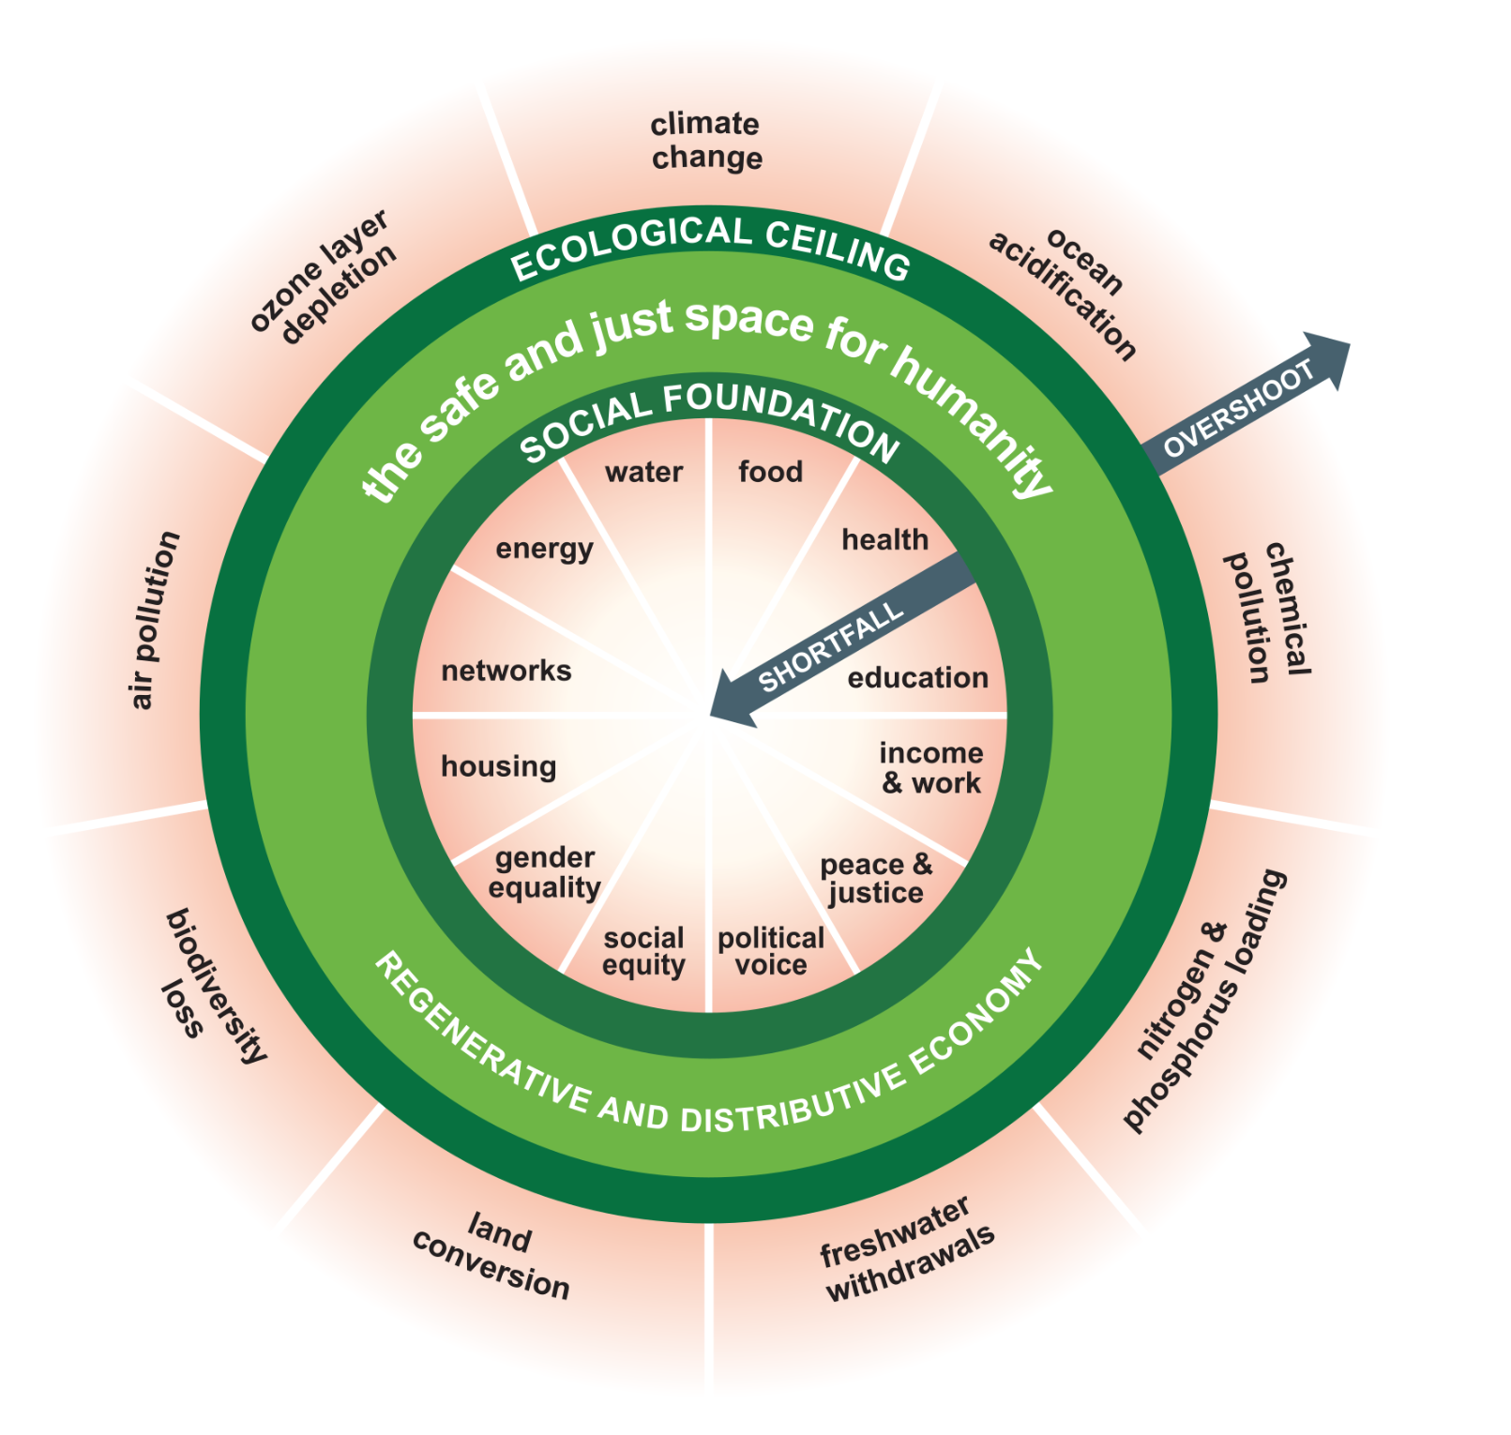
What would it mean for
our place to live in the Doughnut?
E C O L O G I C A L C E I L I N G
How can our place become
a home to thriving people in a thriving place, while respecting the wellbeing of all people, and the health of the whole planet?
S O C I A L F O U N D A T I O N

Slide 3
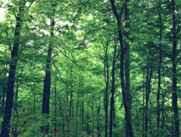
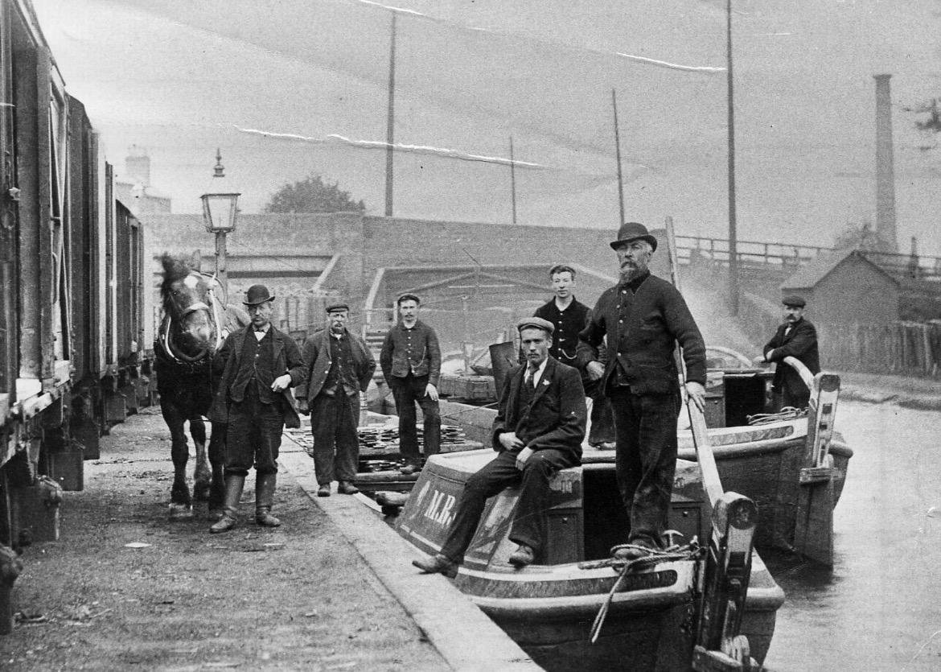
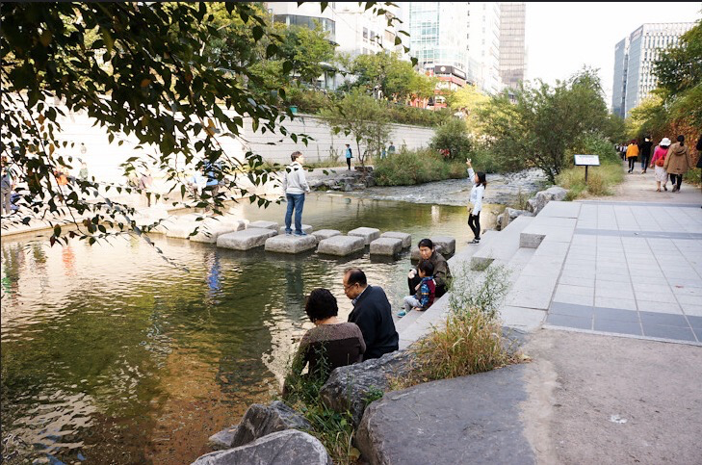
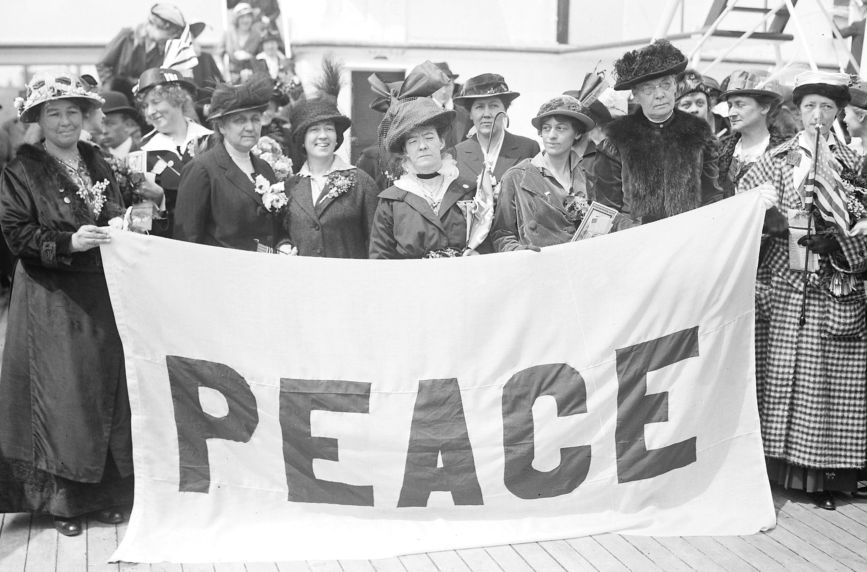
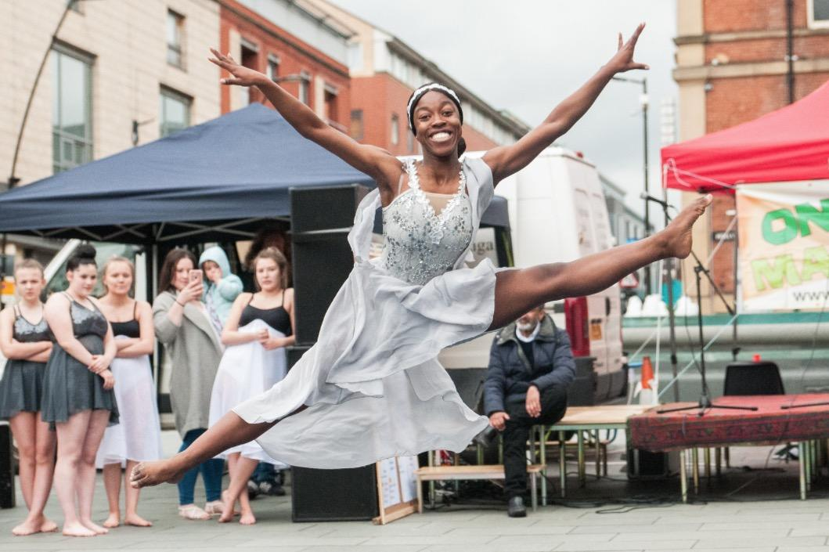
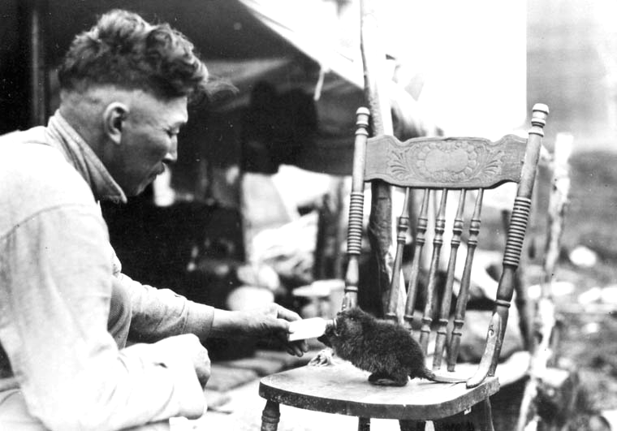
Local
Global
E C O L O G I C A L C E I L I N G
How can our place be as generous as nature?
How can our place respect the health of the whole planet?
Cleanse the air
House biodiversity
Store carbon
Cycle water
Harvest energy
Regulate the
temperature
Build &
protect soil
Enhance wellbeing
Climate change
Ocean acidification
Chemical
pollution
Excessive fertilizer use
Water withdrawals
Land conversion
Biodiversity loss
Air pollution
Ozone layer
depletion
Local strengths and assets
Current targets & indicators
Possibilities & dreams
Challenges in your place
Questions
Food
Water
Health
Education
Housing
Energy
Connectivity
Mobility
Community
Culture
Income & work
Social equity
Equality in diversity
Political
voice
Peace & justice
Food
Water
Health
Education
Housing
Energy
Income & work
Social equity
Equality in diversity
Community & networks
Political
voice
Peace & justice
How can all the people of our place thrive?
How can our place respect the wellbeing of all people?
S O C I A L F O U N D A T I O N

Slide 4
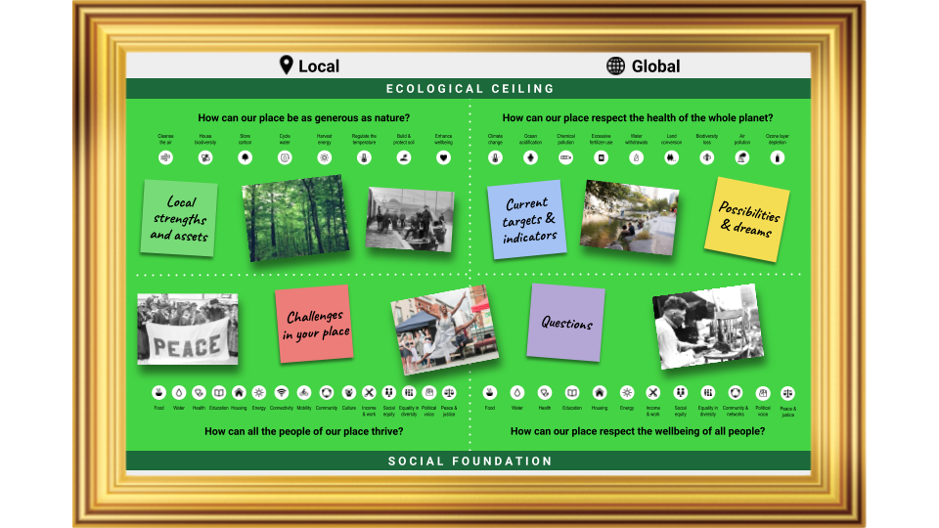
One portrait, many layers
Dreams, possibilities and imagination
Possibilities & dreams
Experience and sense of place
History and stories
Questions
Questions
Challenges
Challenges
Strengths
Local strengths
Target
Indicator
Targets and indicators

Slide 5
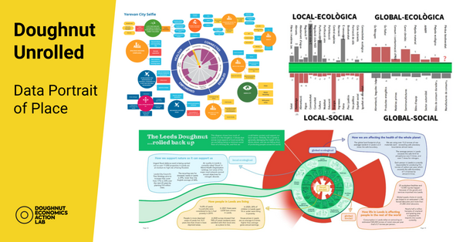
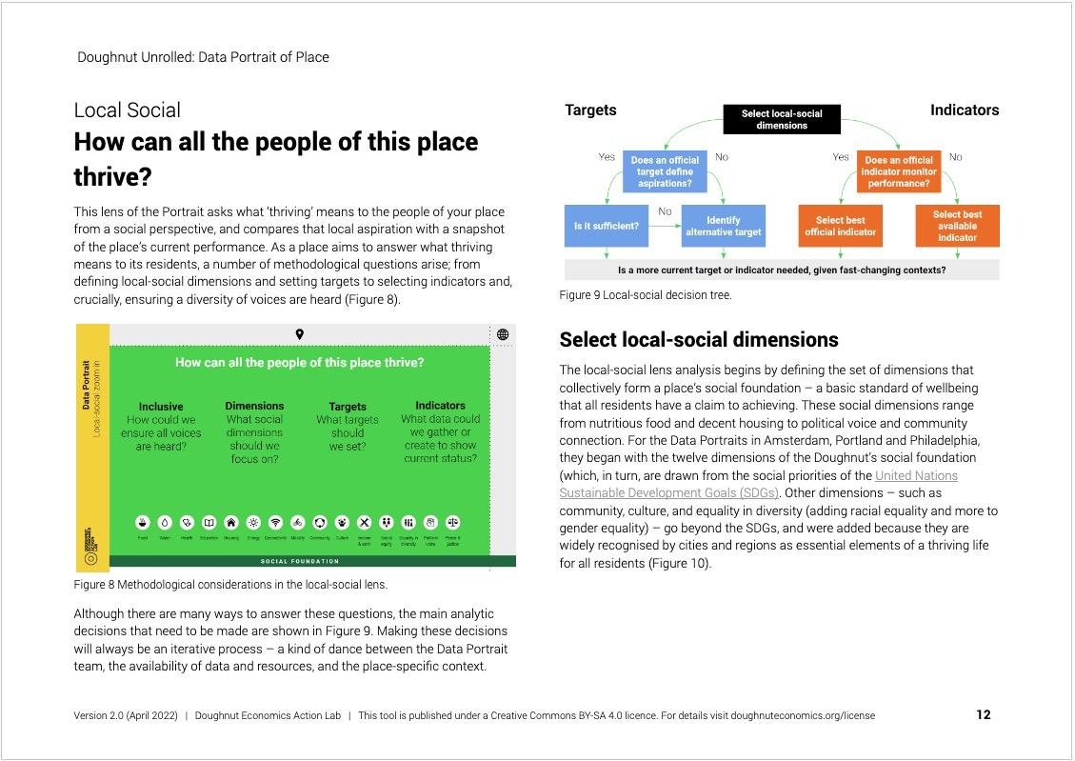
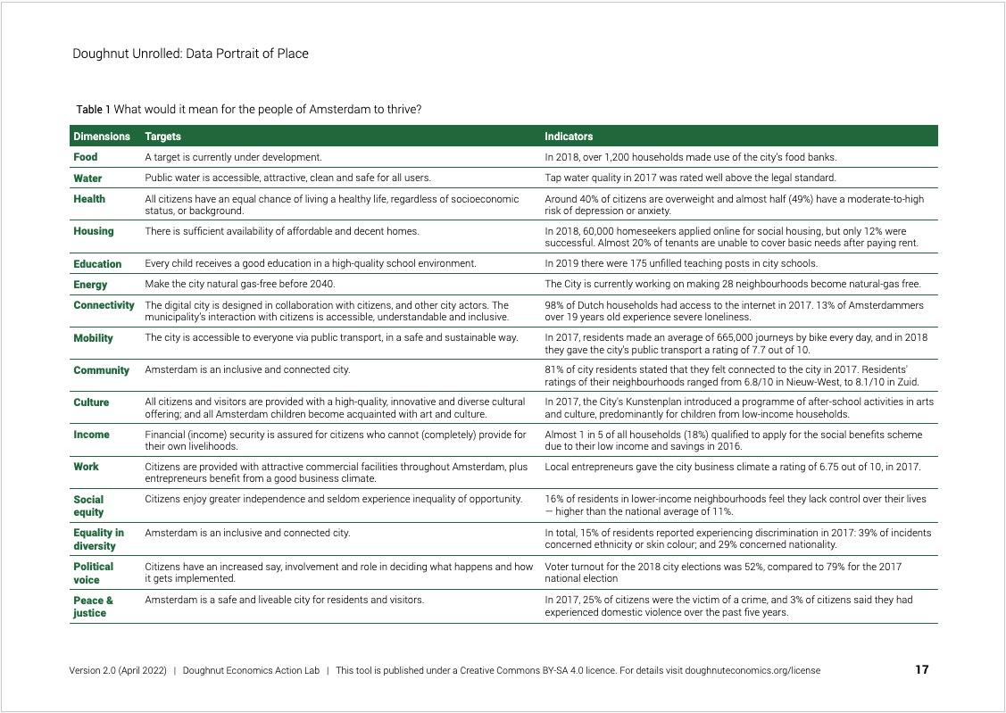
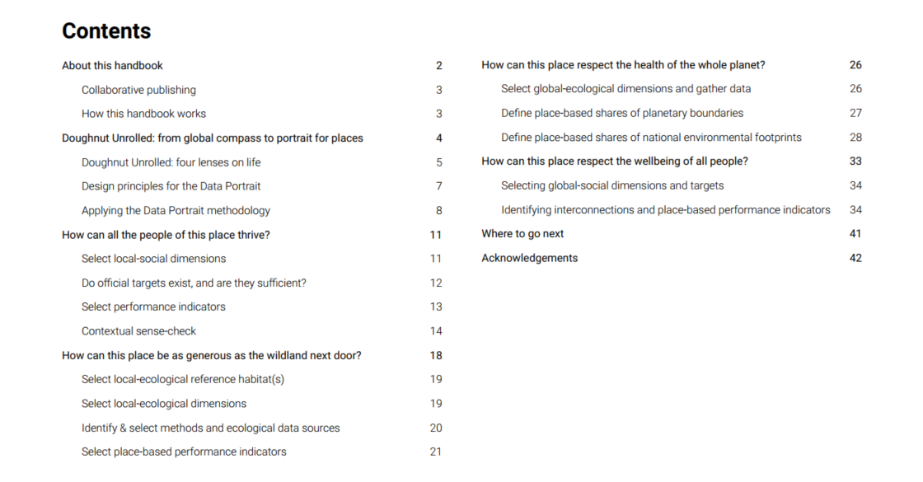
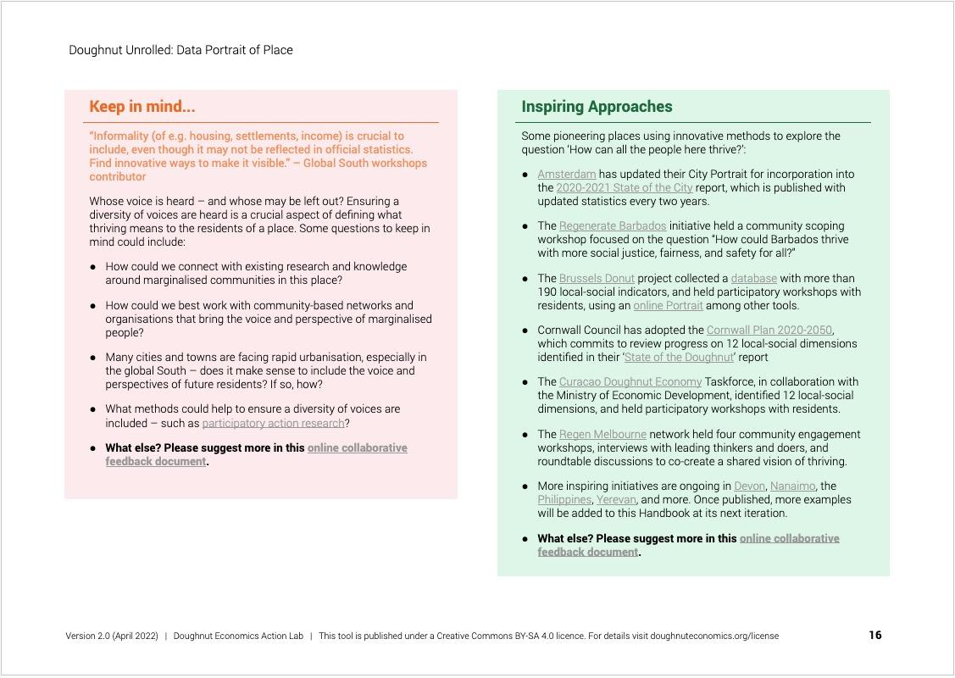
Target
Indicator
Targets and indicators

Slide 6
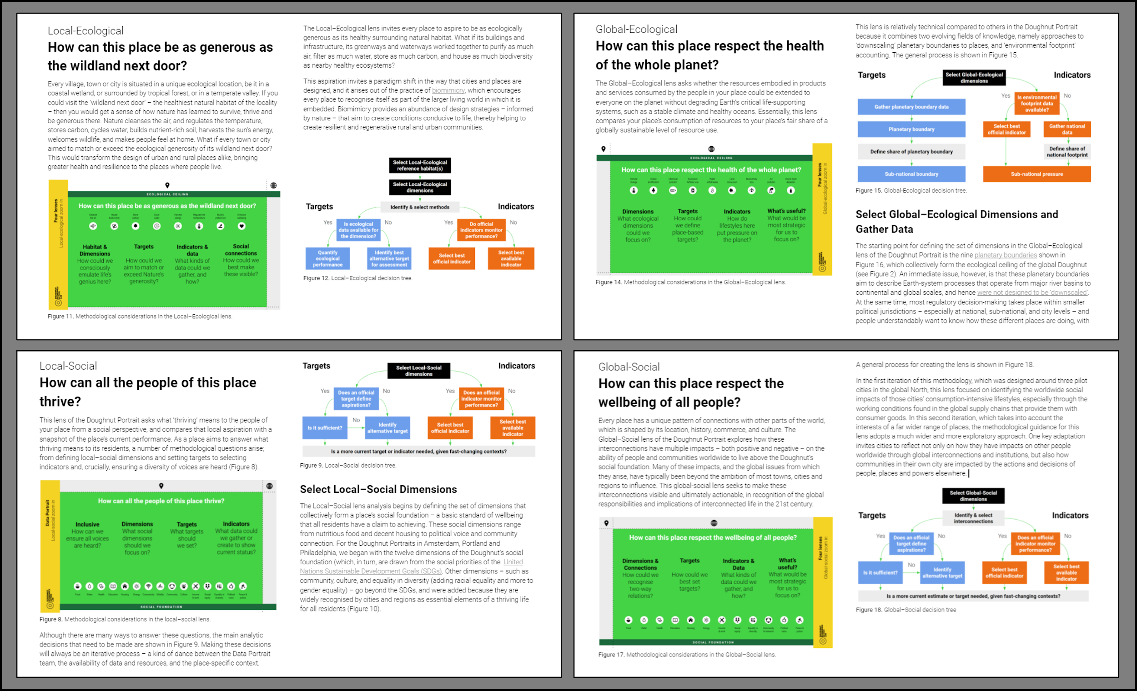
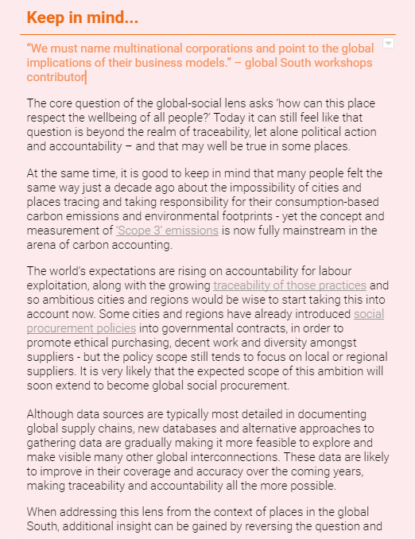
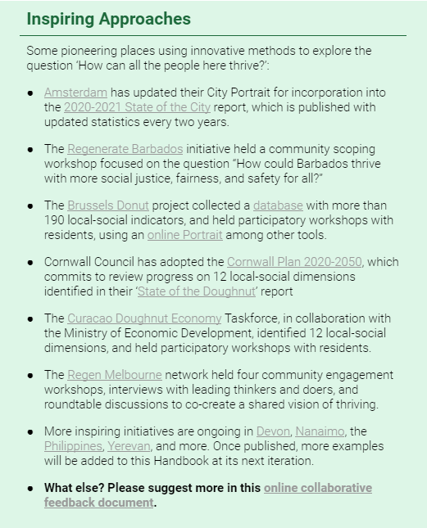
Design principles of the Data Portrait
Be locally relevant, rather than comparable between places
Take the long view
Compare desired outcomes versus current performance
Offer a holistic ‘snapshot’ for discussing complex issues
Create an opportunity for tracking progress
Combine data with community perspectives

Slide 7
Quantitative data
Qualitative data
If available targets and indicators are comparable numerically, their ratios can indicate shortfall or overshoot.
If available targets and indicators are not numerically comparable, they can still be usefully assessed qualitatively.
Social indicator
Ecological indicator
Social
target
Social indicator
= Shortfall
(if less than 1)
= Overshoot
(if more than 1)
Ecological target
Ecological indicator
Social target
Ecological target

Slide 8
Local
Global
E C O L O G I C A L C E I L I N G
How can our place be as generous as nearby nature?
How can our place respect the health of the whole planet?
Cleanse the air
House biodiversity
Store carbon
Cycle water
Harvest energy
Regulate the
temperature
Build &
protect soil
Enhance wellbeing
Climate change
Ocean acidification
Chemical
pollution
Excessive fertilizer use
Water withdrawals
Land conversion
Biodiversity loss
Air pollution
Ozone layer
depletion
What’s our target or commitment?
Is it ambitious enough?
How are we doing?
Are we collecting the data we need?
Food
Water
Health
Education
Housing
Energy
Connectivity
Mobility
Community
Culture
Income & work
Social equity
Equality in diversity
Political
voice
Peace & justice
Food
Water
Health
Education
Housing
Energy
Income & work
Social equity
Equality in diversity
Community & networks
Political
voice
Peace & justice
How can all the people of our place thrive?
How can our place respect the wellbeing of all people?
S O C I A L F O U N D A T I O N

Slide 9
Local
Global
E C O L O G I C A L C E I L I N G
How can our place be as generous as nearby nature?
How can our place respect the health of the whole planet?
Cleanse the air
House biodiversity
Store carbon
Cycle water
Harvest energy
Regulate the
temperature
Build &
protect soil
Enhance wellbeing
Climate change
Ocean acidification
Chemical
pollution
Excessive fertilizer use
Water withdrawals
Land conversion
Biodiversity loss
Air pollution
Ozone layer
depletion
What’s our target or commitment?
Is it ambitious enough?
How are we doing?
Are we collecting the data we need?
Food
Water
Health
Education
Housing
Energy
Connectivity
Mobility
Community
Culture
Income & work
Social equity
Equality in diversity
Political
voice
Peace & justice
Food
Water
Health
Education
Housing
Energy
Income & work
Social equity
Equality in diversity
Community & networks
Political
voice
Peace & justice
How can all the people of our place thrive?
How can our place respect the wellbeing of all people?
S O C I A L F O U N D A T I O N

Slide 10
How can all the people of our place thrive?
Inclusive
How could we ensure all voices are heard?
Dimensions
What social dimensions should we
focus on?
Targets
What targets should
we set?
Indicators
What data could we gather or create to show current status?
Data Portrait
Local-social zoom in
Food
Water
Health
Education
Housing
Energy
Connectivity
Mobility
Community
Culture
Income & work
Social equity
Equality in diversity
Political
voice
Peace & justice
S O C I A L F O U N D A T I O N

Slide 11
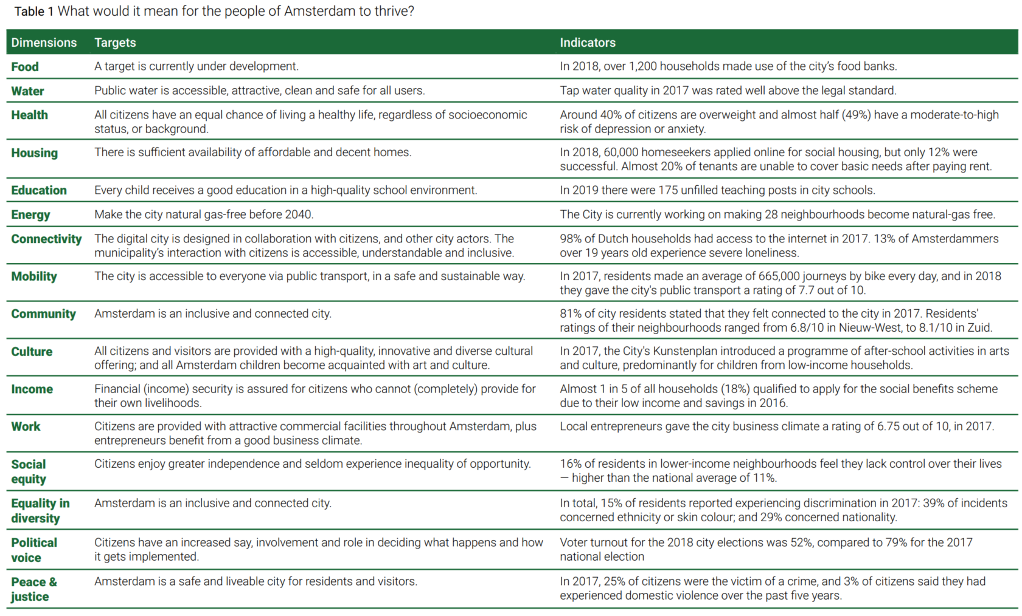
Local-social data: Amsterdam

Slide 12
E C O L O G I C A L C E I L I N G
How can our place be as generous as nearby nature?
Cleanse the air
House biodiversity
Store carbon
Cycle water
Harvest energy
Regulate the
temperature
Build &
protect soil
Enhance wellbeing
Data Portrait
Local-ecological zoom in
Habitat & Dimensions
How could we consciously emulate life’s genius here?
Targets
How could we aim to match or exceed Nature’s generosity?
Indicators & data
What kinds of data could we gather, and how?
Social connections
How could we best make
these visible?

Slide 13
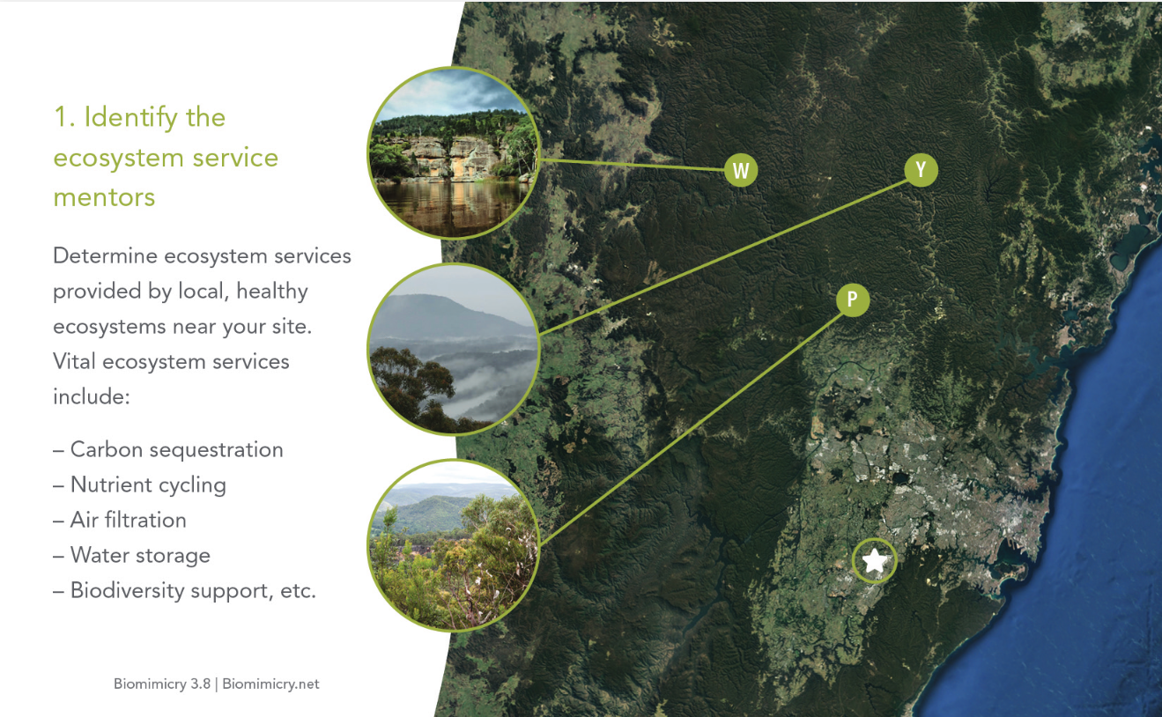
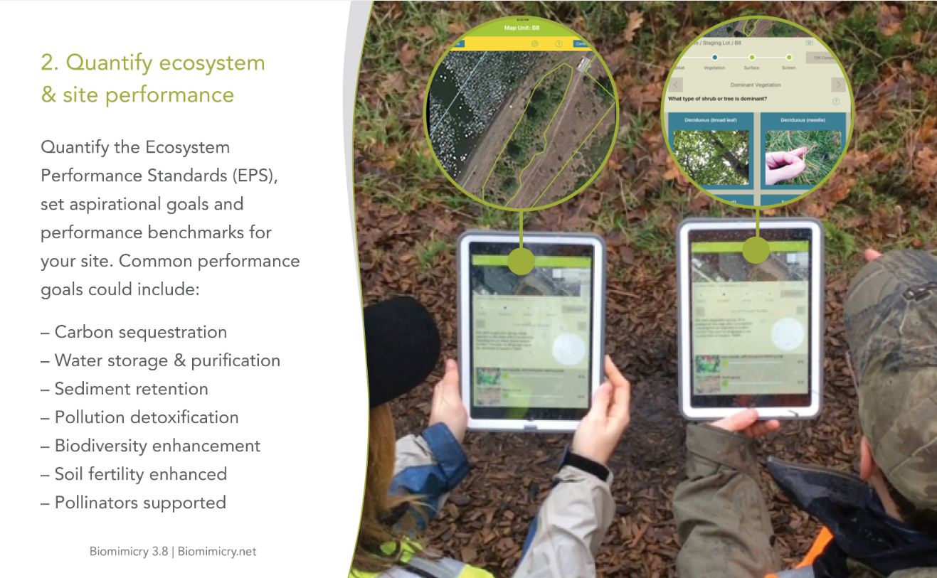
E C O L O G I C A L C E I L I N G
How can our place be as generous as nearby nature?
Cleanse the air
House biodiversity
Store carbon
Cycle water
Harvest energy
Regulate the
temperature
Build &
protect soil
Enhance wellbeing
Data Portrait
Local-ecological zoom in

Slide 14
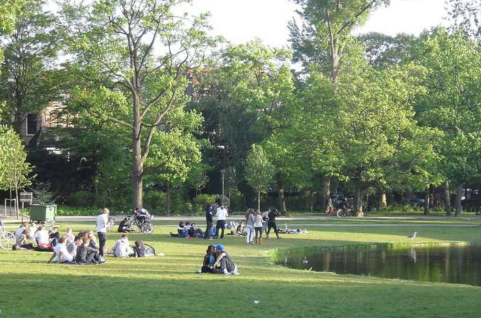
E C O L O G I C A L C E I L I N G
How can our place be as generous as nearby nature?
Cleanse the air
House biodiversity
Store carbon
Cycle water
Harvest energy
Regulate the
temperature
Build &
protect soil
Enhance wellbeing
Data Portrait
Local-ecological zoom in
HOW NATURE DOES IT:
Forests cool air temperatures through evapotranspiration
CITY TARGET:
Increase the use of green space as green infrastructure
CITY SNAPSHOT:
Amsterdam's temperatures can be up to 5°C warmer than surrounding areas due to urban heat island effect.

Slide 15
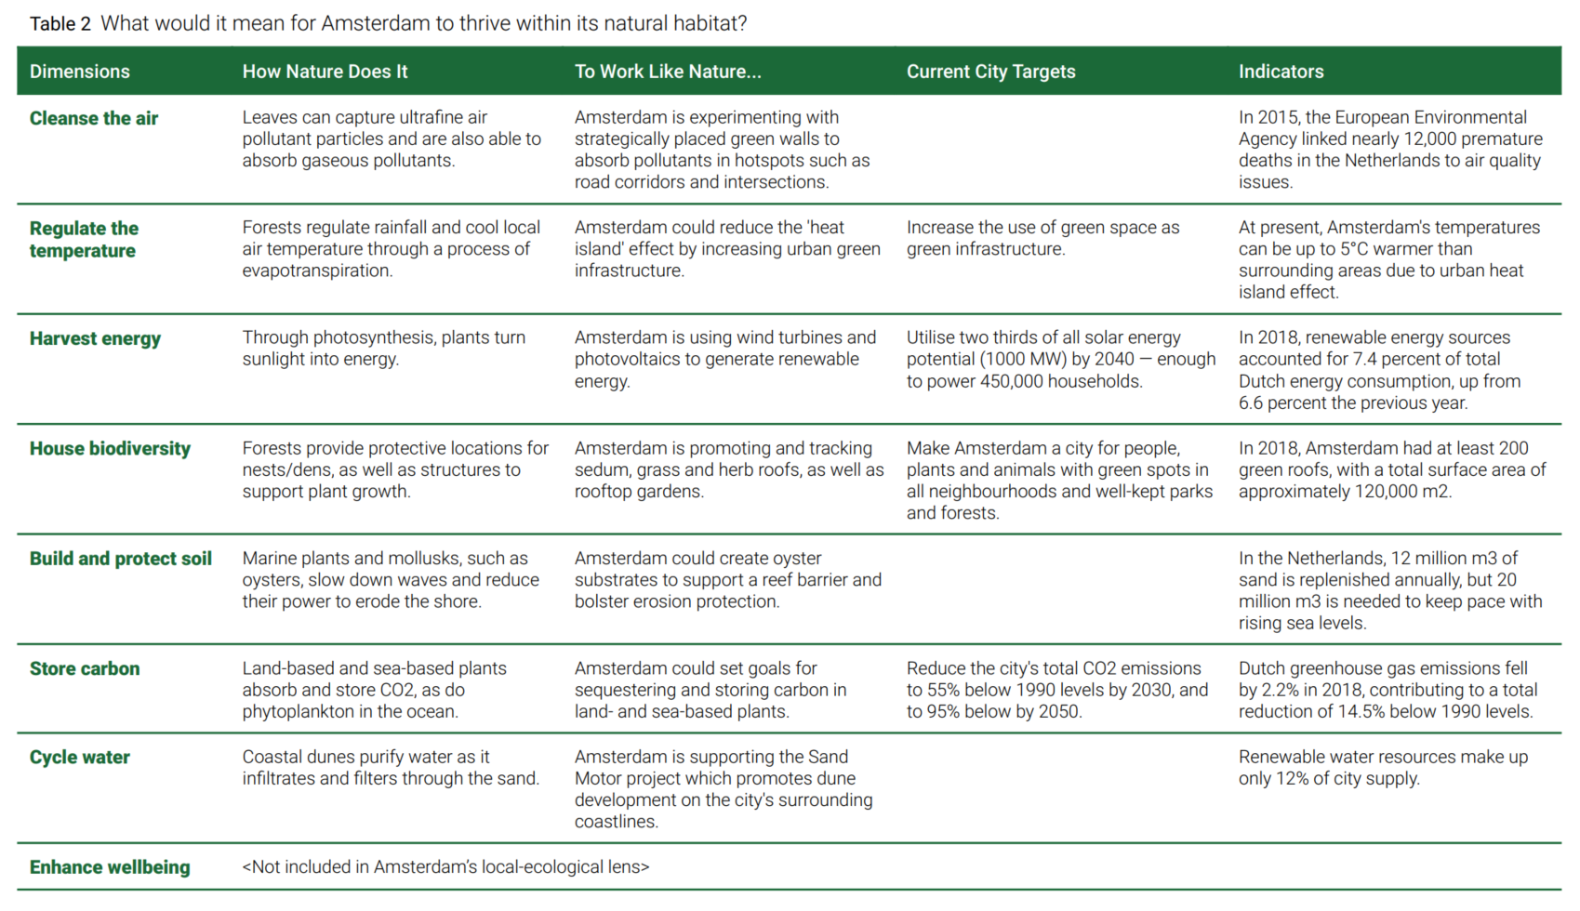
Local-ecological data: Amsterdam

Slide 16
E C O L O G I C A L C E I L I N G
How can our place respect the health of the whole planet?
Climate change
Ocean acidification
Chemical
pollution
Excessive fertilizer use
Water withdrawals
Land conversion
Biodiversity loss
Air pollution
Ozone layer
depletion
Data Portrait
Global-ecological zoom in
Dimensions
What ecological dimensions could we
focus on?
Targets
How could
we define place-based targets?
Indicators
How do lifestyles here put pressure on the planet?
What’s useful?
What would be most strategic for us to
focus on?

Slide 17
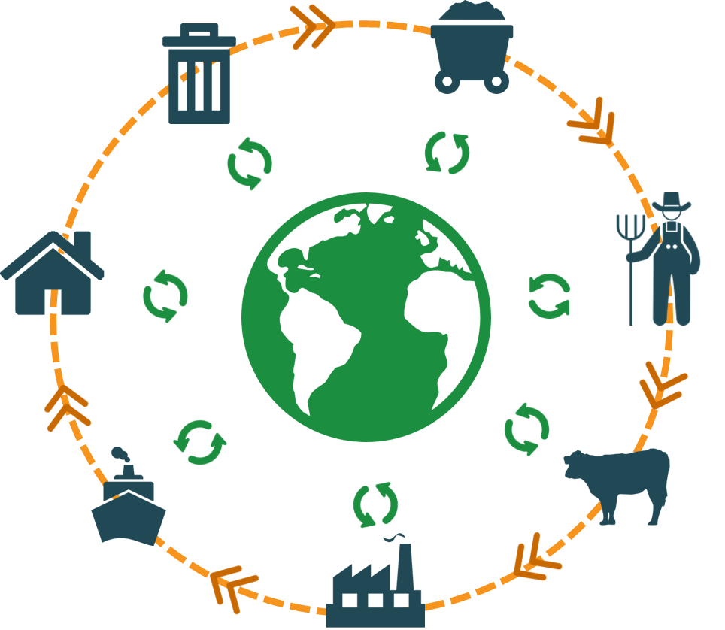
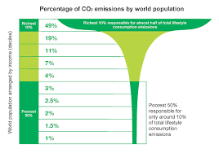
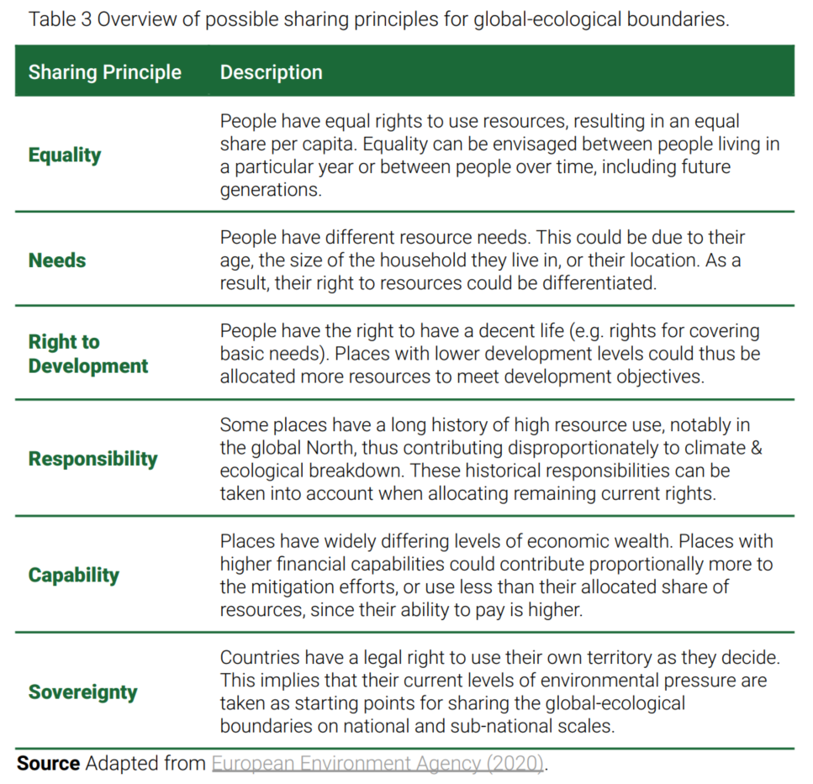
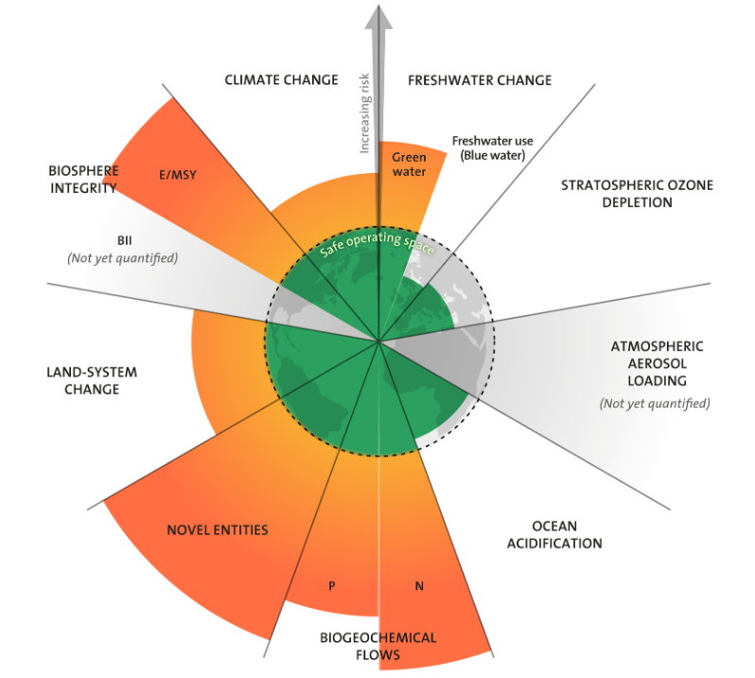
‘Downscaling’ planetary boundaries
National environmental footprint
Define city share of footprint
Gather environmental footprint data
City environmental footprint
Income-adjusted
Select ecological dimensions
= City Overshoot
City boundary
Gather planetary boundary data
Define city share of boundary
Planetary boundary

Slide 18
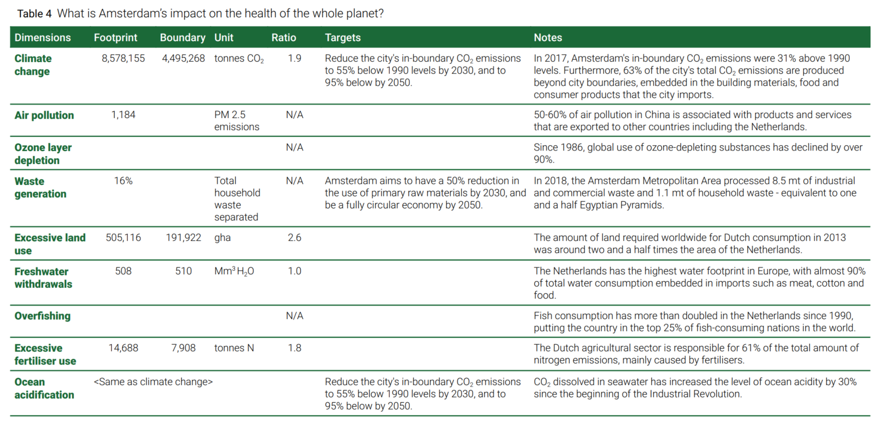
Global-ecological data: Amsterdam

Slide 19
How can our place respect the wellbeing of all people?
Dimensions & Connections
How could we recognise two-way relations?
Targets
How could we best set
targets?
Indicators & Data
What kinds of data could we gather, and how?
What’s
useful?
What would be most strategic for us to
focus on?
Data Portrait
Global-social zoom in
Food
Water
Health
Education
Housing
Energy
Income & work
Social equity
Equality in diversity
Community & networks
Political
voice
Peace & justice
S O C I A L F O U N D A T I O N

Slide 20
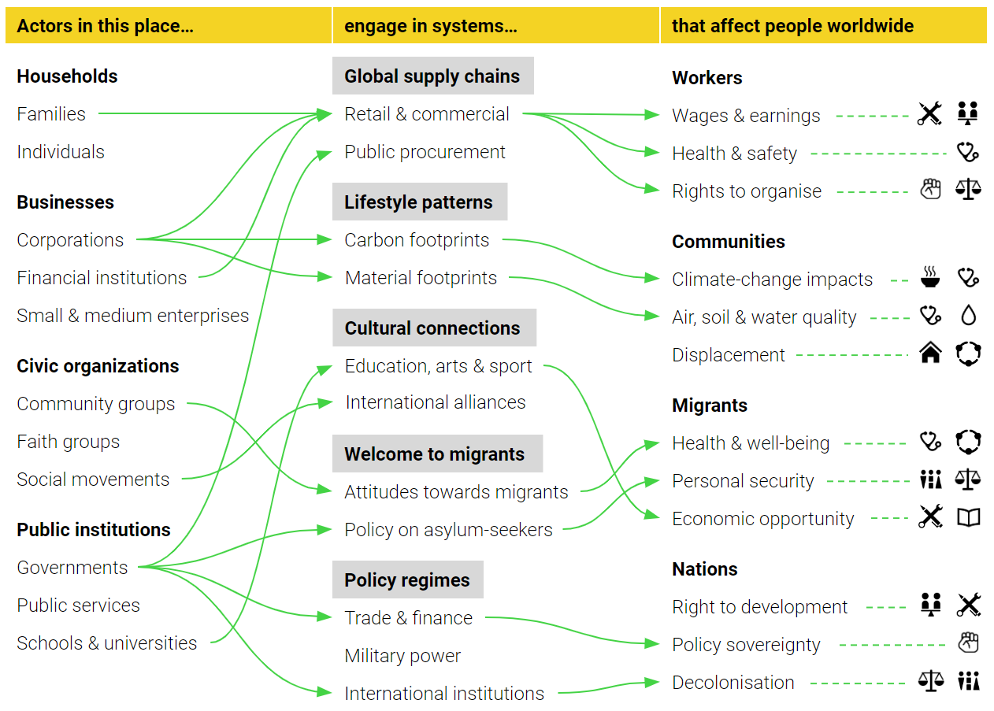
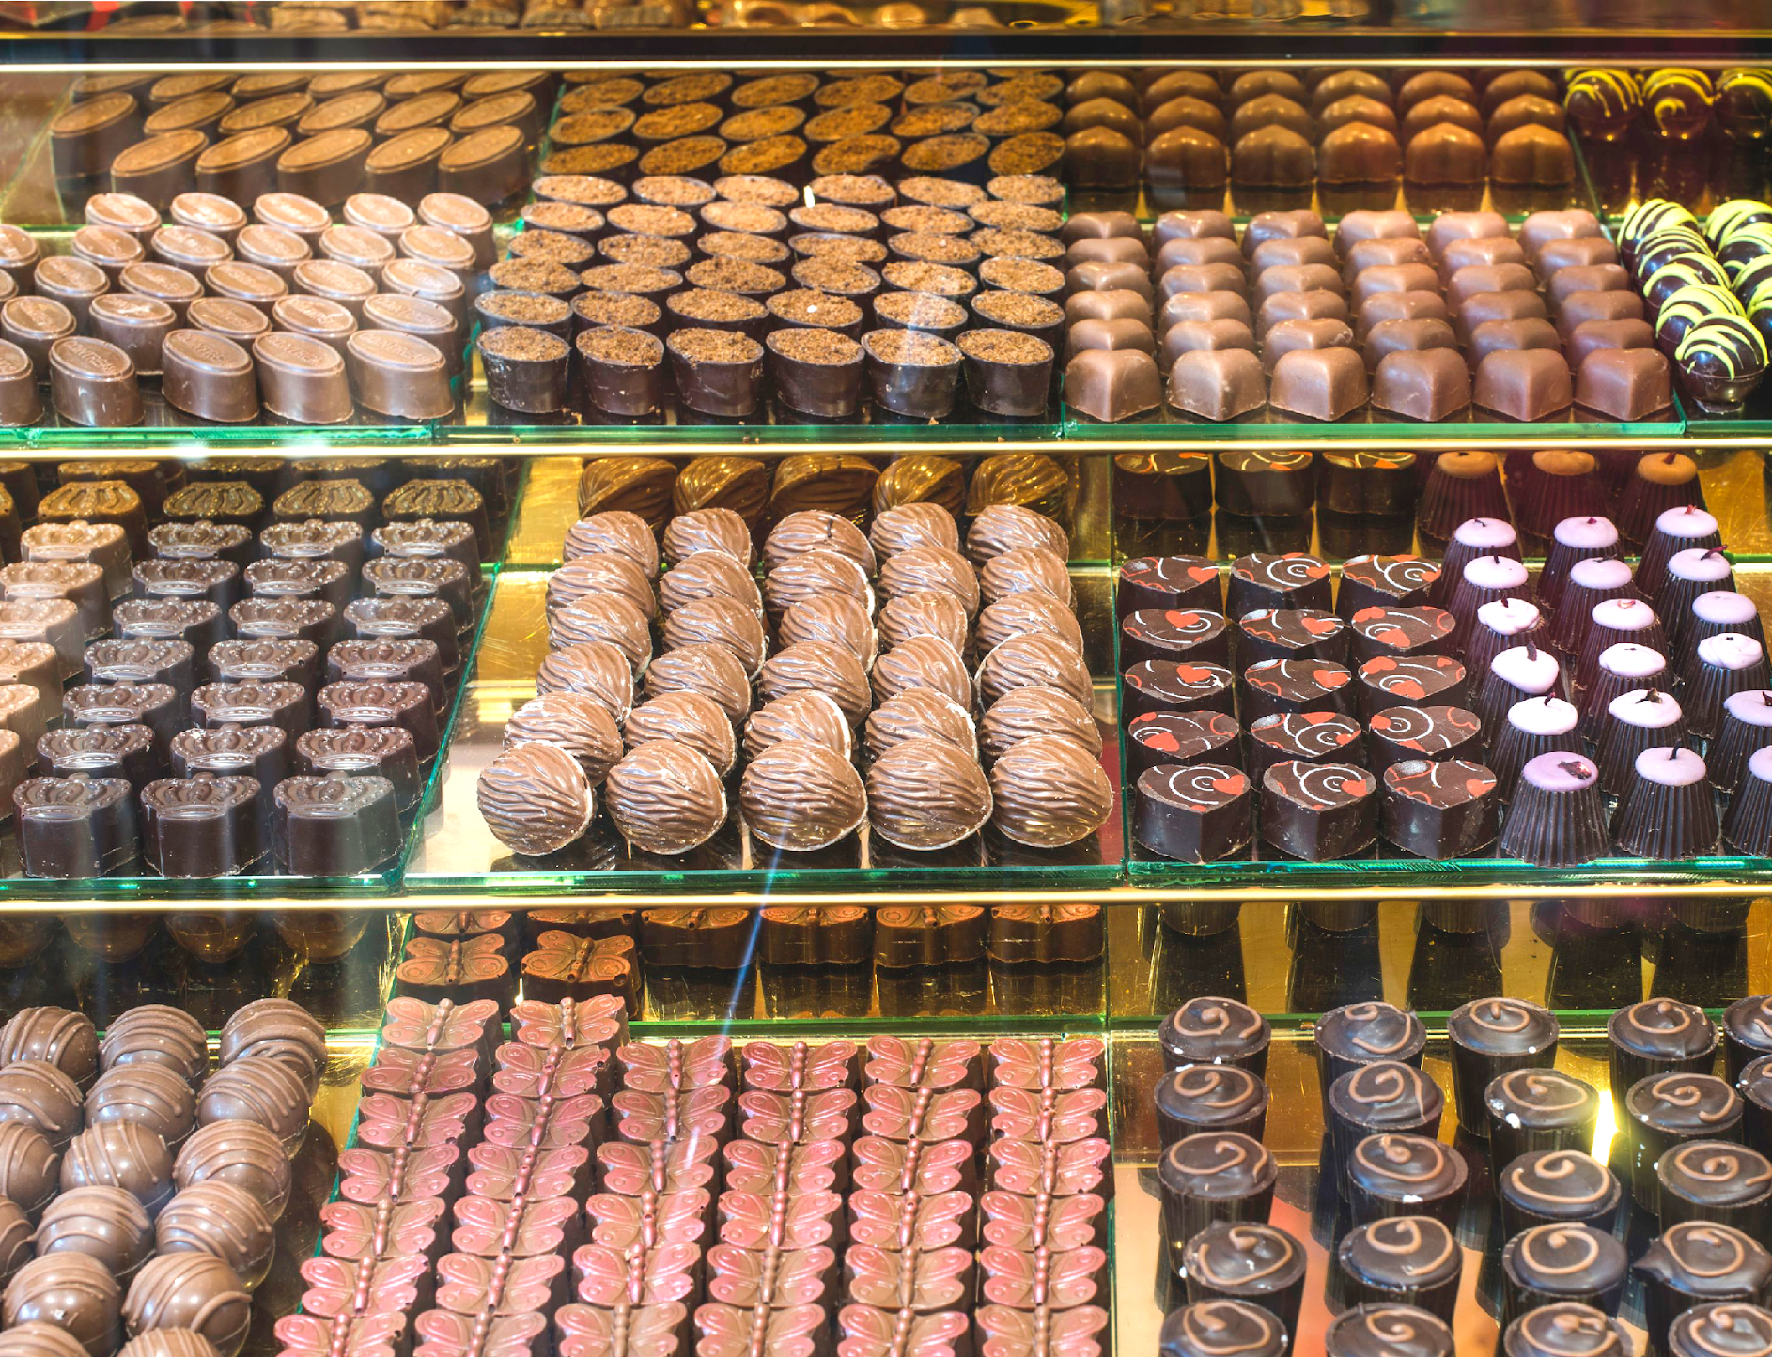
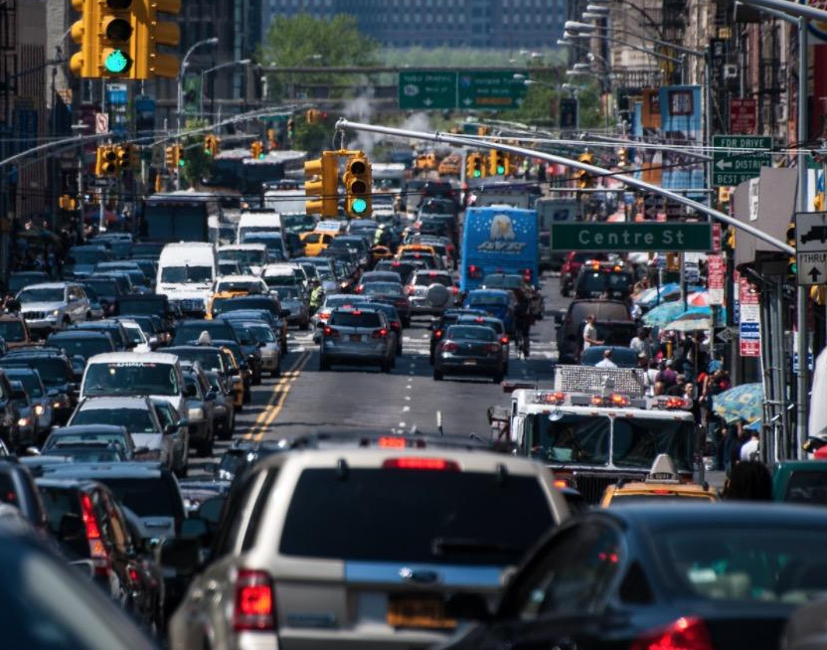
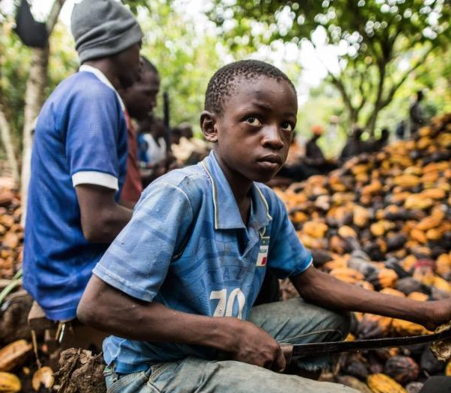
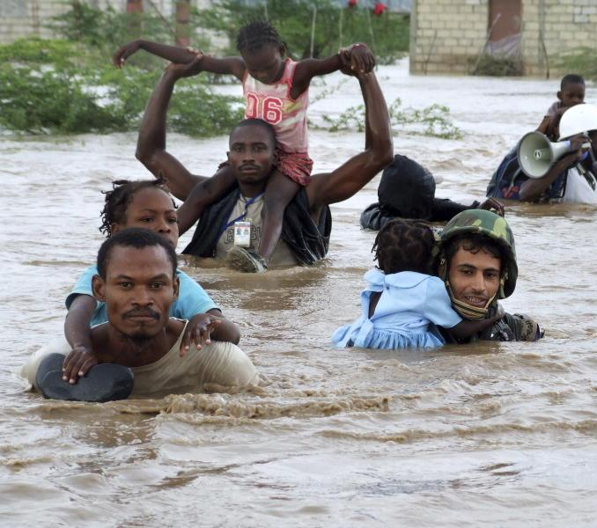
How can our place respect the wellbeing of all people?
Data Portrait
Global-social zoom in
Food
Water
Health
Education
Housing
Energy
Income & work
Social equity
Equality in diversity
Community & networks
Political
voice
Peace & justice
S O C I A L F O U N D A T I O N

Slide 21
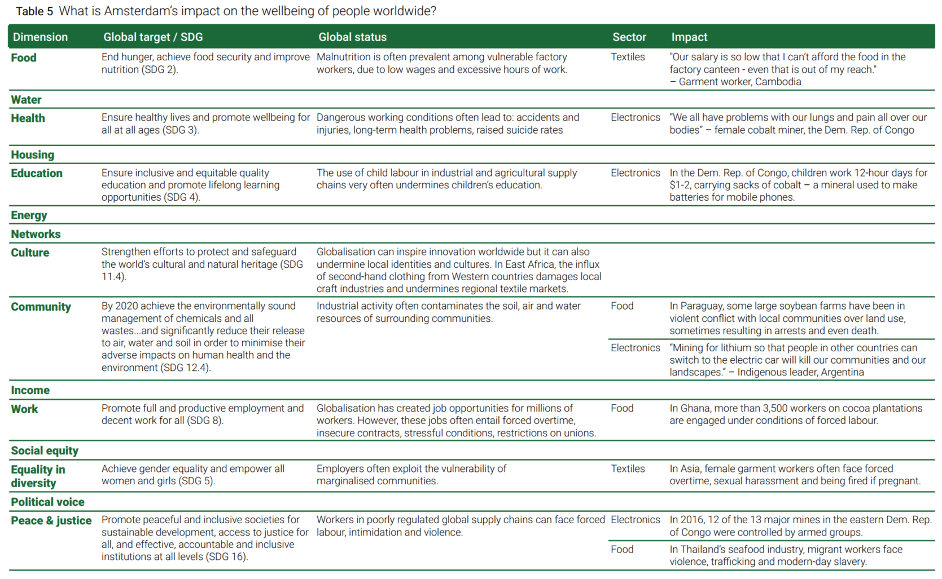
Global-social data: Amsterdam

Slide 22
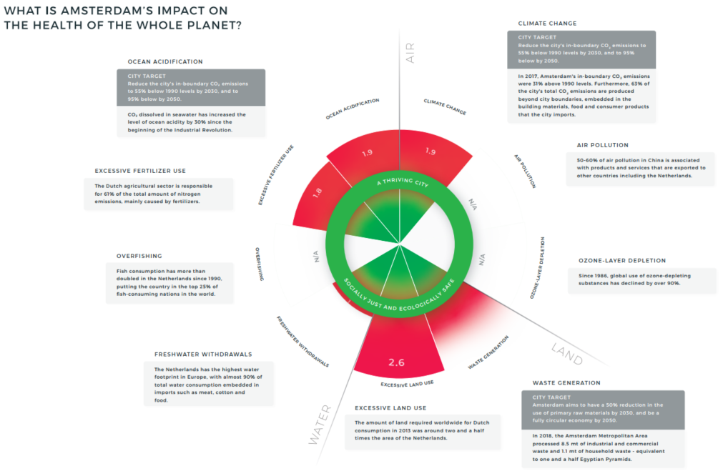
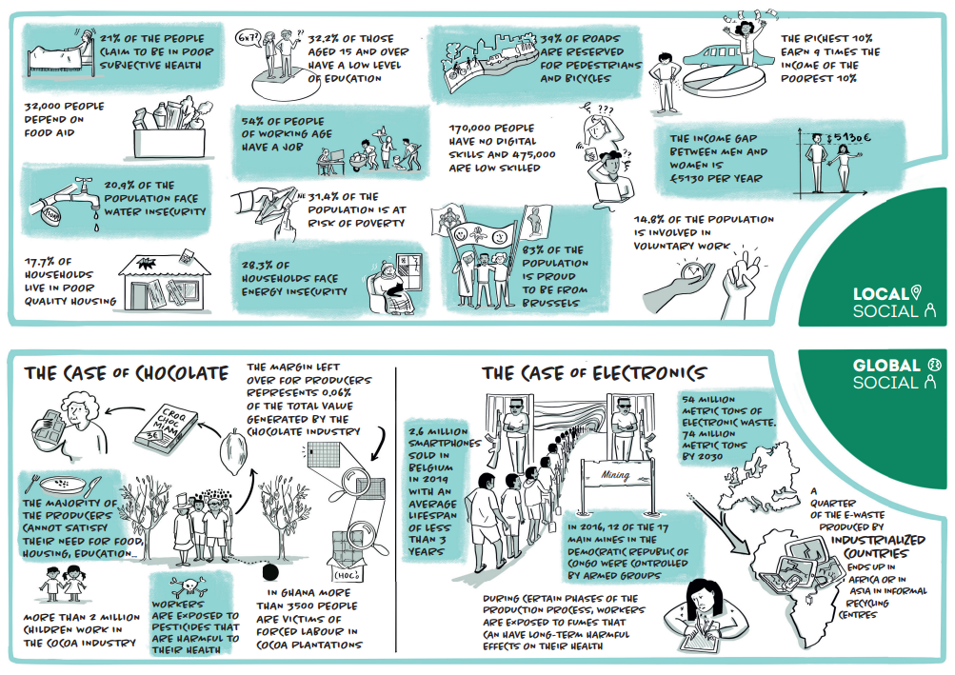
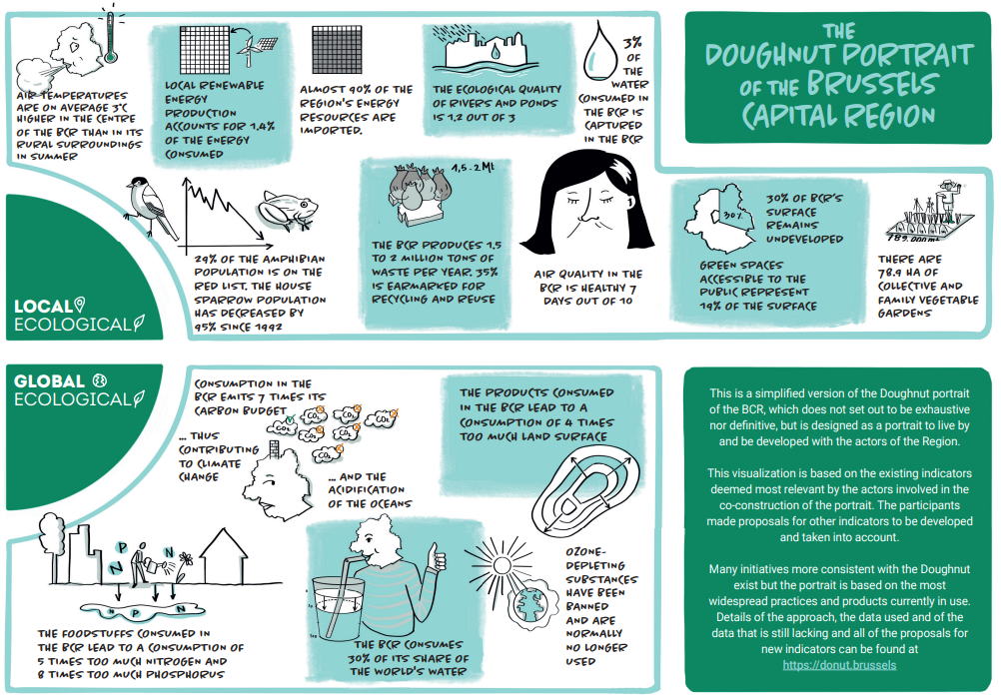
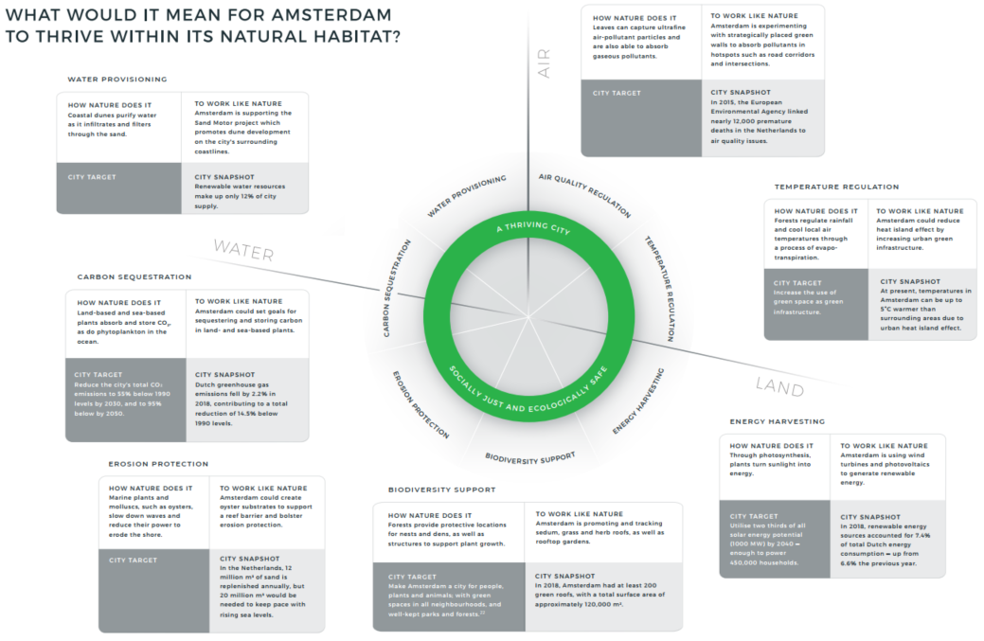
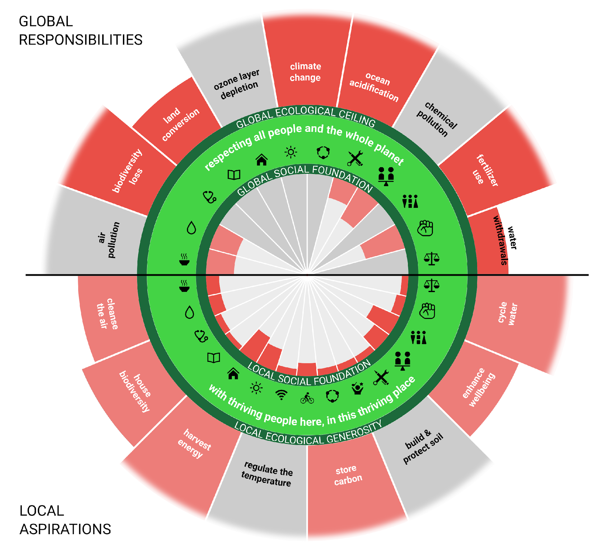
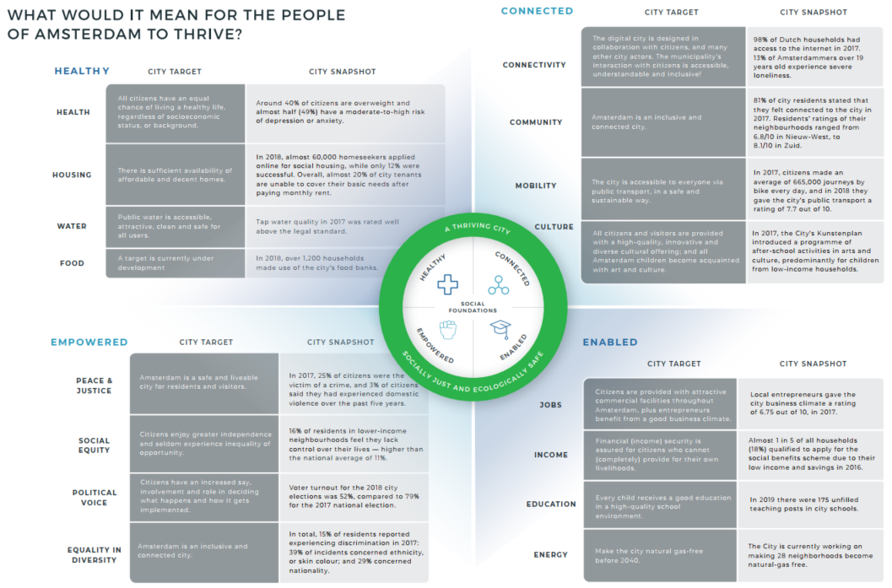
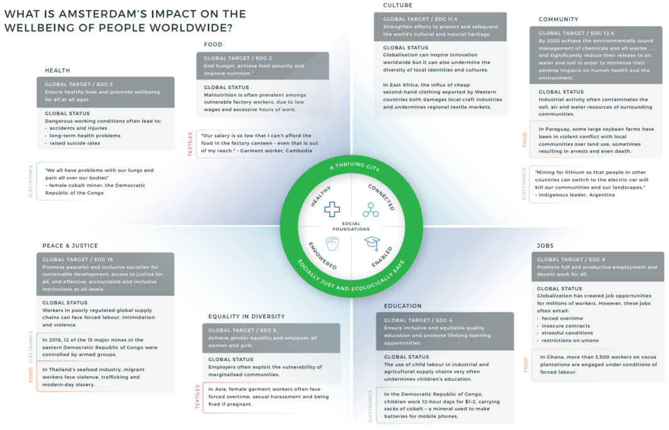
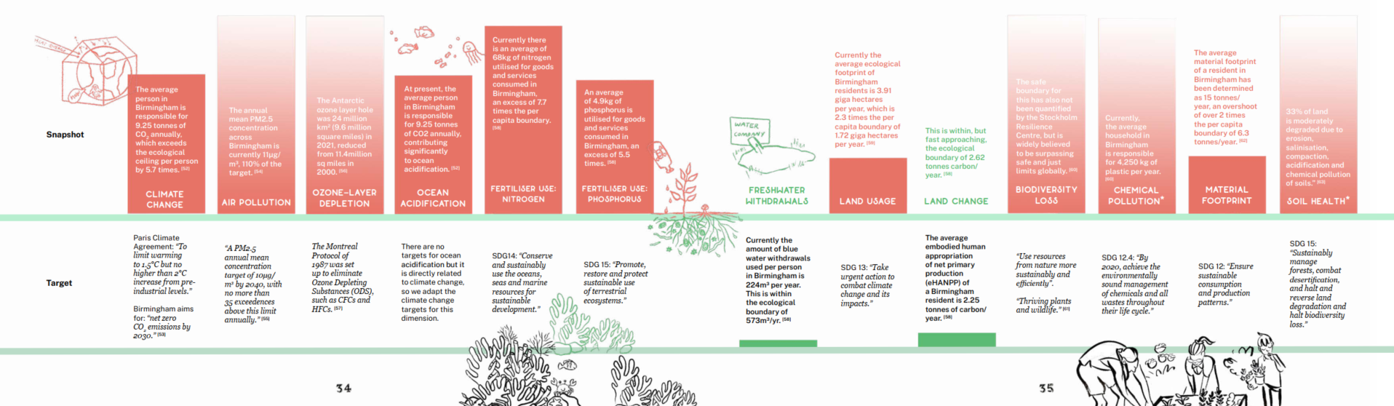
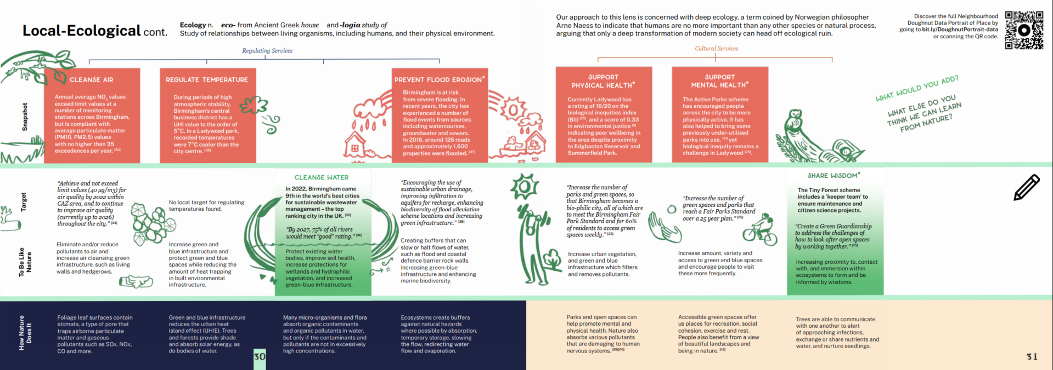
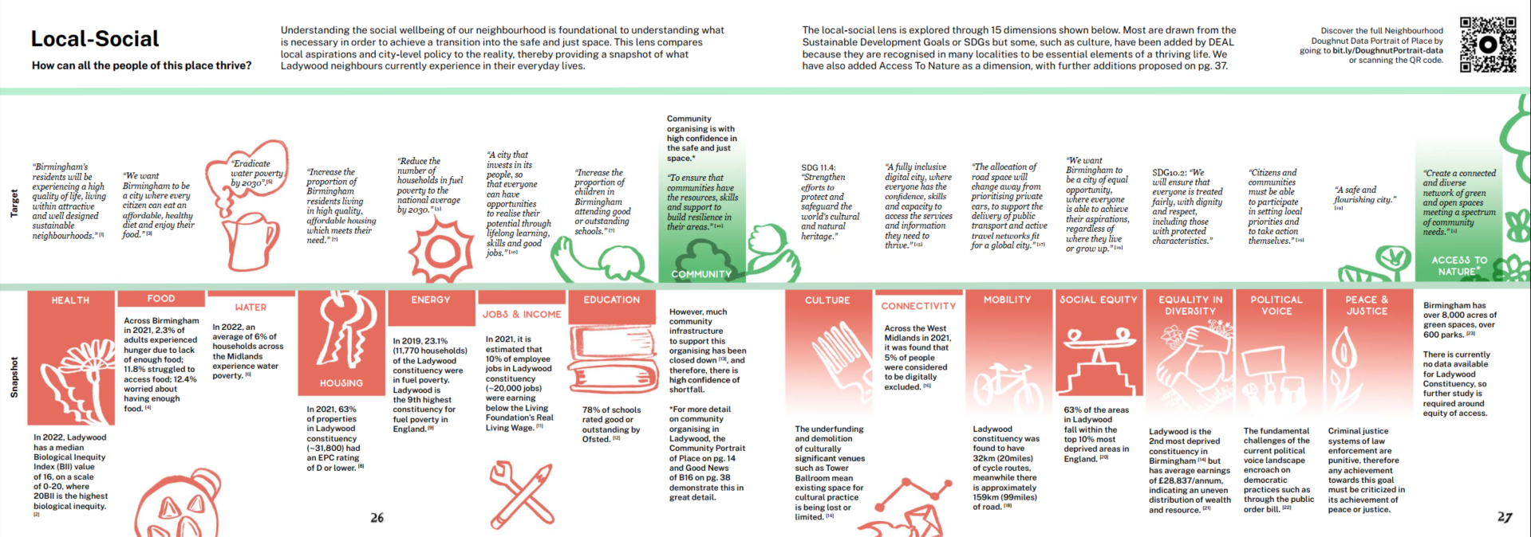
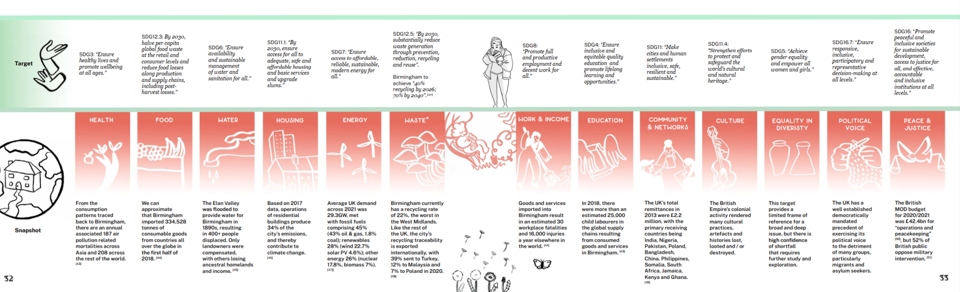
Sharing the Data Portrait results
Amsterdam
Brussels Capital Region
E C O L O G I C A L C E I L I N G
Re-rolled?
S O C I A L F O U N D A T I O N
Ladywood, Birmingham
Leeds
Notes:
Amsterdam: https://doughnuteconomics.org/stories/1
Brussels Capital Region: https://doughnuteconomics.org/stories/83
Ladywood, Birmingham: https://doughnuteconomics.org/stories/213
Leeds: https://doughnuteconomics.org/stories/248

Slide 23
