Slide 1
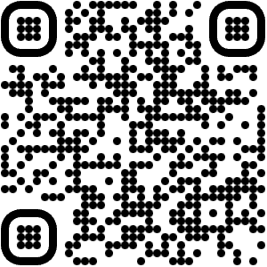
Communities:
Let’s Get Started!
Version 1.0 (May 2023)

Slide 2
Communities: Let’s Get Started!
Doughnut Economics covers so much that it can feel overwhelming! Use this tool to find ways to get started in putting the ideas into practice with your community.
Use it as a signpost to see things you would like to…
do straight away
do in future
share with others
‹#›

Slide 3
What do we mean by ‘communities’? *
Household
Street
Neighbourhood
Town,
City
Region, Nation
Global
Learning about the ideas & taking action in your life & home
Connecting and taking action with neighbours locally
Connecting with others over wider scales to work towards deeper systemic change
Connecting and learning with people applying the ideas in all sorts of places and contexts
* in the context of Doughnut Economics in action
‹#›

Slide 4
What’s in this tool?
1 What is Doughnut Economics?
2 How can I learn about Doughnut Economics with others?
3 How can I introduce the ideas of Doughnut Economics to my community?
4 How can we apply the ideas of Doughnut Economics within our community?
5 How can I apply the ideas of Doughnut Economics in my own life?
6 How can I connect with others locally to create a network for change?
7 How can we take action for deeper systemic change?
8 What is the DEAL Community and how can I connect with others globally?
9 How can I ask other questions, find out more, or contribute a story?
Click the DEAL logo bottom left of every page to come back to this menu page
‹#›

Slide 5
1 What is Doughnut Economics?

Slide 6
Let’s start by introducing the Doughnut - the idea at the heart of Doughnut Economics - and some tools you can use to learn more about it, including translations in your language.

Slide 7
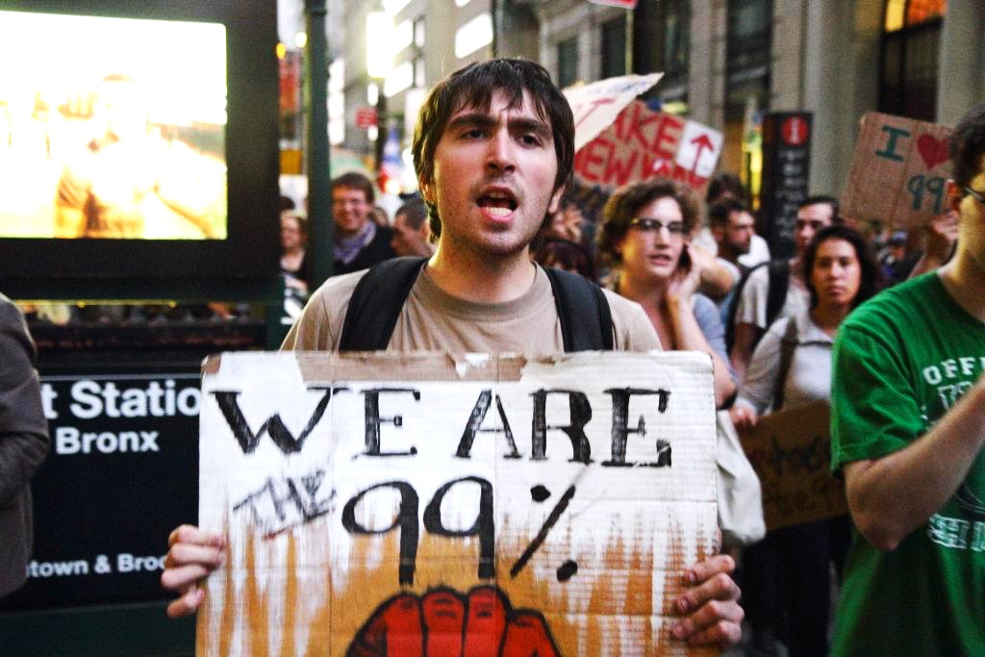
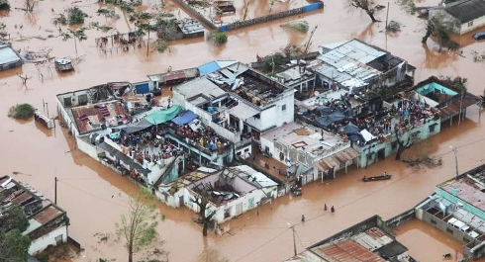
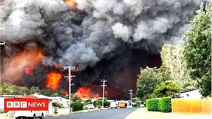
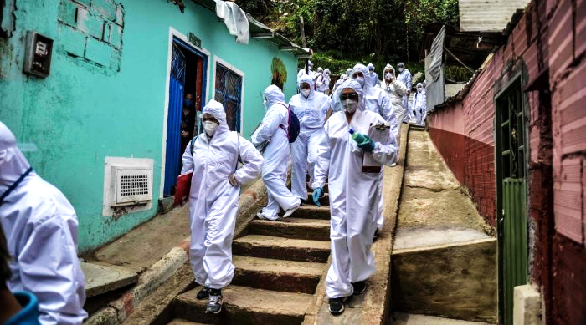
We have a world in crisis
Financial meltdown
Climate breakdown
COVID lockdown
New York, US
Sofala, Mozambique
Kuala Lumpur, Malaysia
Athens, Greece
Sydney, Australia
Bogotá, Colombia
Notes:
Commentary

Slide 8
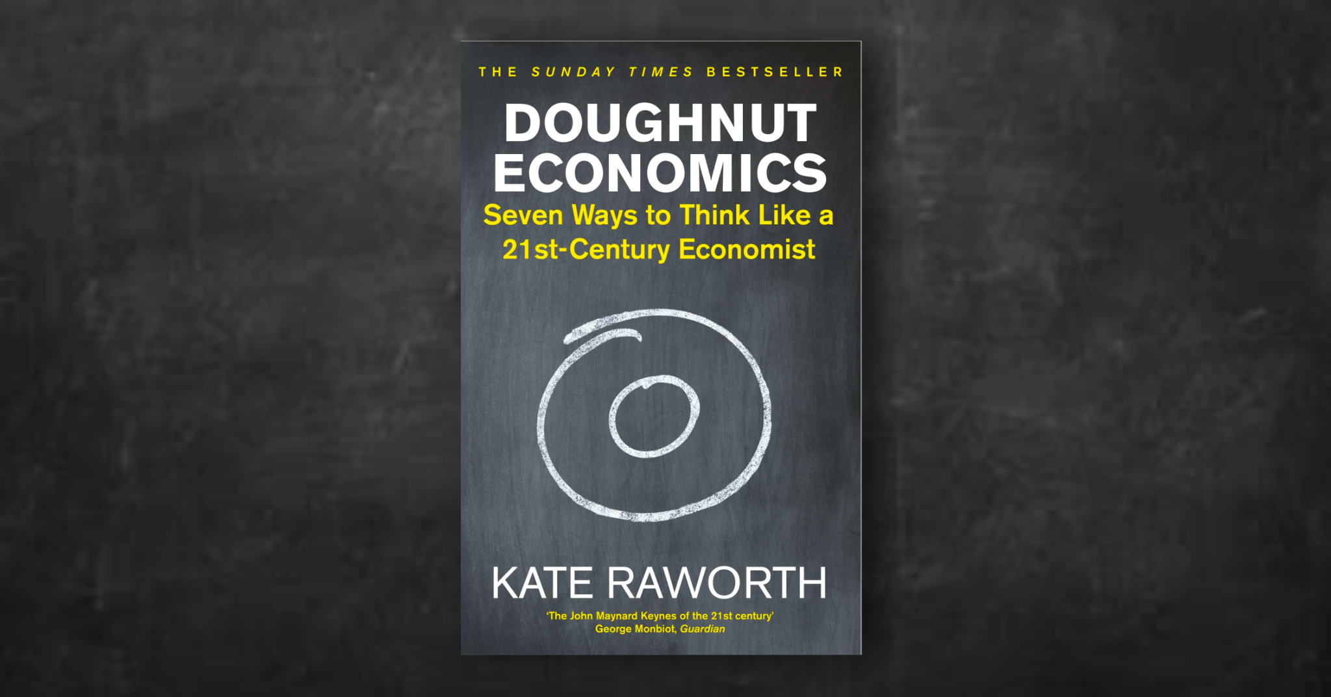
It’s time for new economic thinking
‹#›
Notes:
Commentary

Slide 9
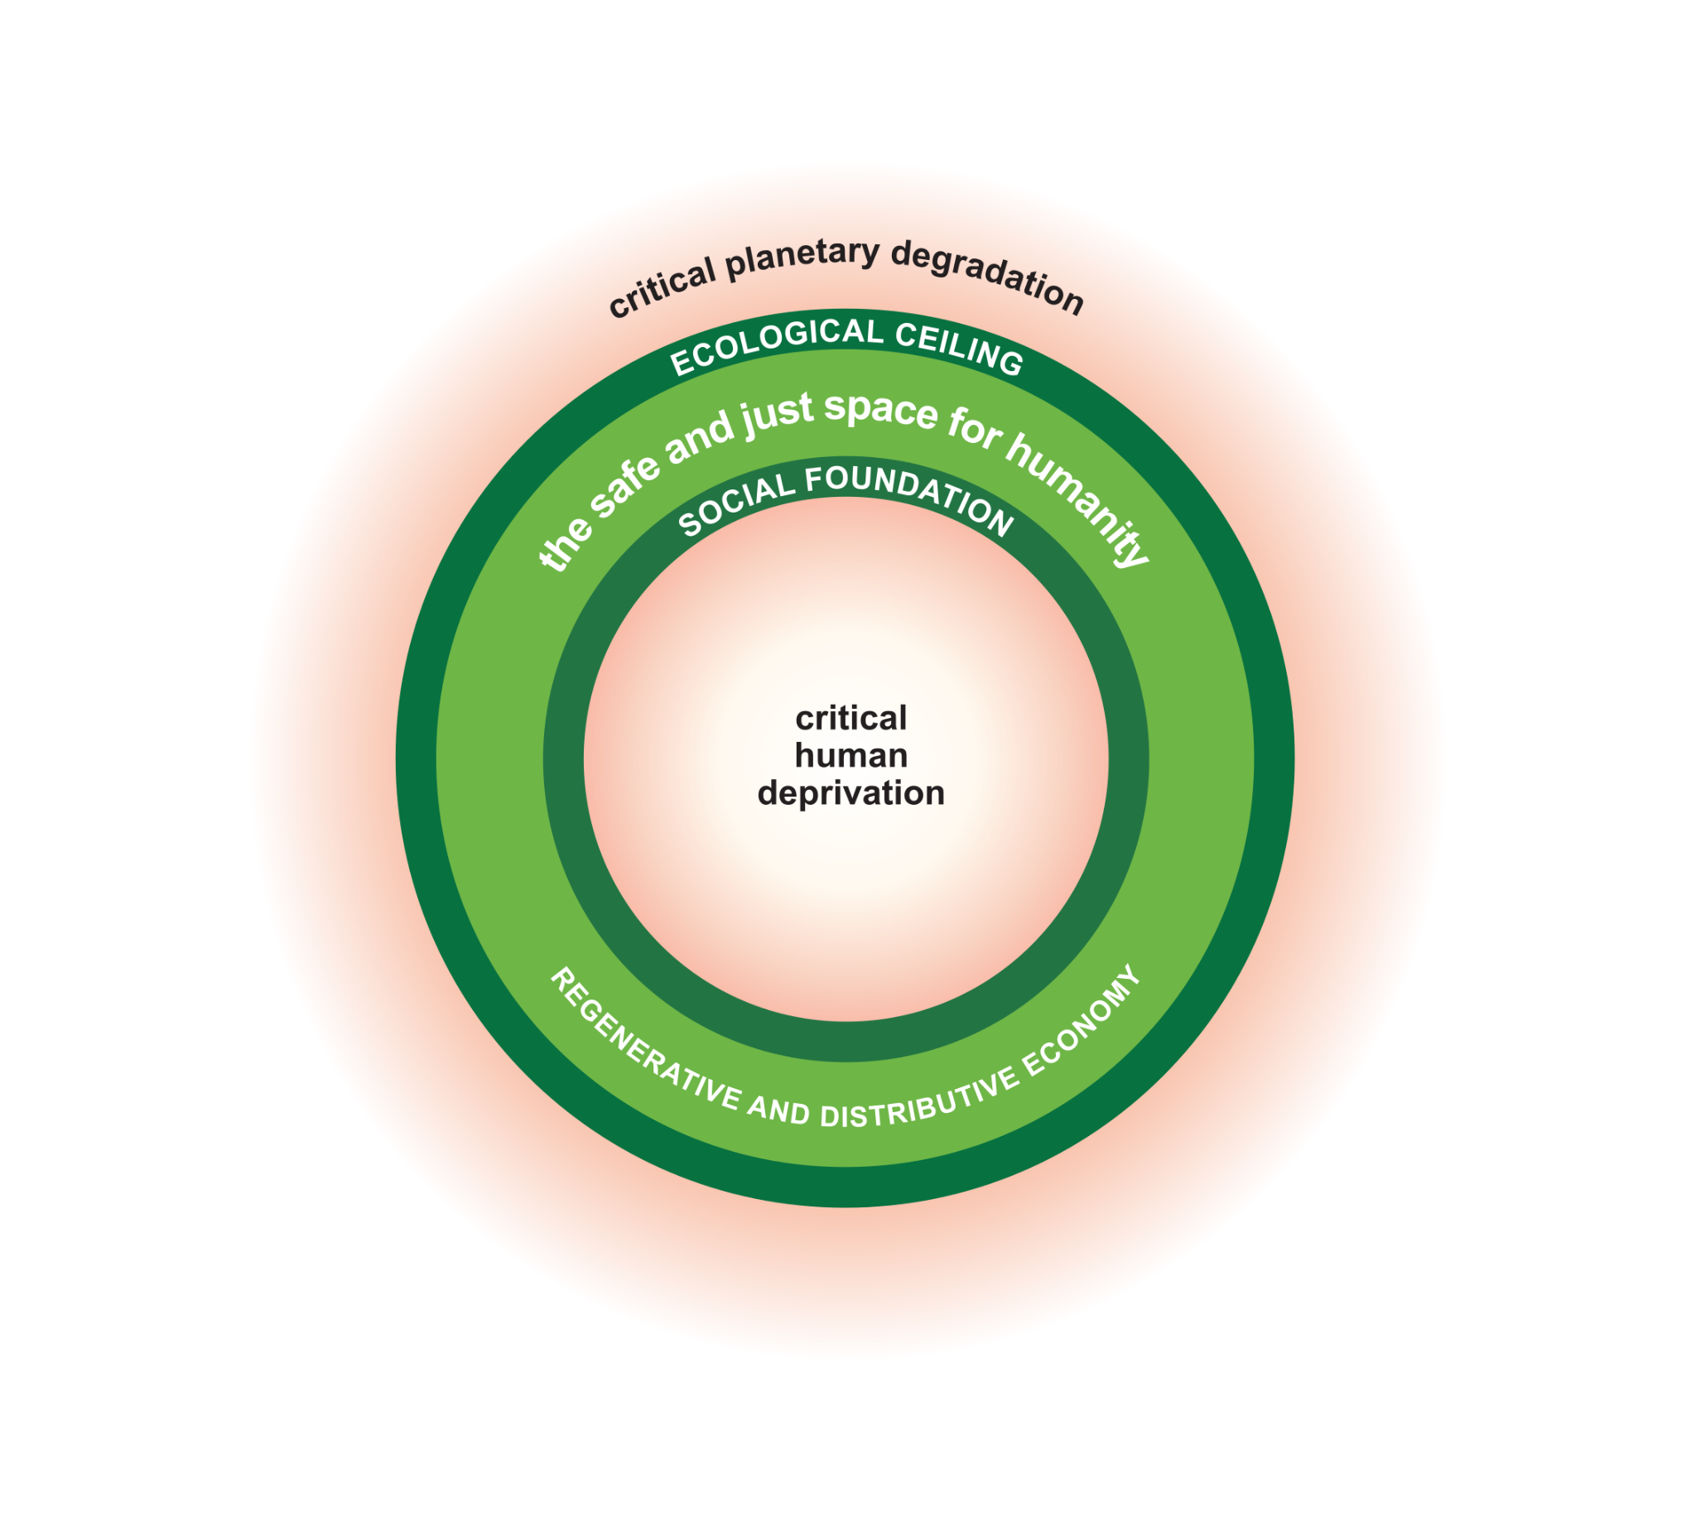
Doughnut Economics offers a goal for the 21st century:
“To meet the
needs of all people
within the
means of the
living planet”
Notes:
Commentary

Slide 10
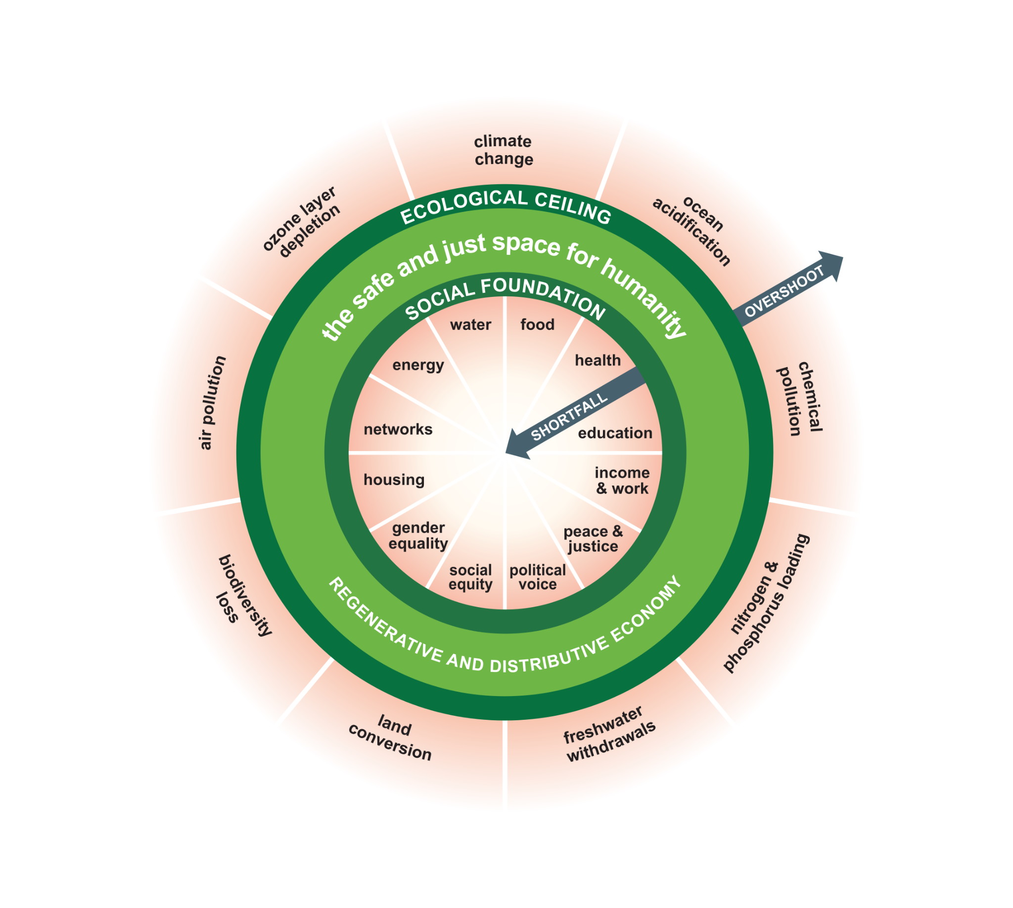
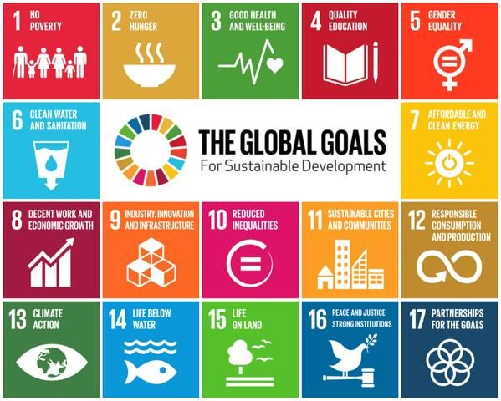
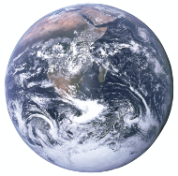
A compass for human prosperity:
Based on the social priorities of the UN Sustainable Development Goals and the nine planetary boundaries of Earth Systems Science
Social priorities of the UN SDGs
9 Planetary Boundaries
Notes:
Commentary

Slide 11
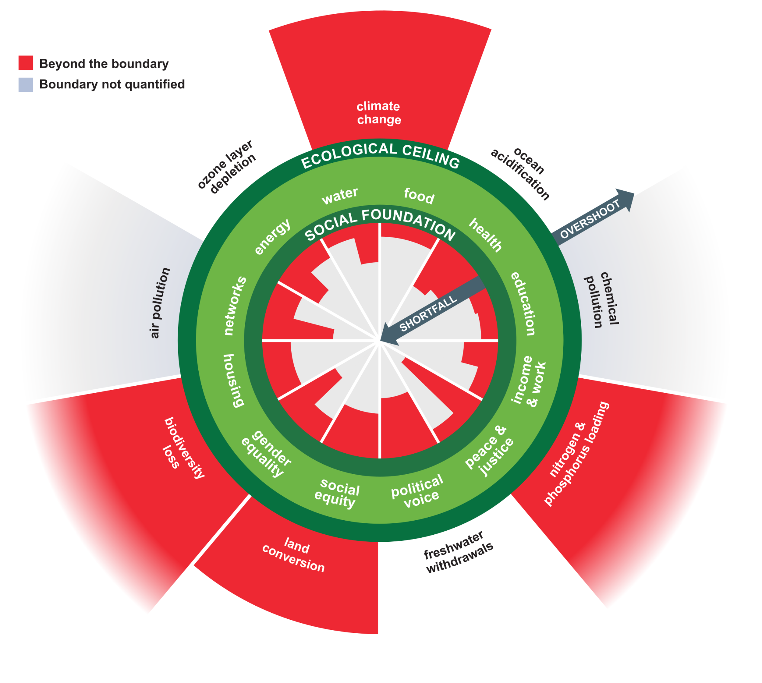
A mirror for humanity:
Showing a world perilously out of balance.
So how can we design our economies to come back into the space of the Doughnut?
Notes:
Commentary

Slide 12
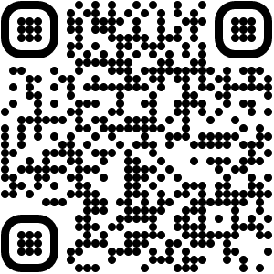
Download the Doughnut diagrams and Embedded Economy diagrams in your own language so you can share them in presentations, print them as posters, or use them in workshops.
‹#›
Notes:
Commentary

Slide 13
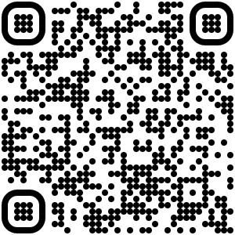
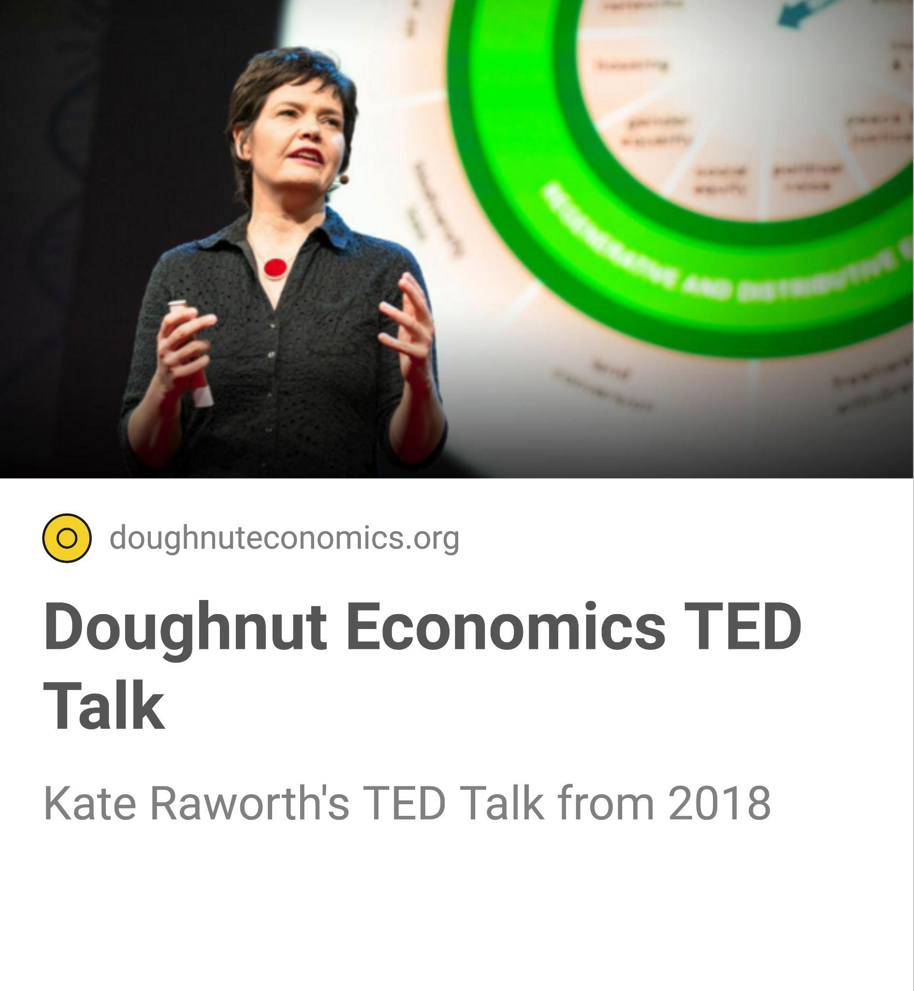
15 minutes
Watch Kate Raworth’s TED Talk from 2018 that introduces the idea of the Doughnut and invites us to think again about goal of the economy: from endless growth to thriving in balance.
‹#›
Notes:
Commentary

Slide 14
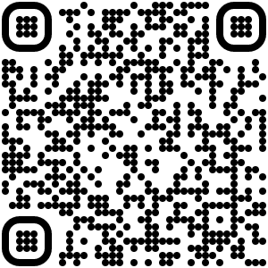
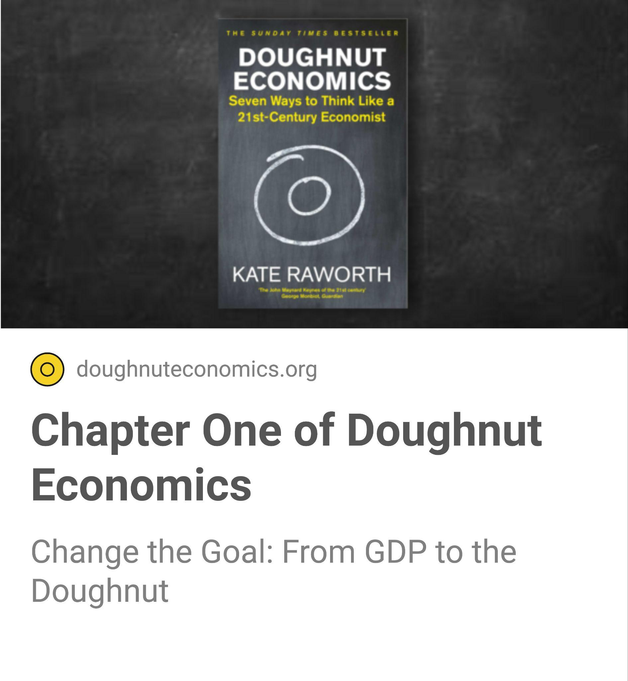
60 minutes
Read chapter one of Doughnut Economics that more deeply explores the goal of the economy, the origin of GDP and how we might reimagine the goal to be thriving in balance.
‹#›
Notes:
Commentary

Slide 15
The following pages introduce the seven ways of Doughnut Economics, with some questions you can reflect on with your community. There are then some tools you can use to explore them in different ways.

Slide 16
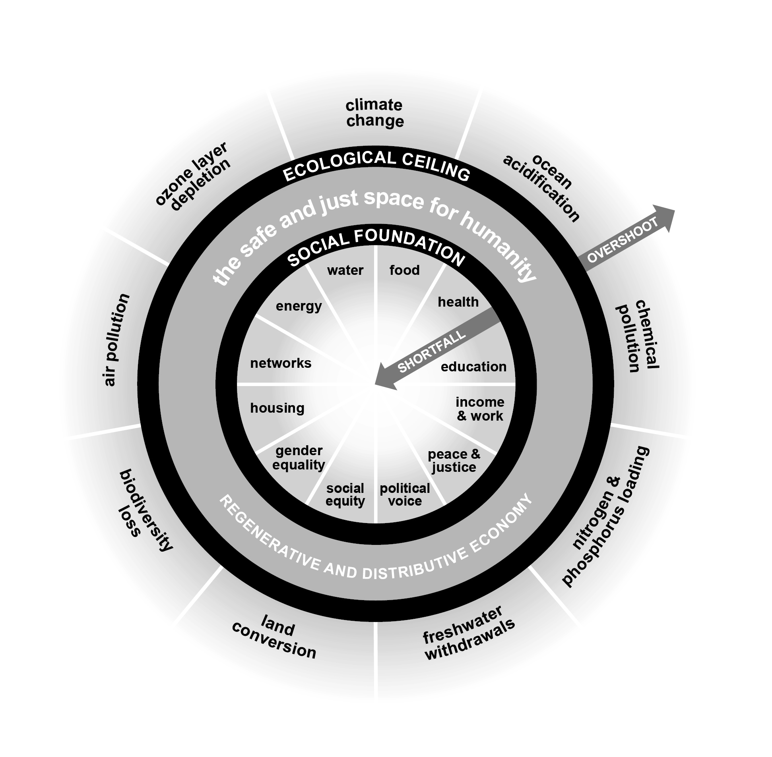
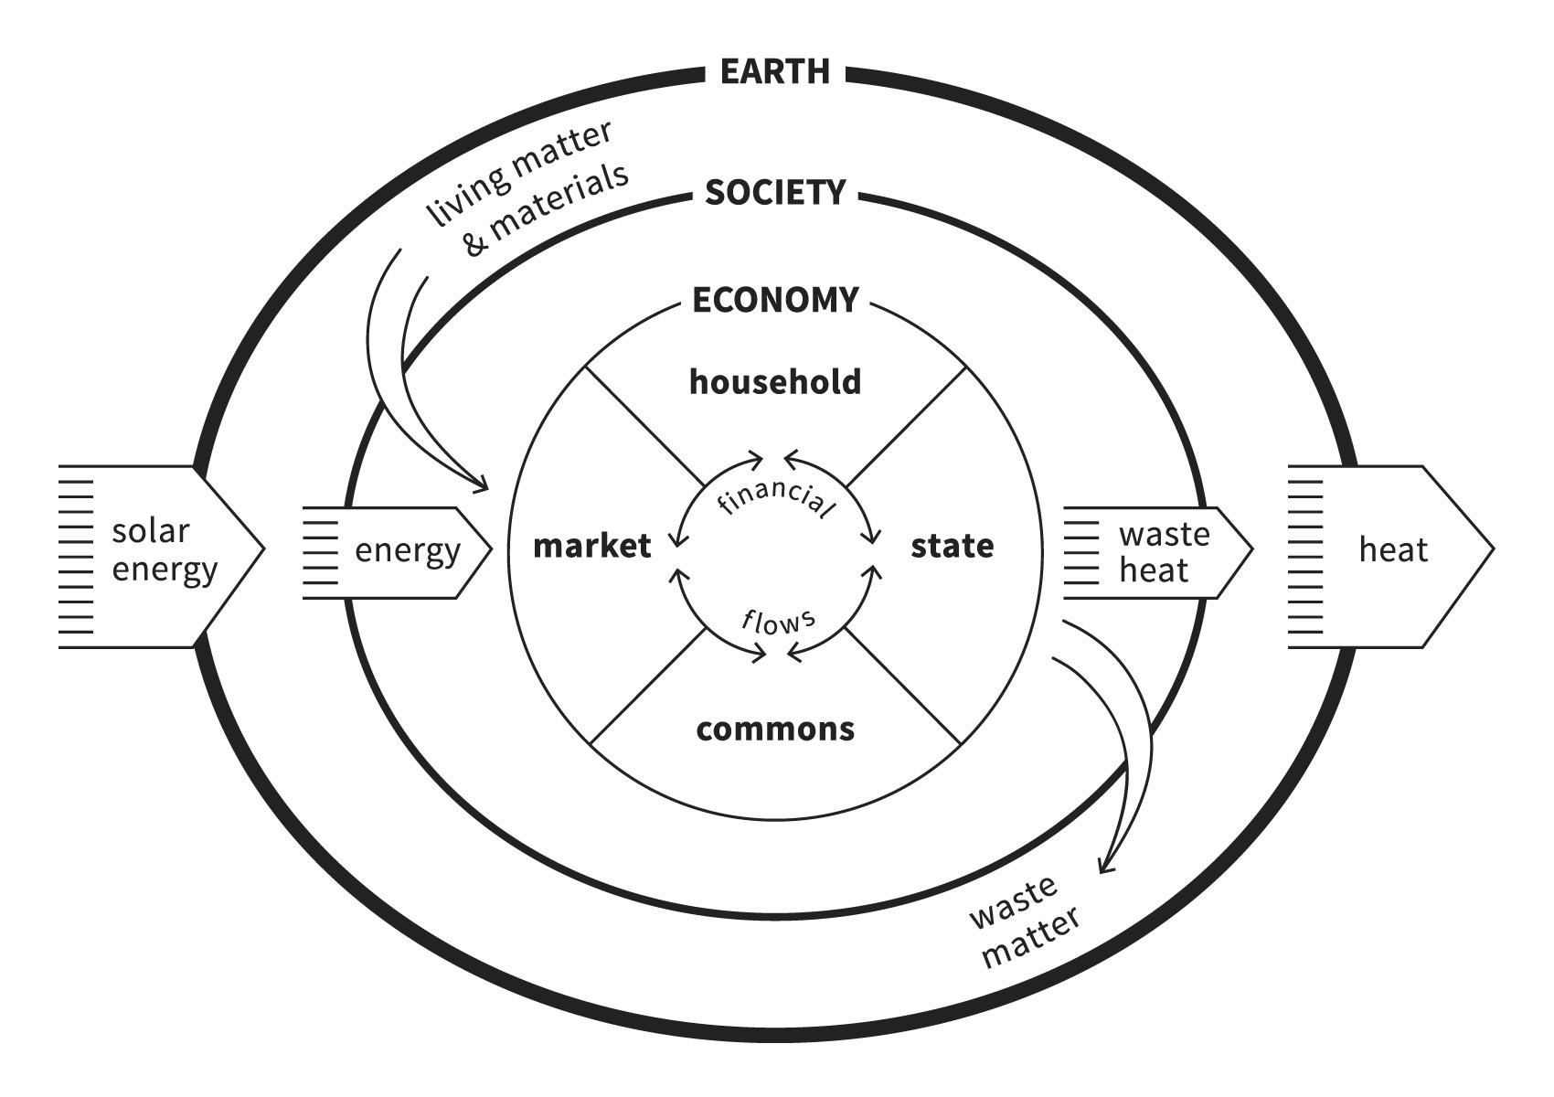
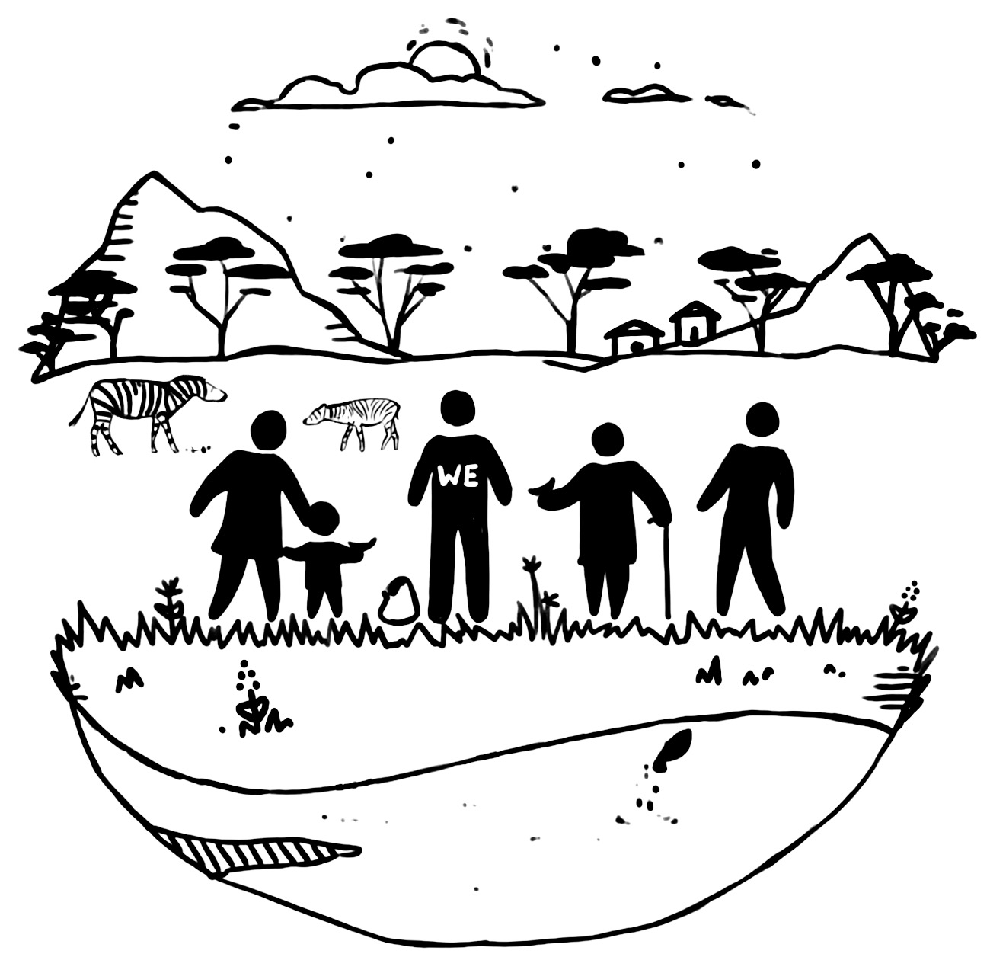
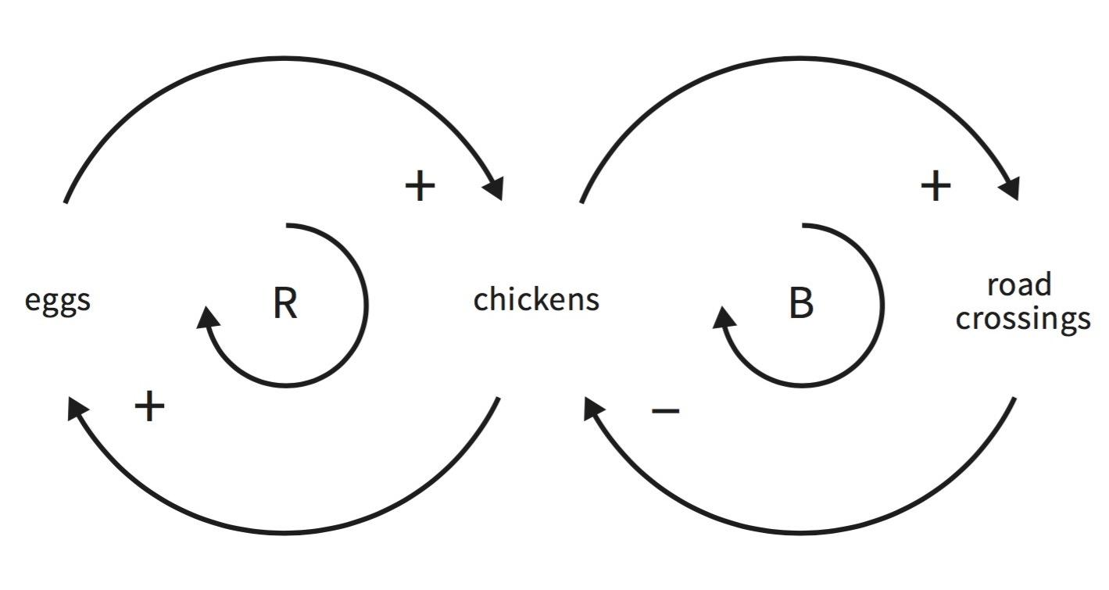
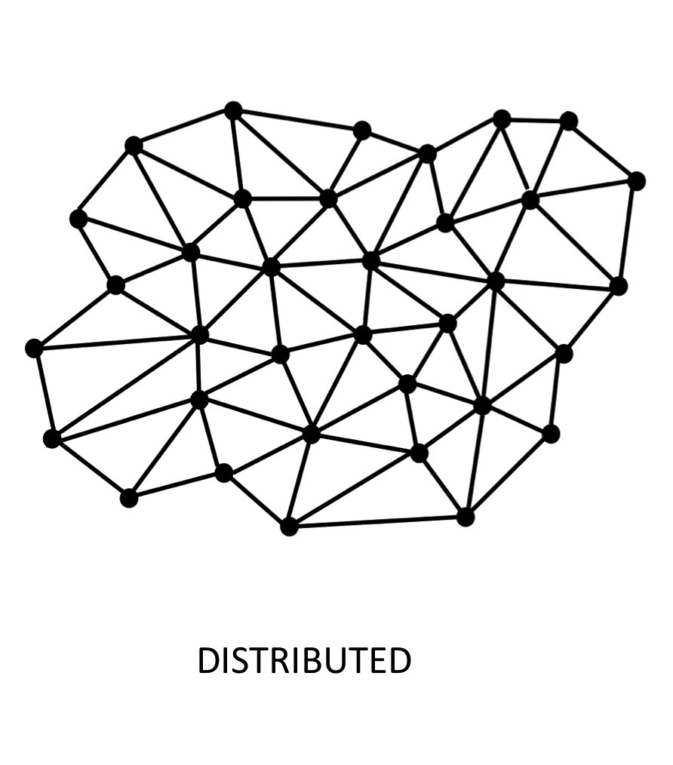
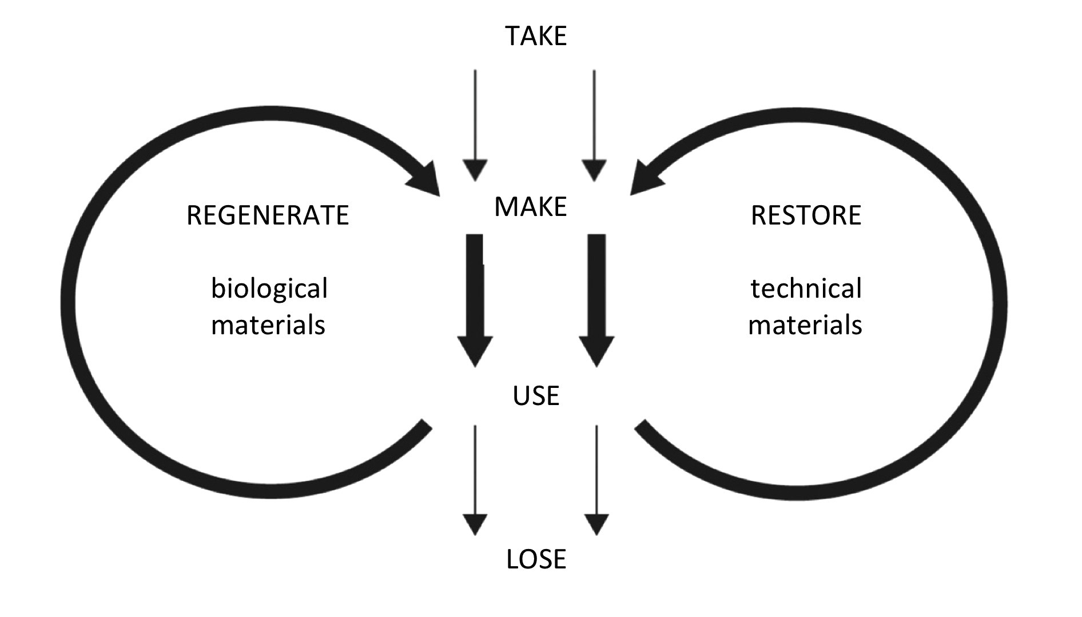
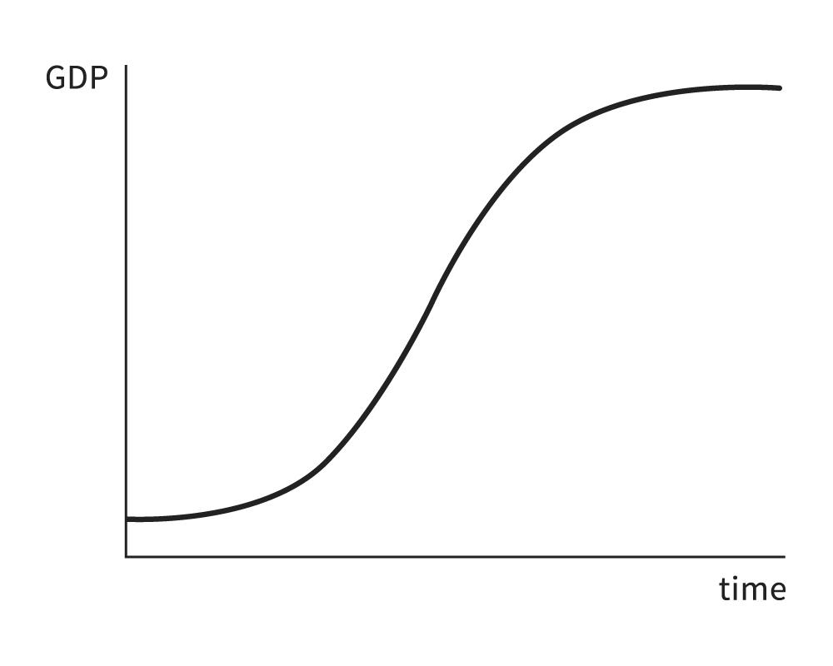
Doughnut Economics offers seven ways to think like a 21st century economist
1. Change the goal
2. See the big economic picture
3. Nurture human nature
4. Get savvy with systems
5. Be distributive by design
6. Be regenerative by design
7. Think again about growth

Slide 17
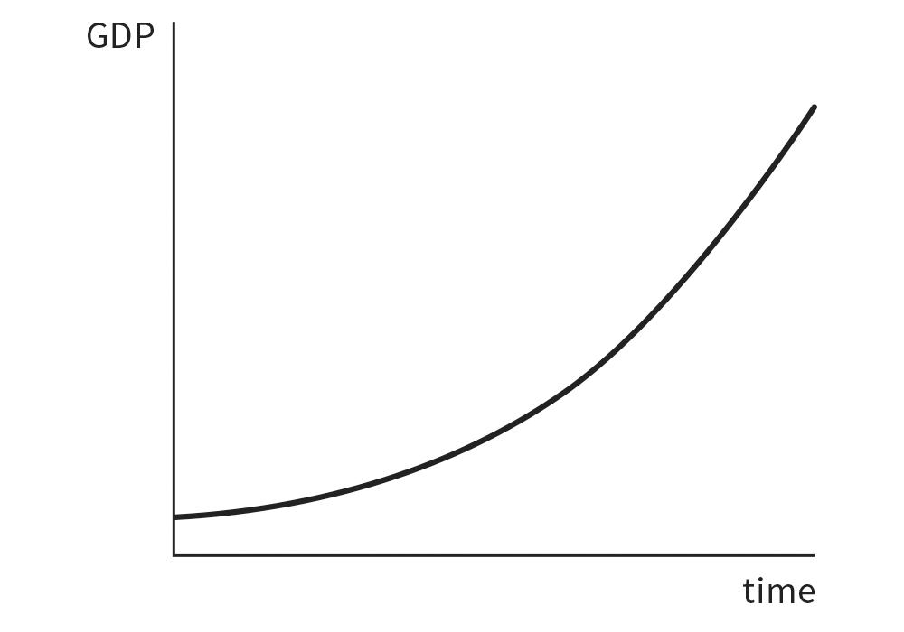
1. Change the goal
from
Gross Domestic Product (GDP)
to
The Doughnut
What is the purpose of the economy and what should be its goal?
What do you think and feel about the current purpose and goal of the economy? What and whom does it serve?
The Doughnut offers the goal of meeting the needs of all people within the means of the living planet. What do you think and feel about this as a goal for the 21st century?
Maximising the monetary value of all goods and services sold through the market or the state
Meeting the needs of all people within the means of the living planet

Slide 18
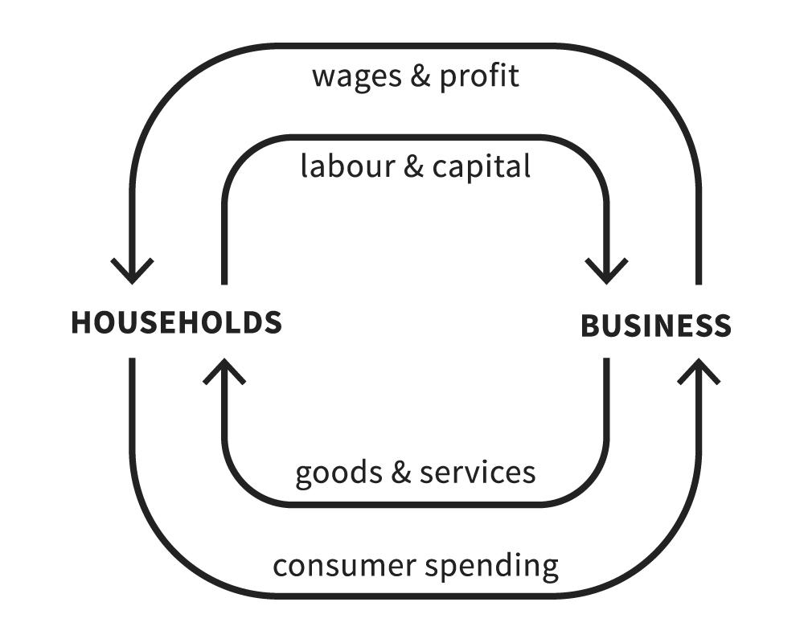
2. See the big economic picture (1 of 2)
from
circular flow
to
embedded economy
What we choose to make visible powerfully impacts what we notice and what we ignore.
How does the economy depend upon and impact the living world?
How is the economy shaped by society - by law, politics, media, civic organisations, and more?
How could all four modes of provisioning (market, state, household and commons) serve humanity well together?
The economy as a closed loop of money and resources flowing between households and businesses
The economy as both diverse and embedded (within society and the living world, upon which it depends)

Slide 19
2. See the big economic picture (2 of 2)
The household
The unpaid activity within the household that sustains the essentials of family and social life with the universal human resources of time, knowledge, skill, care, empathy, learning and reciprocity. Where you can be parent, child, partner, relative, carer …or kinless.
Within the economy there are four systems of provisioning for our needs, and many economic roles.
The state
The local, regional and national governments that provision public goods and services to meet people’s needs, and create the legislative framework for all other forms of economic activity. Where you can be resident, service user, public servant, regulator, voter, protester …or stateless.
The market
The mechanism by which goods & services are bought and sold according to an agreed exchange value and terms, and the people, groups and organisations that are involved in that exchange. Where you can be consumer, producer, labourer, owner ...or destitute.
The commons
The process and forms of stewarding a shared resource by a self-organising and governing community, outside the direct governance of the market or state, for the shared benefit of the community and place. Where you can be member, co-creator, volunteer, steward …or excluded.
Which roles do you play in each?
Which of these roles feel valued to you?
Where do you see examples of these working well (and not so well) together?

Slide 20
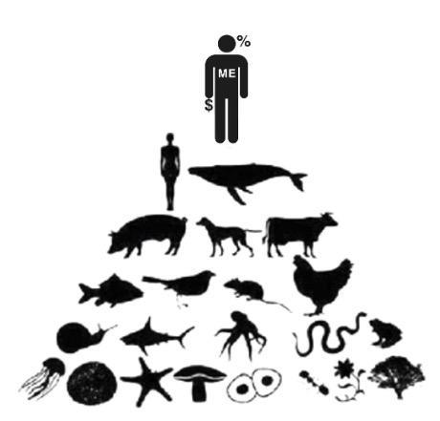
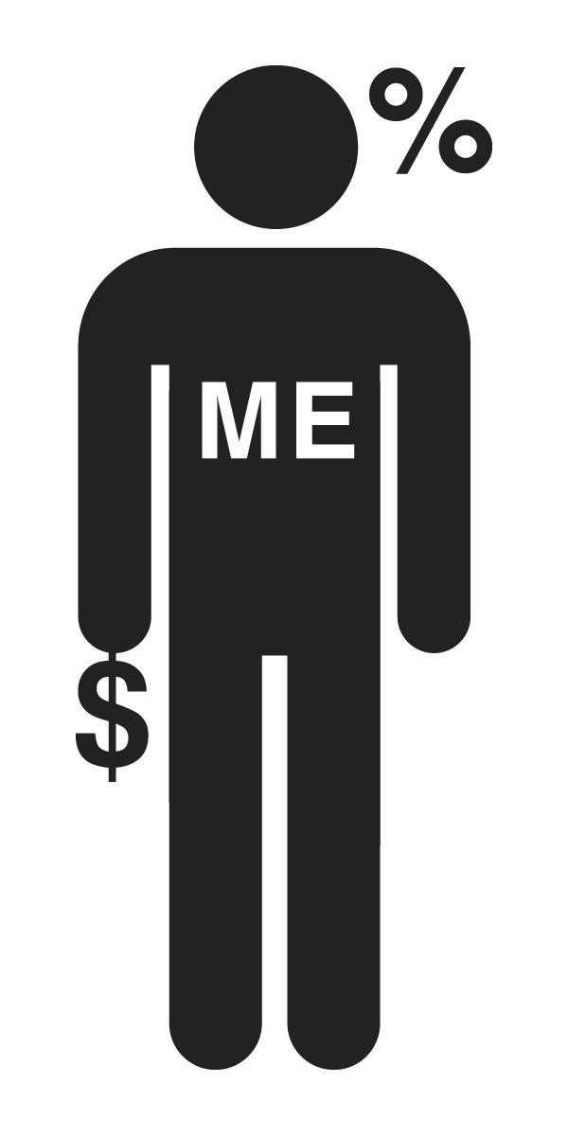
3. Nurture human nature
from
rational economic man
to
social adaptable humans
Who we tell ourselves we are, shapes who we become.
What do you think should be the core characteristics and qualities of humanity in a 21st century economic model?
What could happen if the economy actively nurtured the best of human nature, fostering our innate capacity for cooperation, collaboration and mutual aid?
Alone, self-interested, calculating and competitive, with nature at his feet
Caring, reciprocating, compassionate community that is part of the web of life

Slide 21
4. Get savvy with systems
from
mechanical equilibrium
to
dynamic complexity
What examples of systems can you think of in your daily life and what are the relationships and feedback loops that exist?
What are some examples of feedback loops and tipping points in the economy?
If the economy is a ‘complex system’ that can’t be controlled but only stewarded, what is the role of the economist?
What are the skills required to be a good economist?
Simplifying systems with the aim of predicting and controlling outcomes
Embracing the unpredictability of complex systems and their interconnections

Slide 22
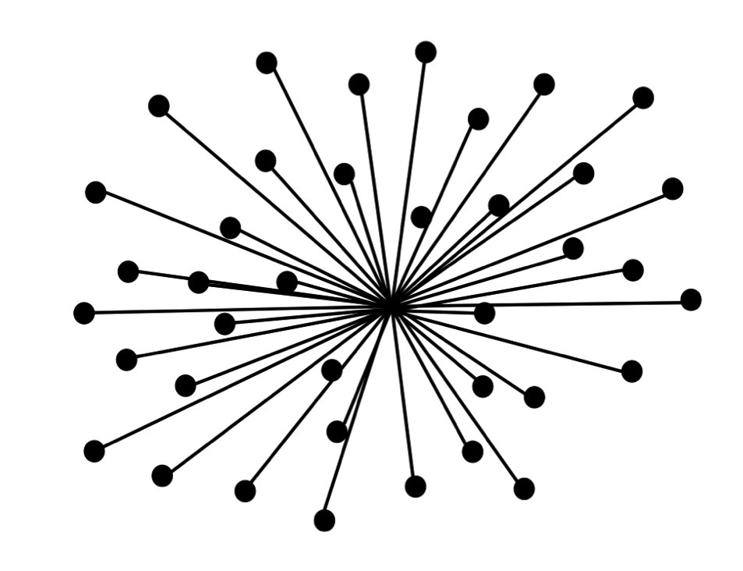
5. Be distributive by design
from
divisive
to
distributive
Who owns the sources of wealth creation where you live, such as land, housing and businesses?
Who determines how land is used, who has access, what housing is built, who benefits from the value created?
Who creates and controls the businesses, and who benefits from the value they create?
What are the laws, regulations, infrastructure, technologies, privilege and inheritance that shape these things?
Capturing opportunity and value in the hands of a few
Sharing opportunity and value with all who co-create it

Slide 23
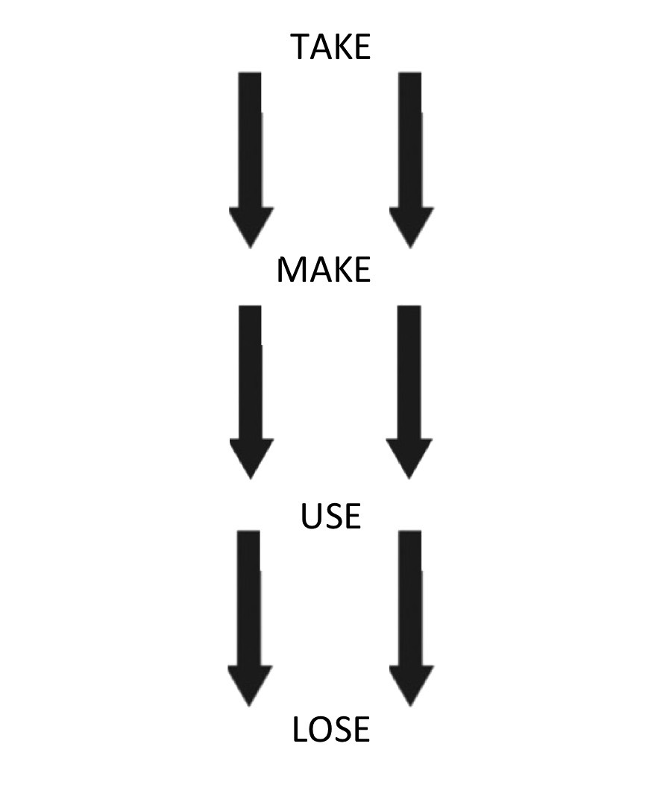
6. Be regenerative by design
from
degenerative
to
regenerative
How can we collectively restore, rewild and regenerate living ecosystems, both locally and globally?
Nature has no waste, so how can we learn from nature to be more regenerative by design: to repair, refurbish, restore, reuse and remake the technical materials we use (such as synthetics, plastics, ceramics and metals) that cannot be returned to nature’s cycles?
Can you think of examples?
Running down Earth’s life- supporting systems, and pushing us over Planetary Boundaries
Restoring and working within the cycles of the living world, and bringing us back within Planetary Boundaries

Slide 24
7. Think again about growth
from
growth-addicted
to
growth agnostic
There are many ‘hooks’ to growth, including: debt-based money creation, consumerism, shareholder-driven business, employment risks, politics captured by wealth, geopolitical power, tax income and fear of public debt.
How could economies end these structural dependencies upon endless growth? What would need to change to make that possible?
We have economies that need to grow, whether or not they make us thrive
We need economies that enable us to thrive, whether or not they grow

Slide 25
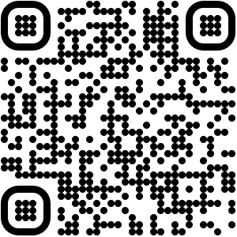
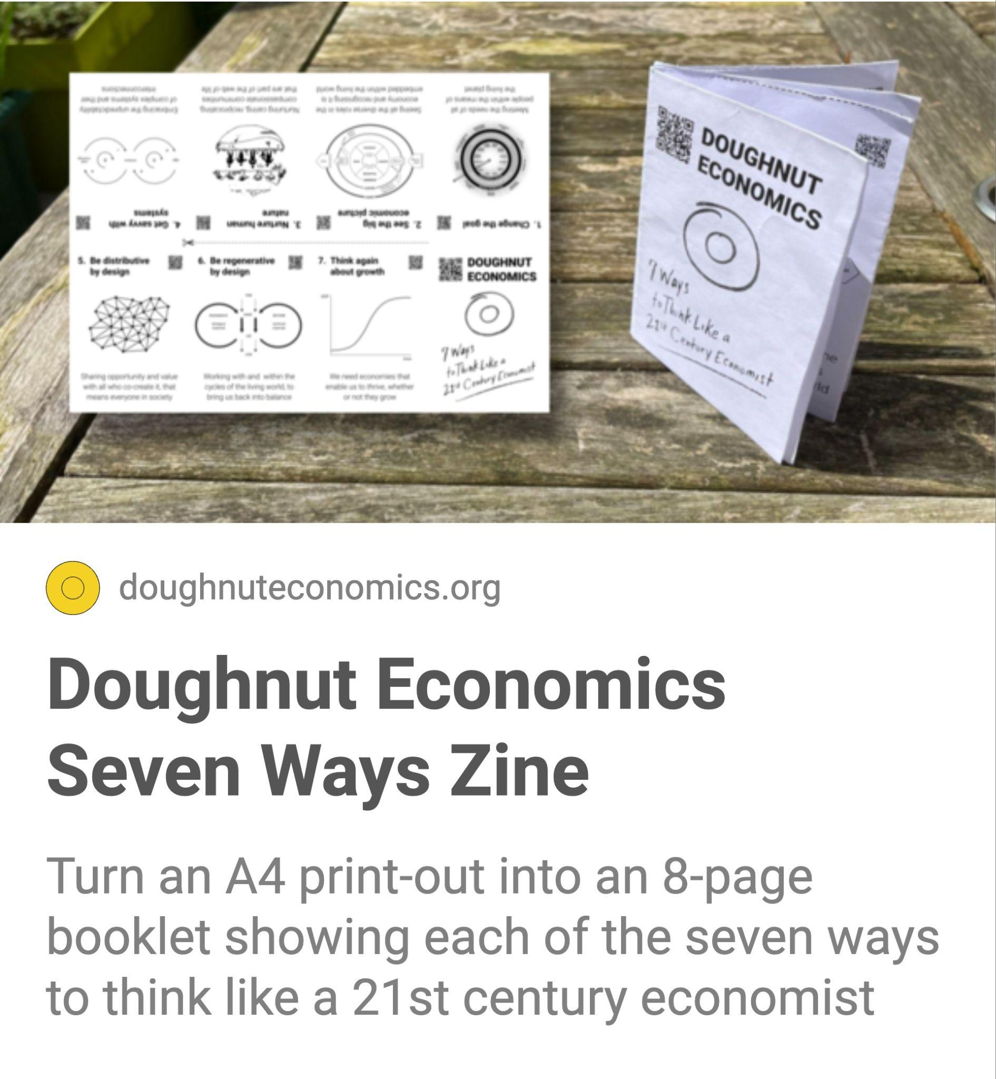
15 minutes
Print this A4 page and turn the seven ways into a zine booklet; something you can keep, make with others or share with others.
‹#›
Notes:
Commentary

Slide 26
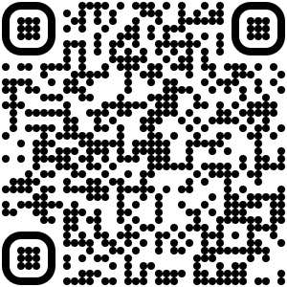
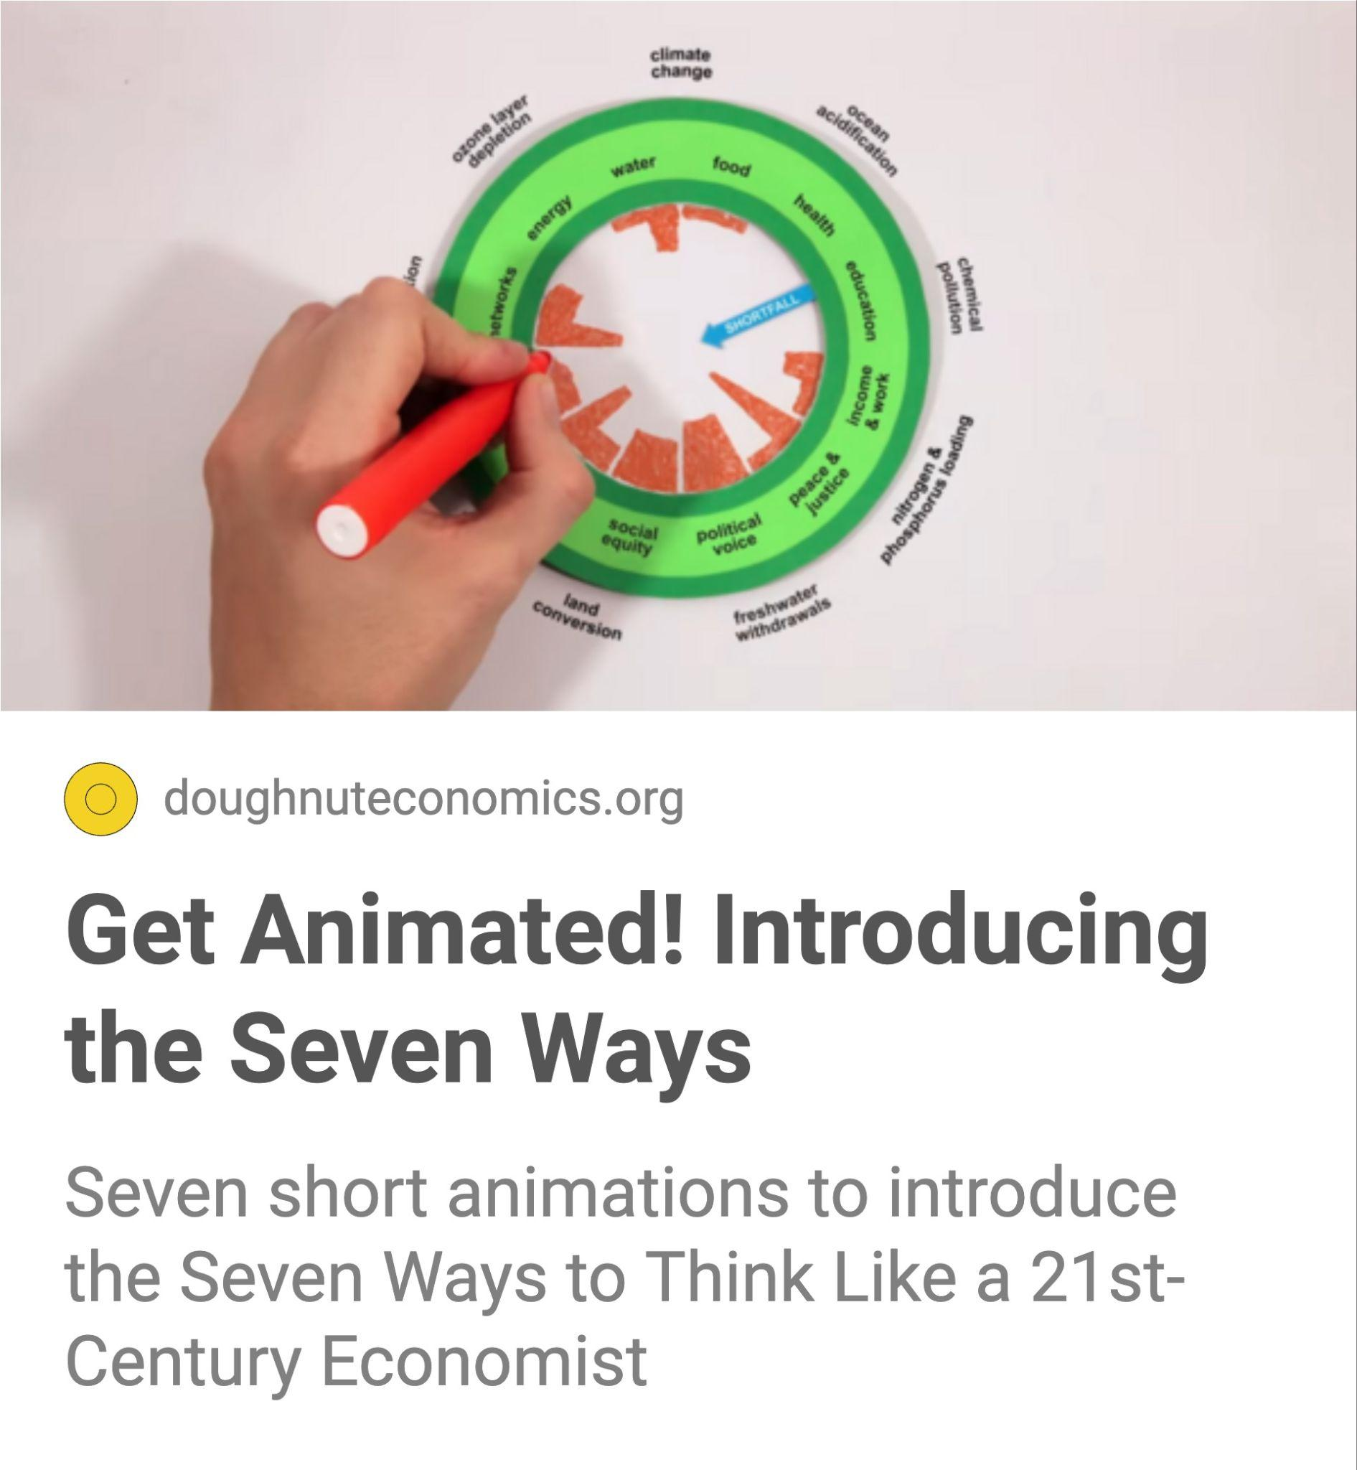
15 minutes
Watch seven short video animations that summarise each of the Seven Ways. You might like to introduce these videos to others and discuss the questions in the previous slides.
‹#›
Notes:
Commentary

Slide 27
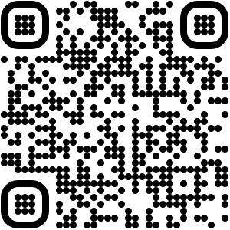
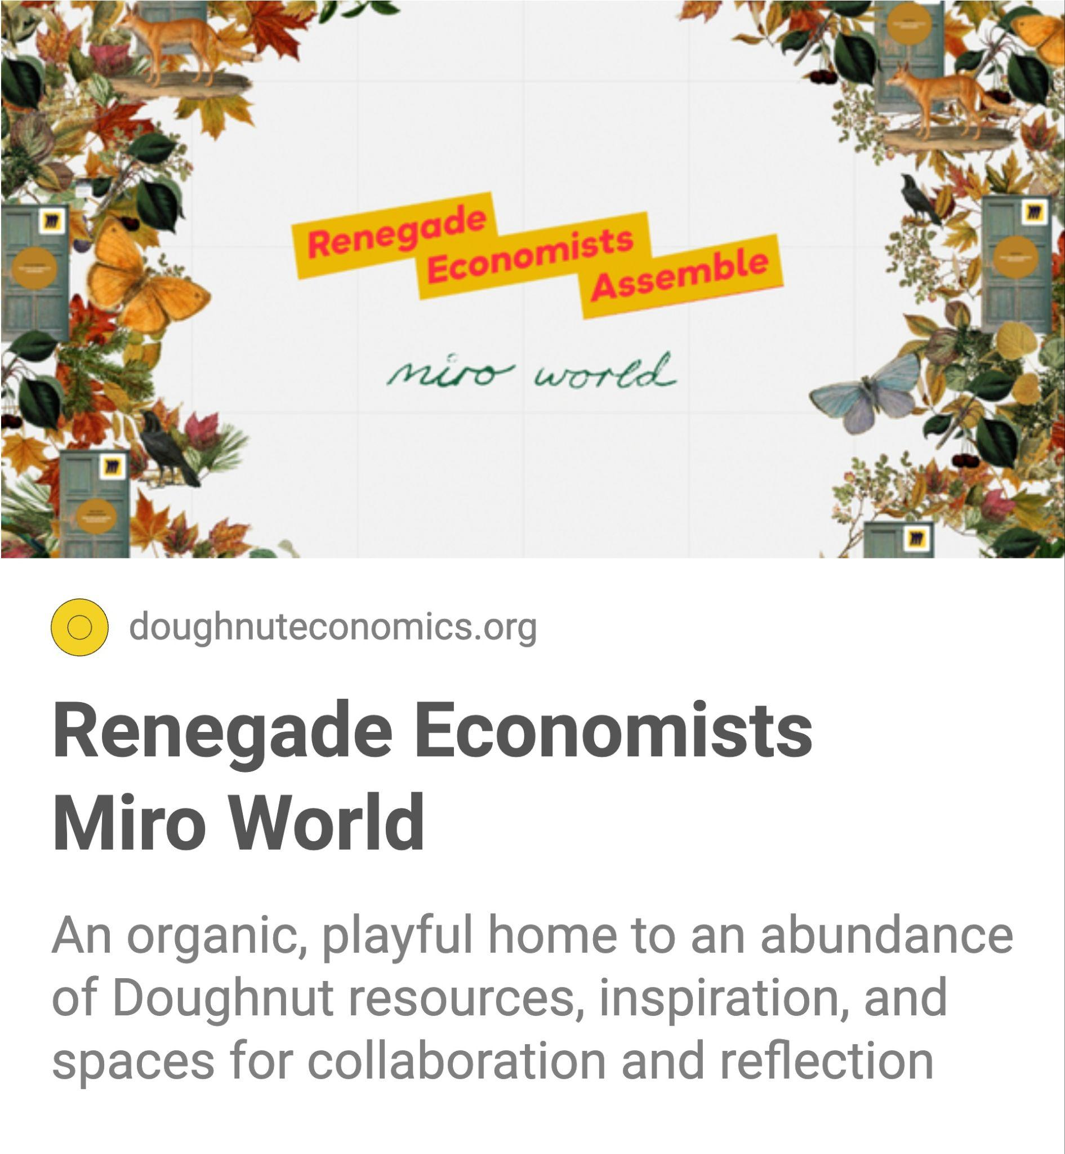
several hours
Explore this Miro world, created by Mona Ebdrup and Magda Petford, that has lots and lots of rich content relating to each of the chapters of the book Doughnut Economics.
‹#›
Notes:
Commentary

Slide 28
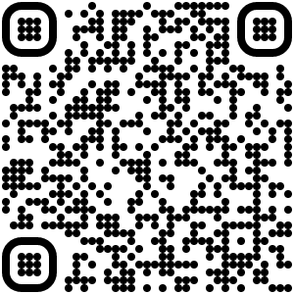
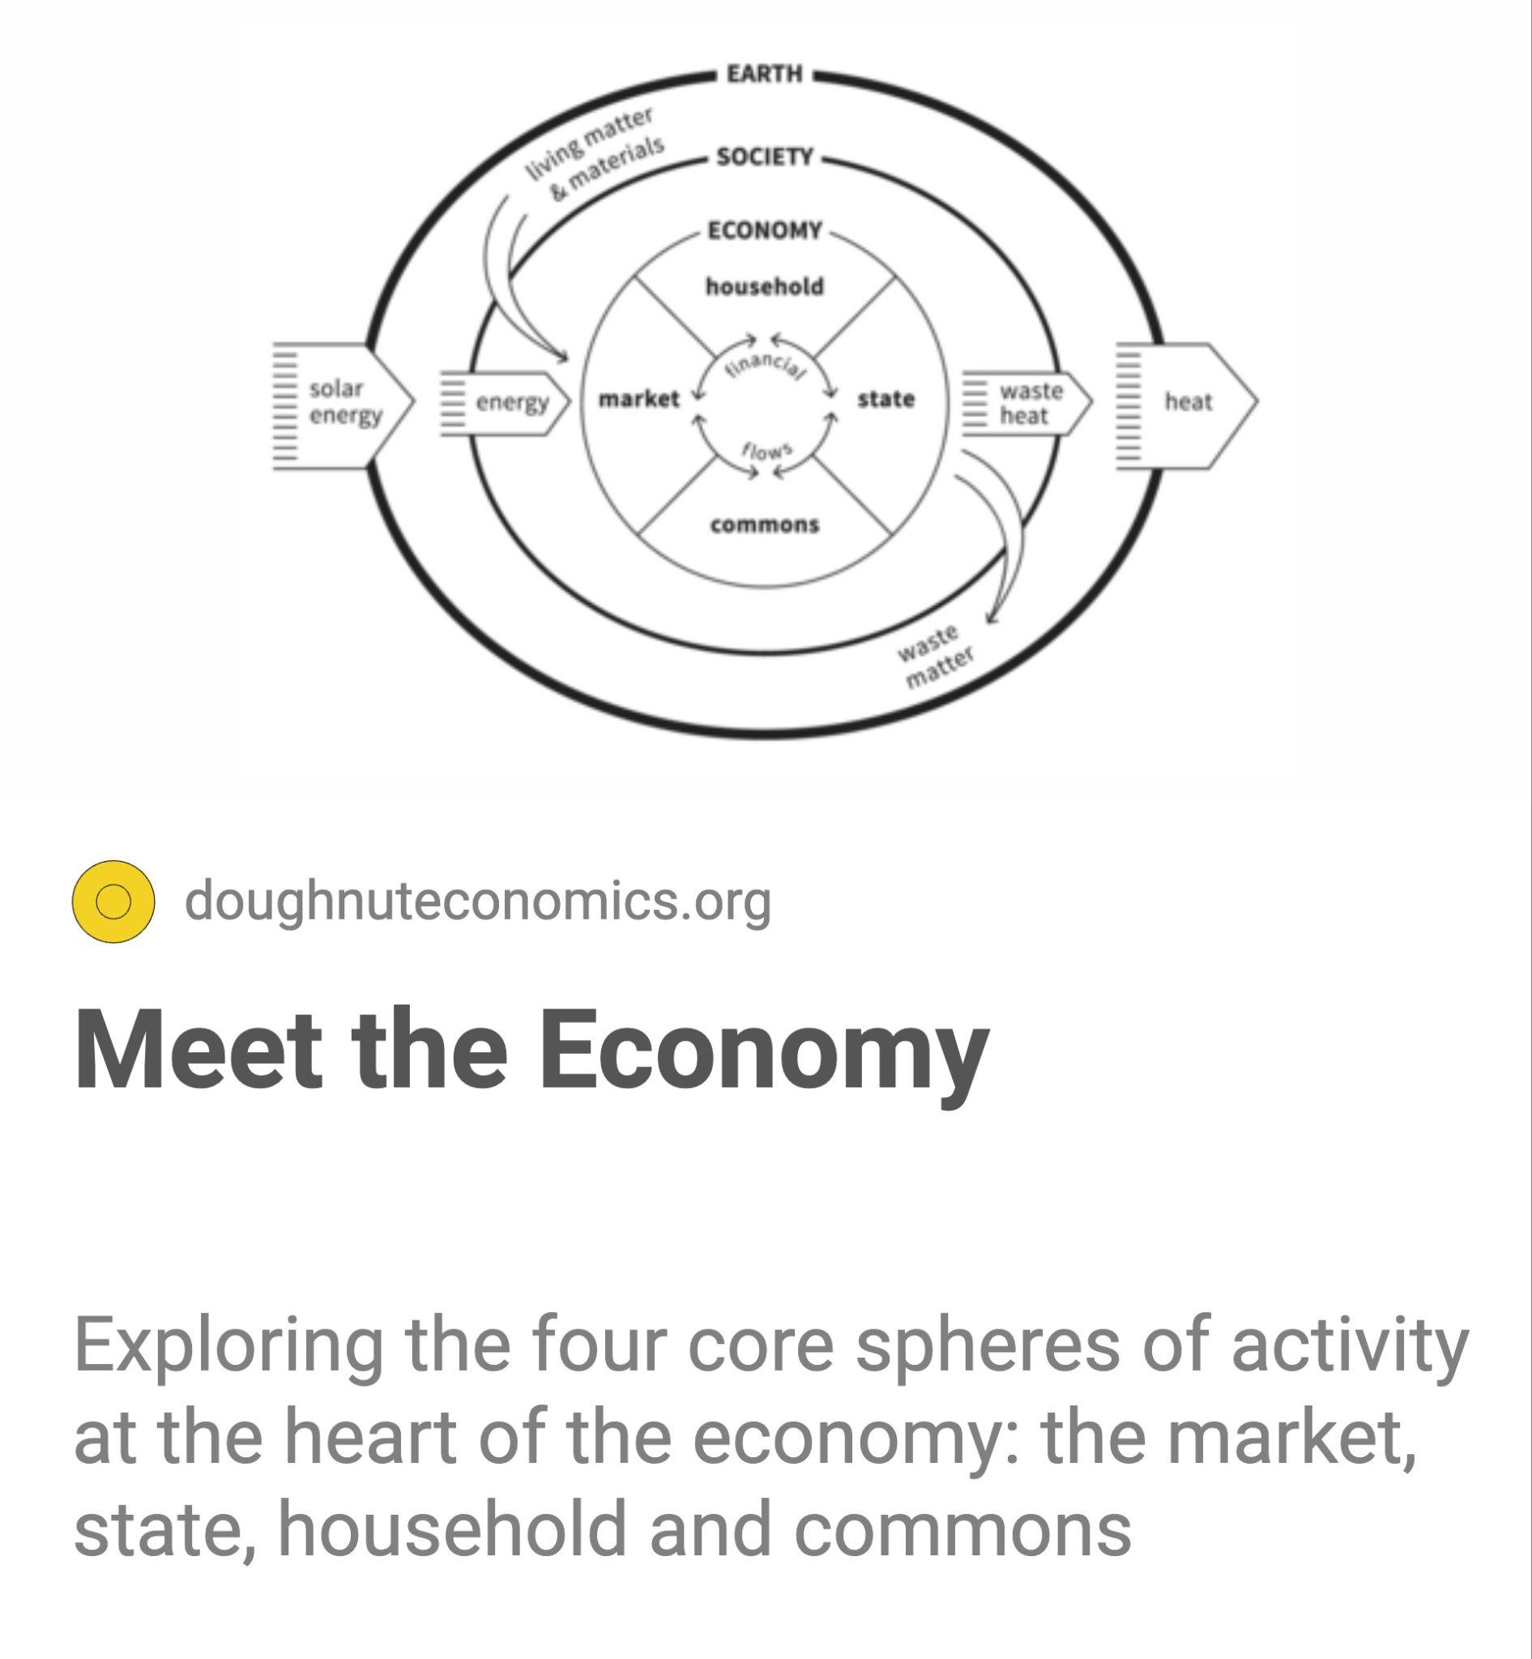
10 minutes
Watch this video introducing the Embedded Economy diagram (from chapter 2), including all the roles and relationships within the economy.
‹#›
Notes:
Commentary

Slide 29
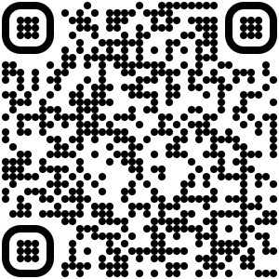
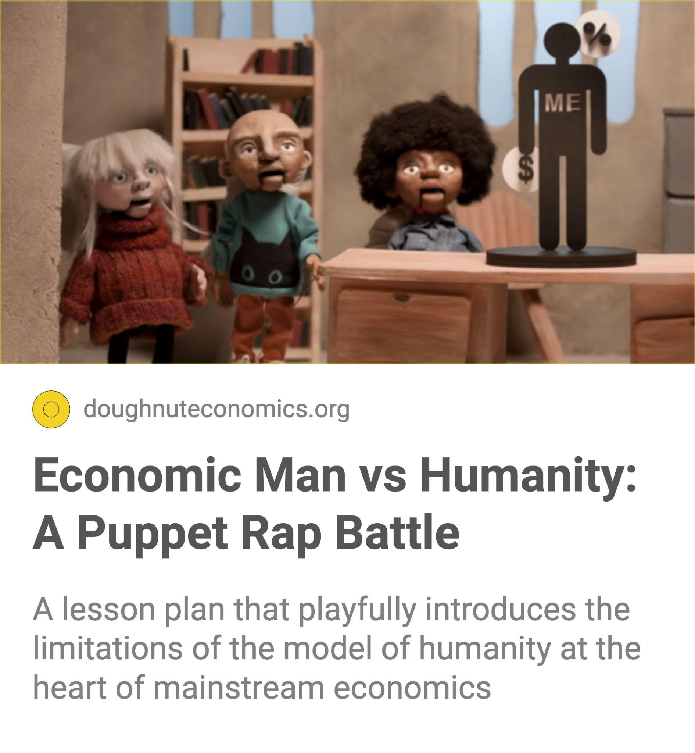
10 minutes
Watch this fun Puppet Rap Battle video about assumptions behind economics’ model of humanity ‘Rational Economic Man’ (from chapter 3).
‹#›
Notes:
Commentary

Slide 30
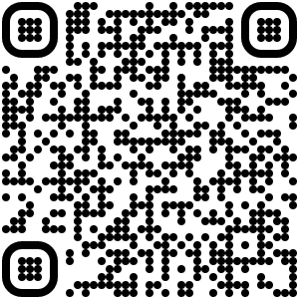
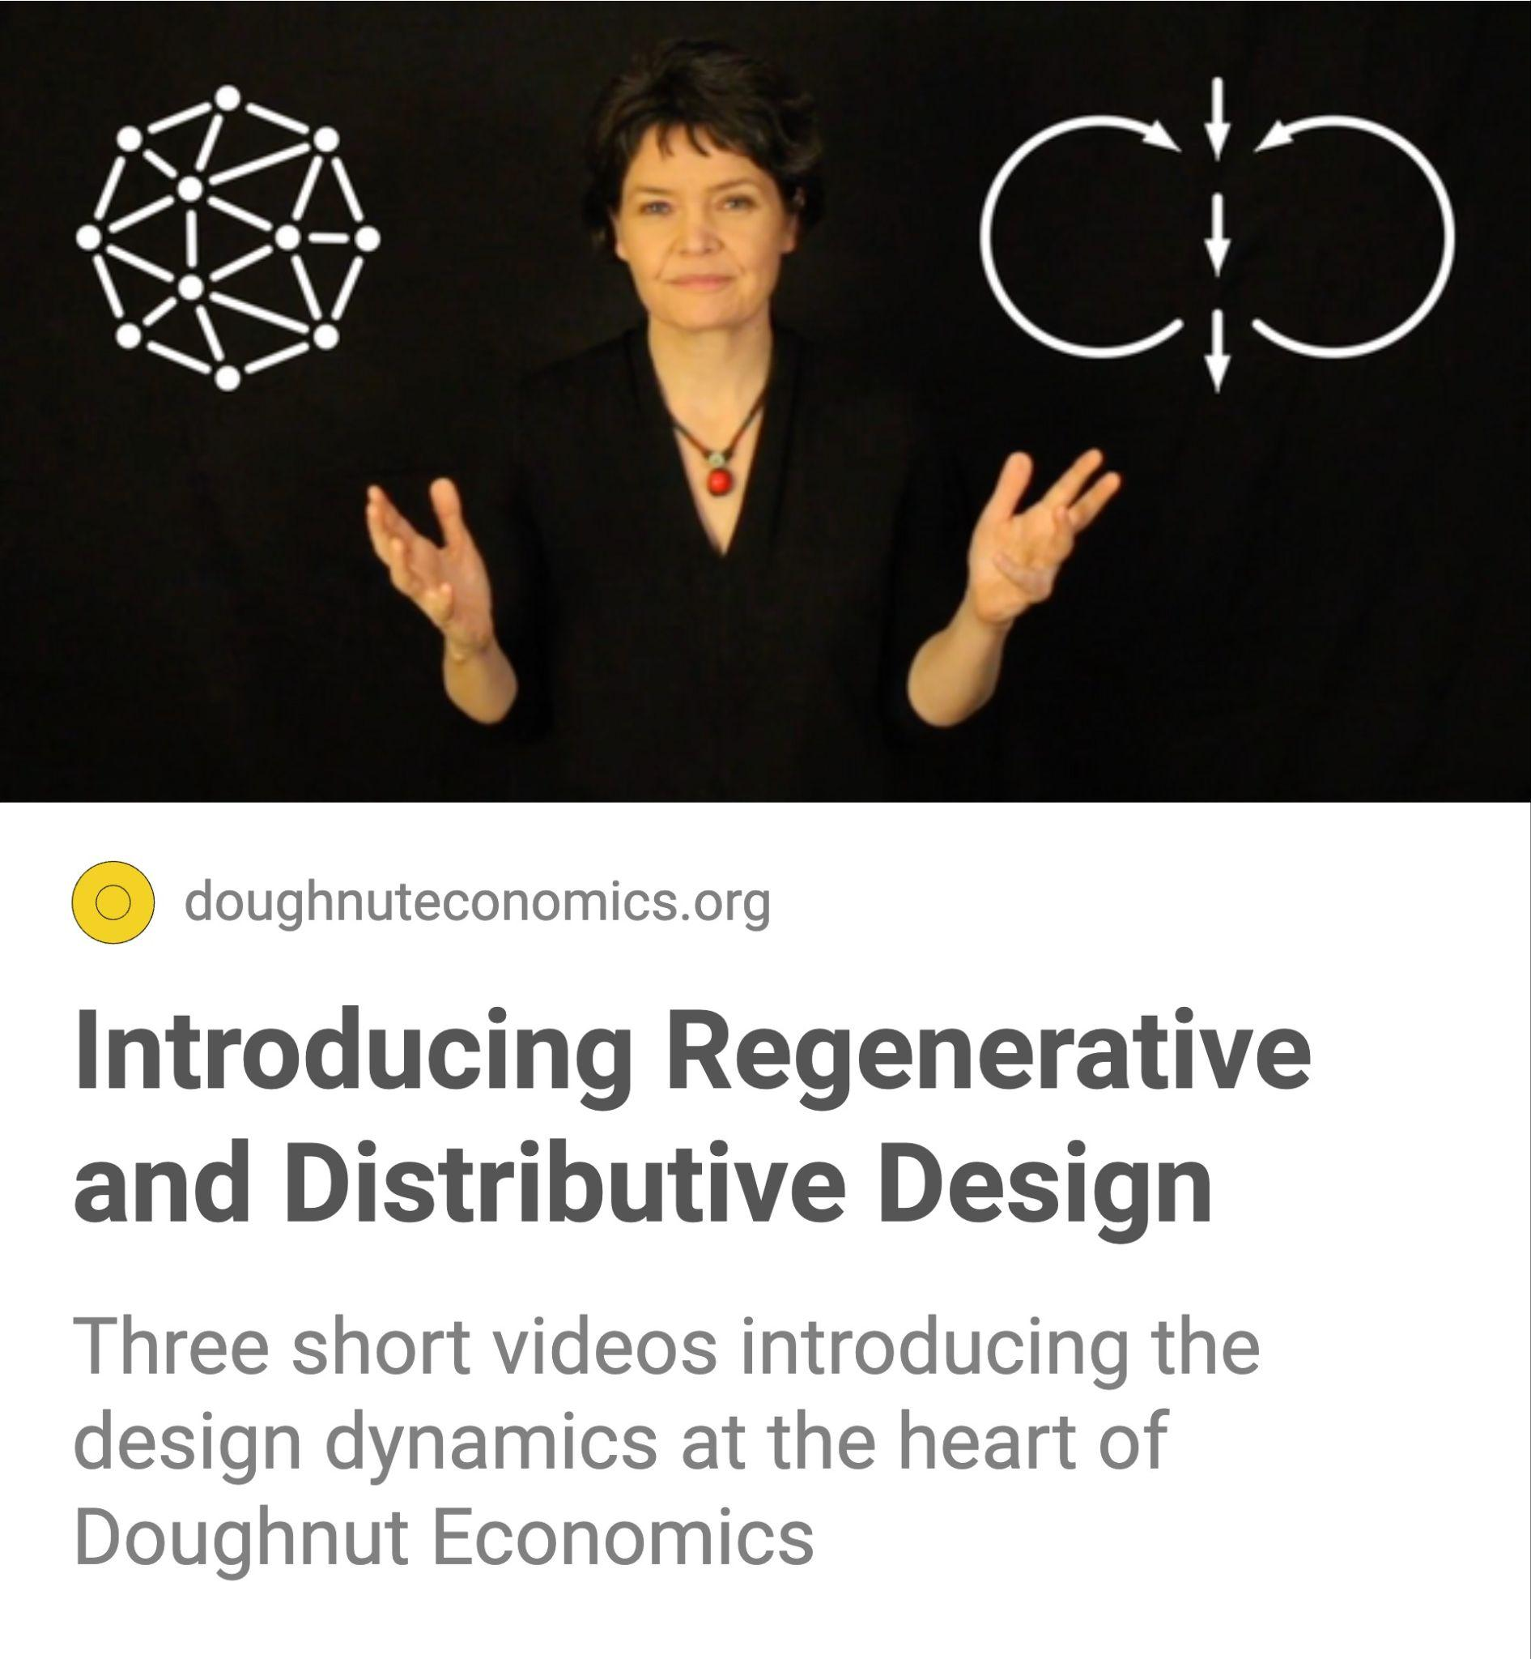
10 minutes
Watch these short videos introducing regenerative and distributive design - the two design dynamics needed to help get humanity into the Doughnut (from chapters 5 and 6).
‹#›
Notes:
Commentary

Slide 31
2 How can I learn about Doughnut Economics with others?

Slide 32
Learning with others helps bring the ideas of Doughnut Economics to life. In this chapter there are a couple of tools and a story about the power of peer-to-peer learning… (‘What feels more possible now?’ they were asked. ‘Anything!’ they answered)

Slide 33
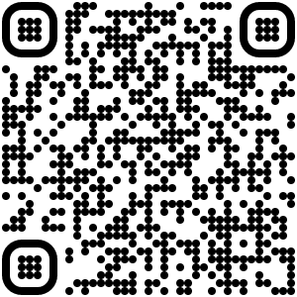
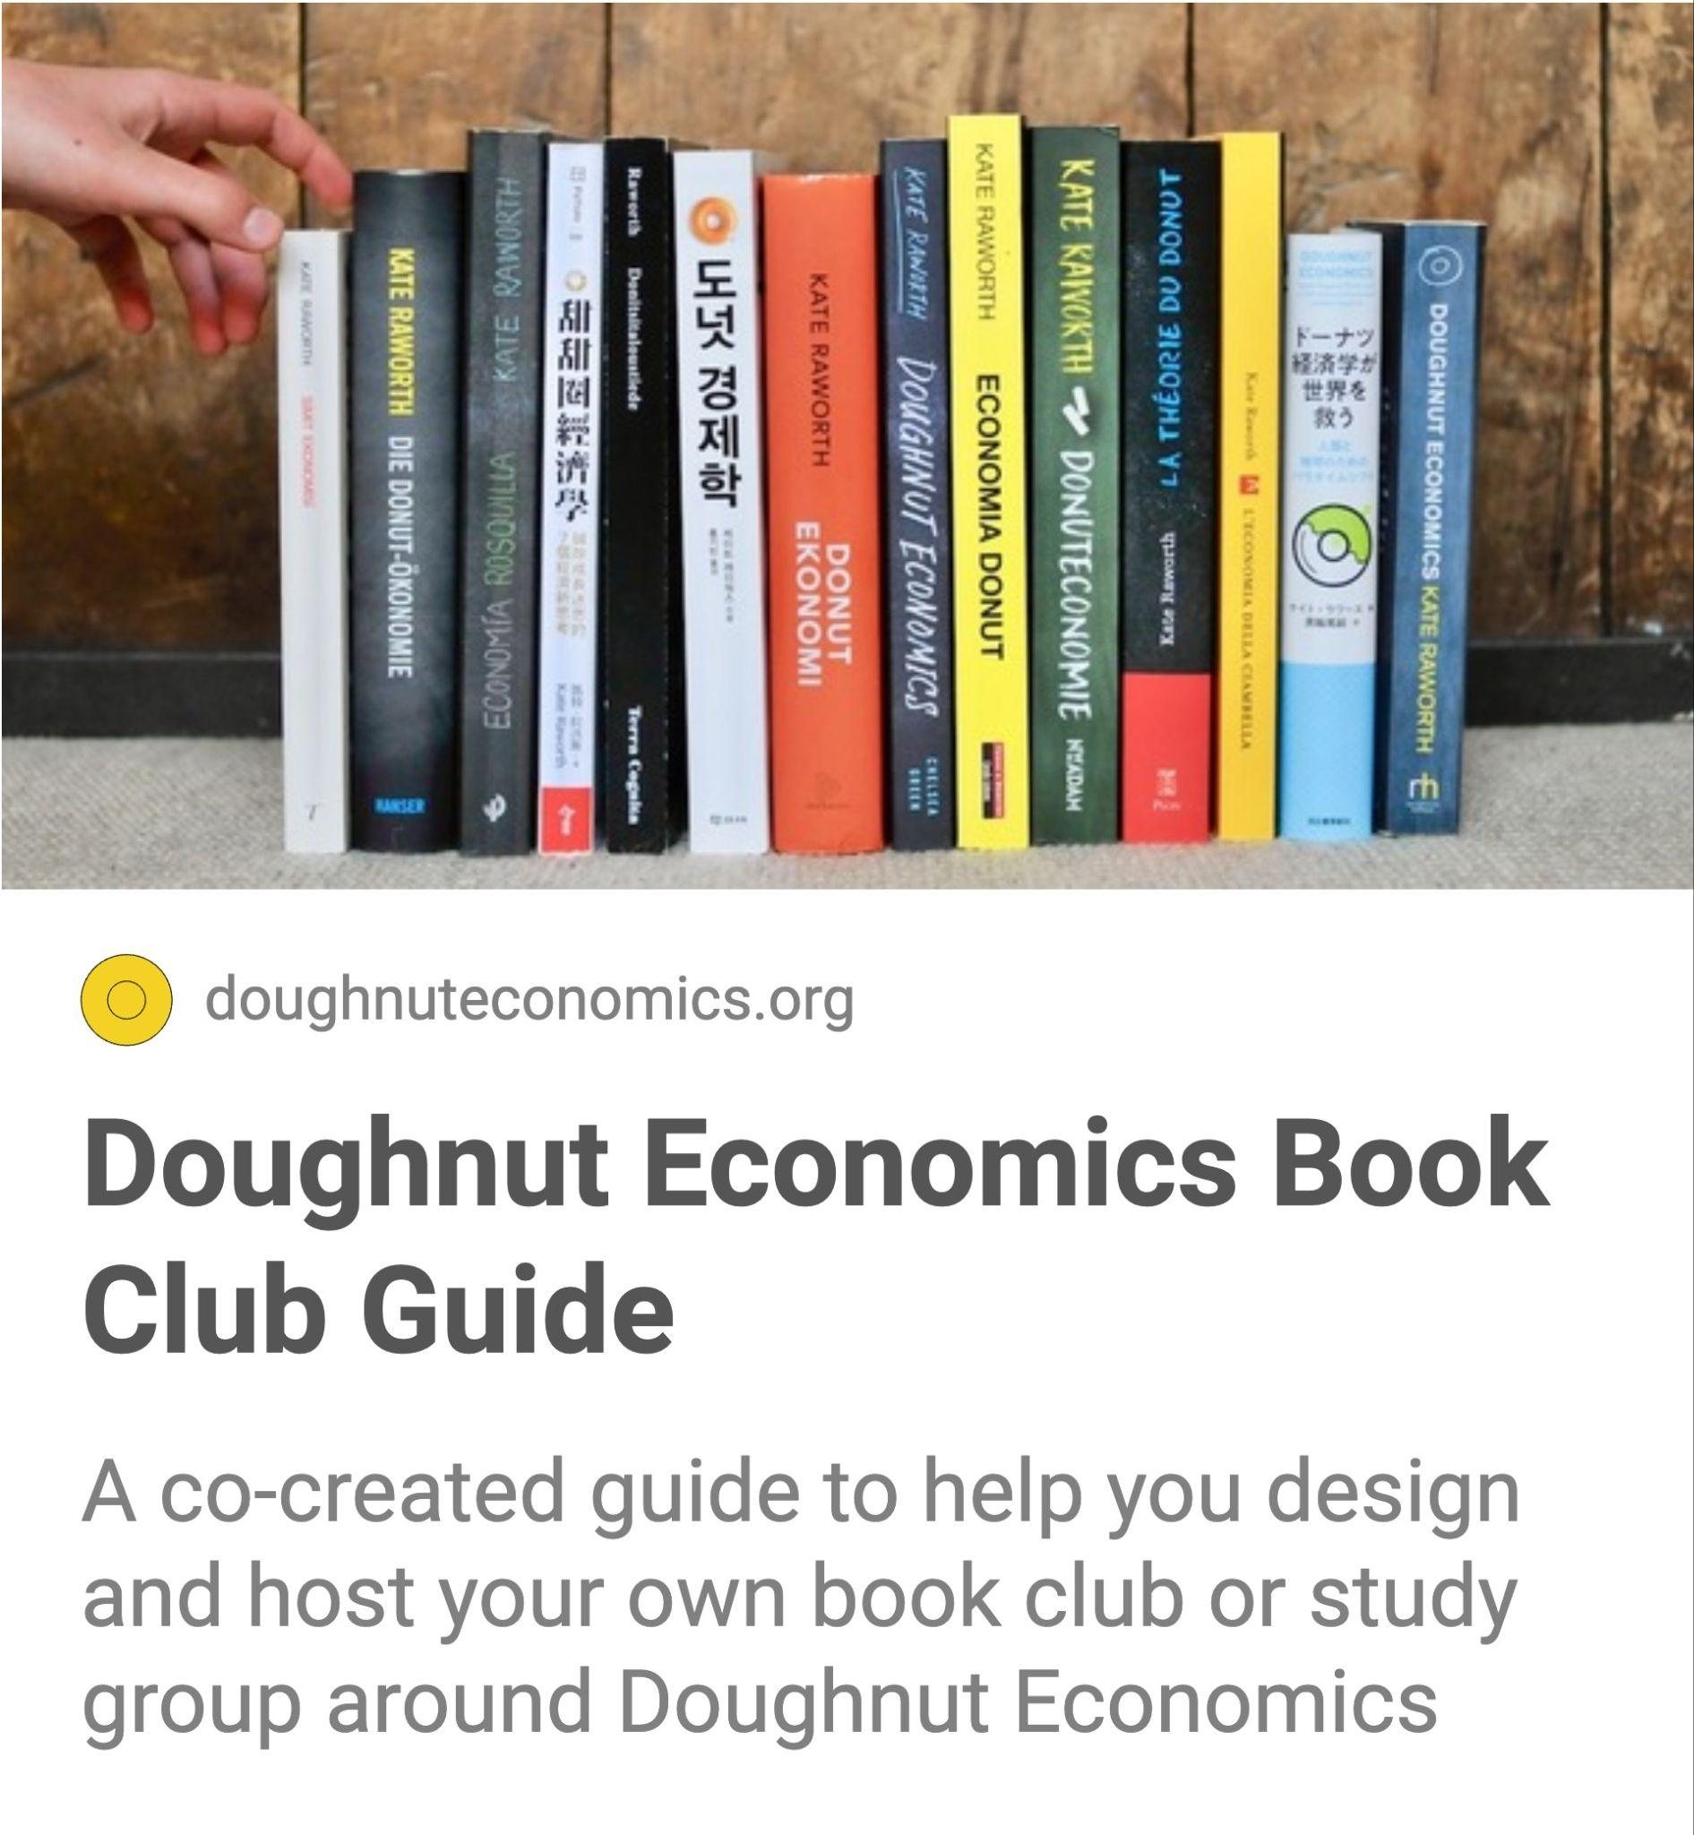
several months
Start or join a book club with others to explore the chapters of the book and what they might mean for you, your family, your work and your community.
‹#›
Notes:
Commentary

Slide 34
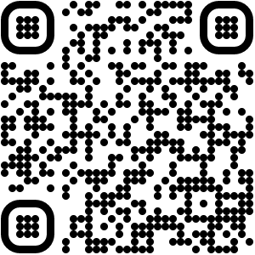
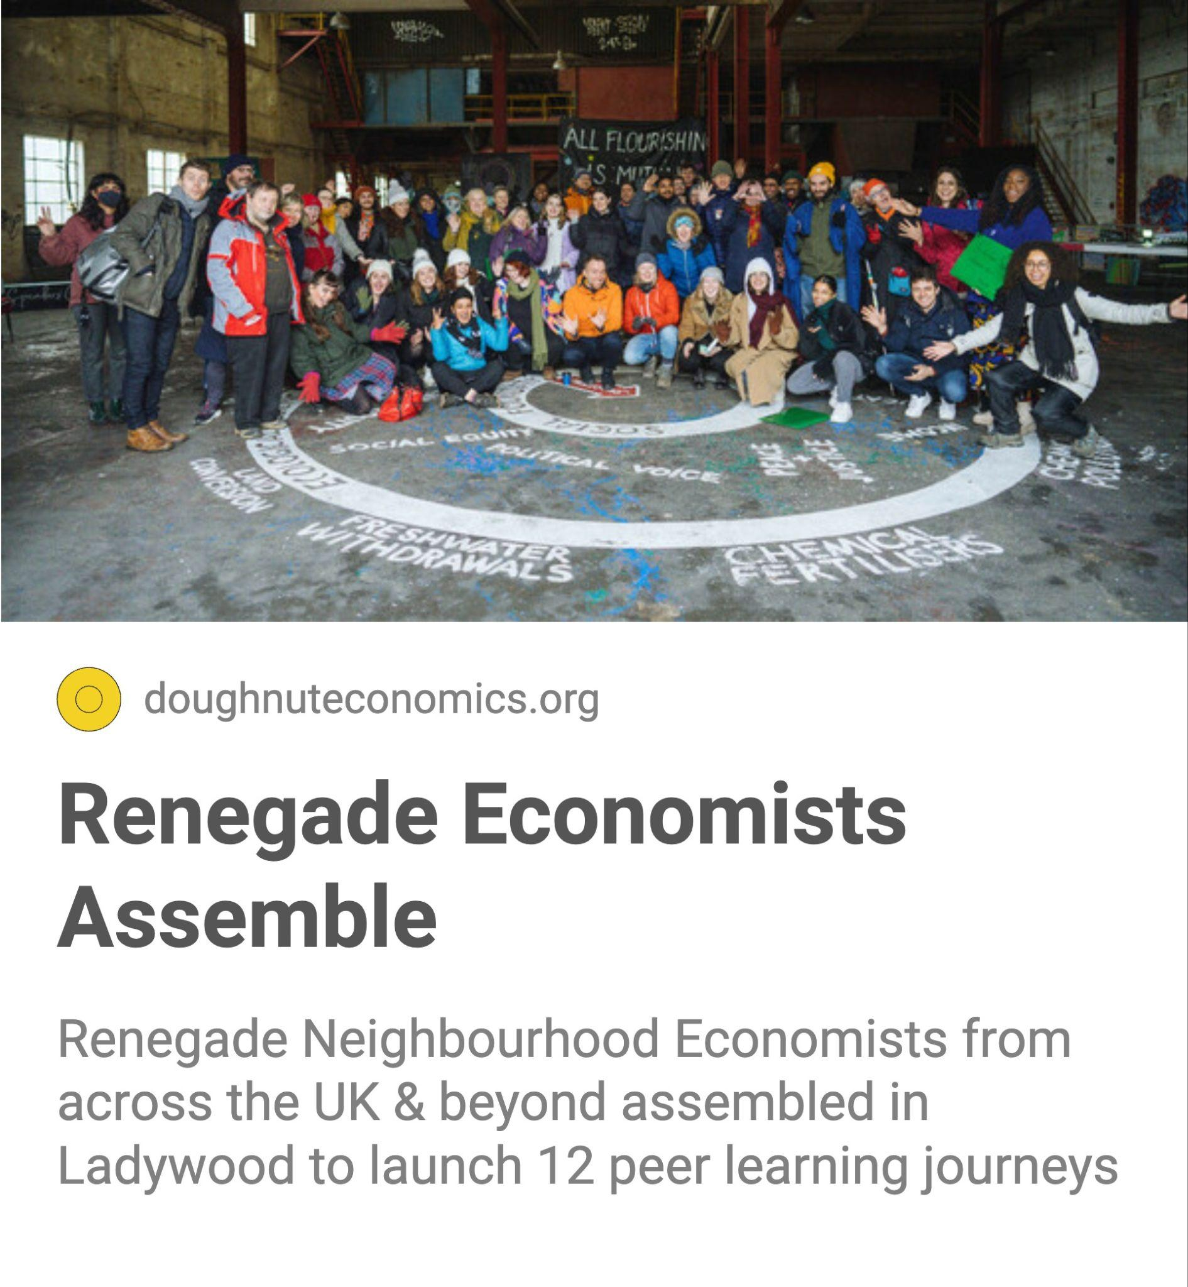
15 minutes
Read how CIVIC SQUARE and Huddlecraft supported people to learn about the ideas of Doughnut Economics as peer groups - mutually supporting each other to apply the ideas in their lives and communities.
‹#›
Notes:
Commentary

Slide 35
several hours
Use this Miro world, created by Mona Ebdrup and Magda Petford, to support your learning journey through the book Doughnut Economics, with others.
‹#›
Notes:
Commentary

Slide 36
3 How can I introduce the ideas of Doughnut Economics to my community?

Slide 37
Here you’ll find some activities and workshops you can run, and stories of how other people, groups and organisations have introduced the ideas in their community.

Slide 38
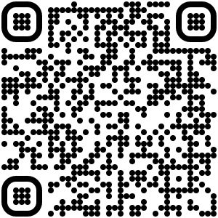
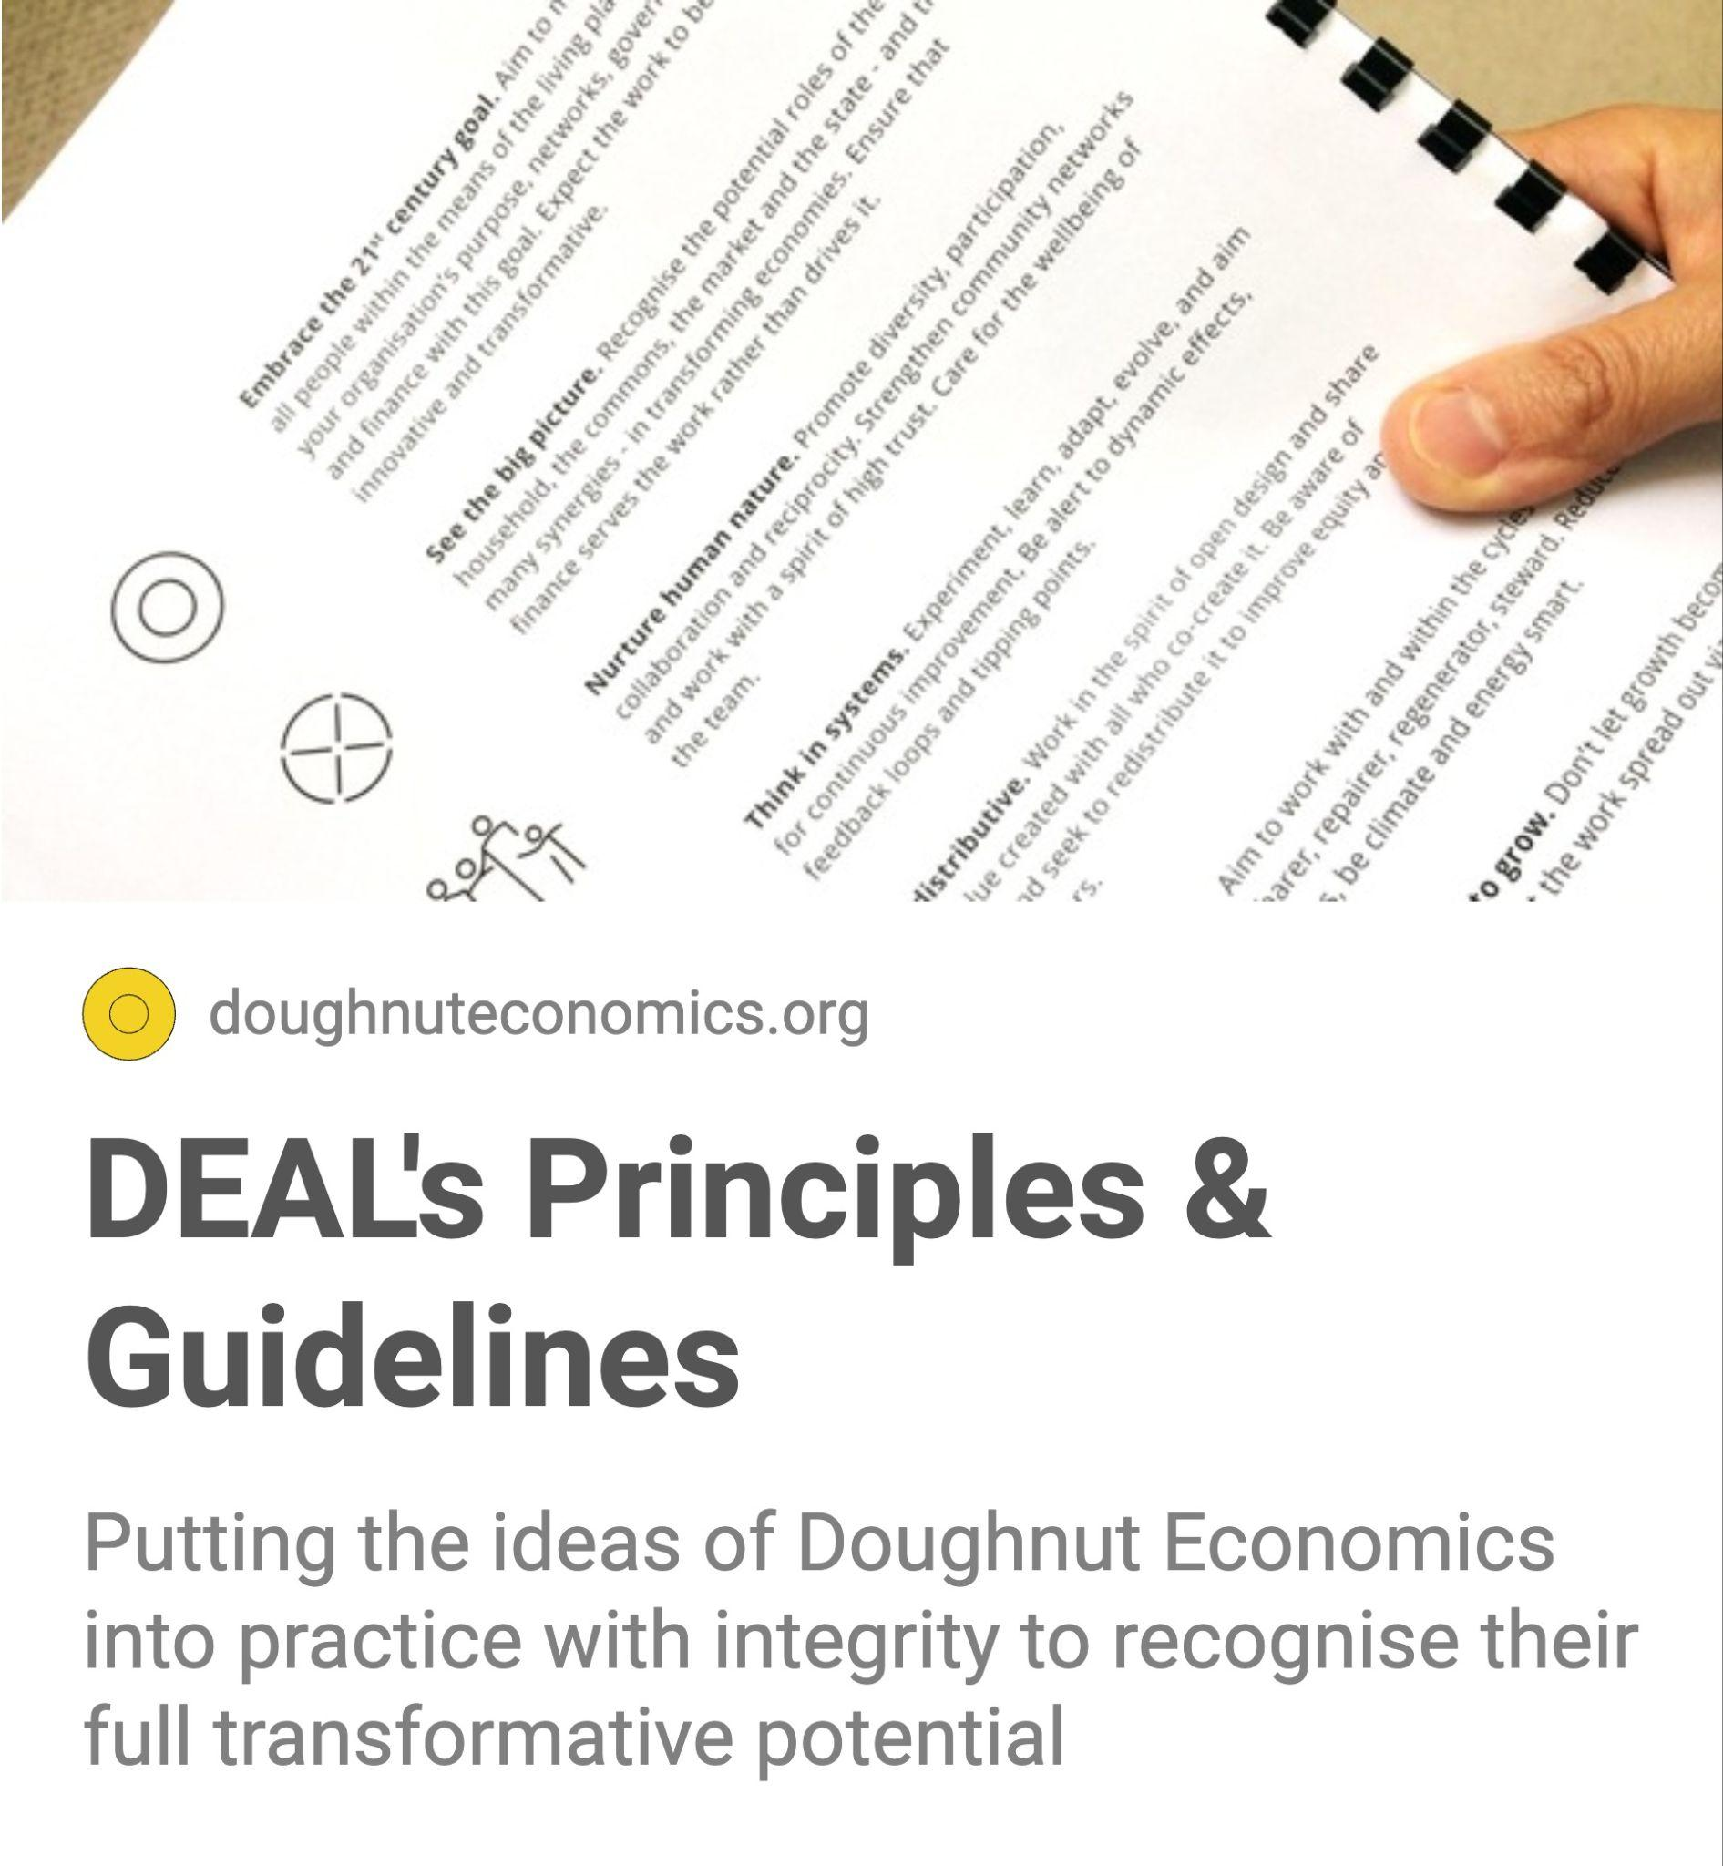
15 minutes
Firstly, please read the principles and guidelines of putting Doughnut Economics into practice, so you can become stewards (like the DEAL Team) to safeguard the integrity of the ideas, to retain their transformative potential.
‹#›
Notes:
Commentary

Slide 39
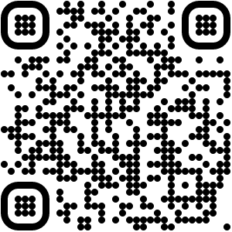
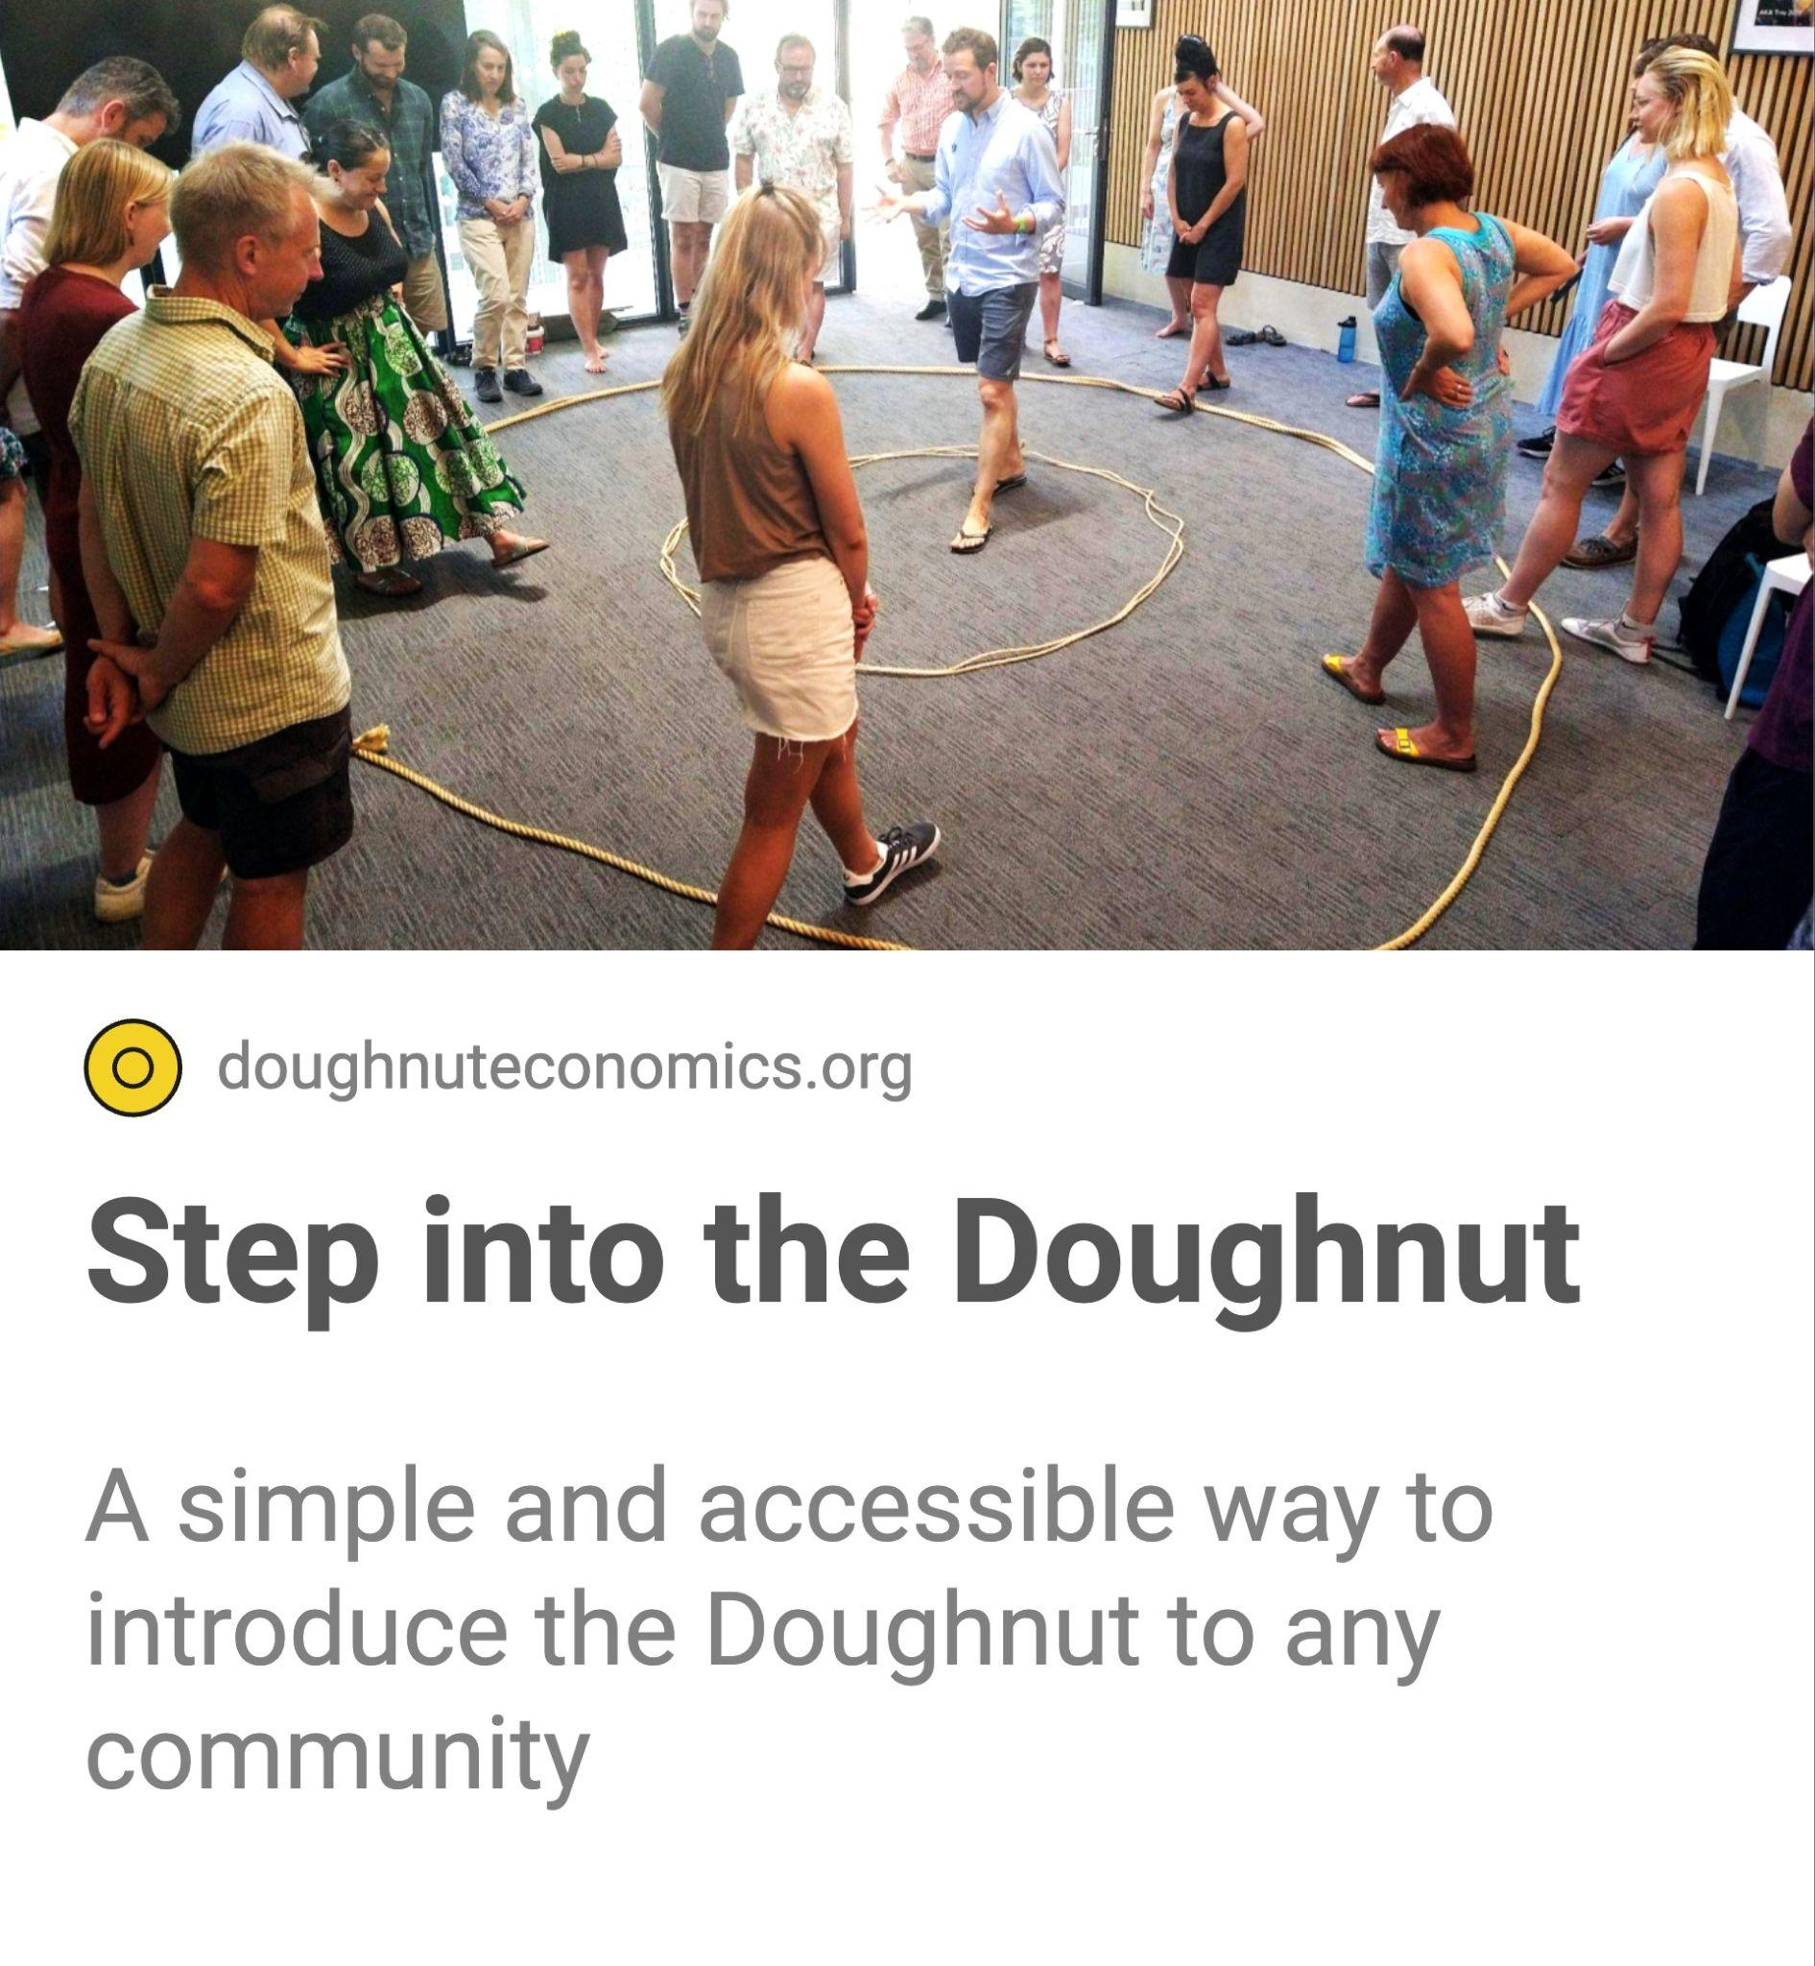
45 minutes
Introduce the Doughnut with the interactive workshop Step into the Doughnut. When we explore the ideas through movement and personal stories, our capacity to engage in their implications increases enormously.
‹#›
Notes:
Commentary

Slide 40
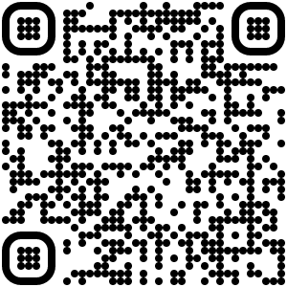
30 minutes
Explore the diversity of perspectives within your community with this workshop that asks ‘Can humanity can get into the Doughnut by 2050?’ and invites us to try other perspectives on for size.
‹#›
Notes:
Commentary

Slide 41
30 minutes
Explore the connections between the dimensions of the Doughnut with this fun and energising activity. Connecting with one person after another, rapidly accelerates both individual and collective understanding.
‹#›
Notes:
Commentary

Slide 42
30 minutes
Invite the imagination of your community - of people of all ages - with this activity that invites people to dream what they want a world in the Doughnut to look and feel like. Connect the dreams together to create a Dream Spiral!
‹#›
Notes:
Commentary

Slide 43
30 minutes
Play the fun and fast game Ring Rescue, to get people working together round a common goal - to rescue someone from the hole in the middle of the Doughnut!
‹#›
Notes:
Commentary

Slide 44
Read the story of how people in Amsterdam Nieuw-West created the Donut Bakery to connect changemakers and host a neighbourhood festival to introduce the ideas to residents and build momentum for change.
‹#›
Notes:
Commentary

Slide 45
Read the story of how people in Berlin organised a street festival to engage passers-by with the ideas, and how this fits within the work of an open group of changemakers called Donut Berlin.
‹#›
Notes:
Commentary

Slide 46
Read how the Zero Carbon Guildford - a UK Climate Emergency Hub - are introducing the ideas to school children and residents of diverse perspective in their place.
‹#›
Notes:
Commentary

Slide 47
Read how the Irish Doughnut Economics Network introduced the ideas through a Movement Lab, at a climate festival at the Irish Museum of Modern Art.
‹#›
Notes:
Commentary

Slide 48
4 How can we apply the ideas of Doughnut Economics to our place?

Slide 49
In this chapter, we’ll introduce ‘Doughnut Unrolled’ and the framework of the four lenses, with some tools you can use and some stories for inspiration about how to apply this to your community.

Slide 50
30 minutes
Read the Doughnut Unrolled method for applying the Doughnut to your community, which introduces the four lenses as a holistic thinking compass to explore local, global, social and ecological perspectives.
‹#›
Notes:
Commentary

Slide 51
30 minutes
Read about the all the dimensions of the four lenses in this tool. You can also turn this into an interactive activity with the tool Sparking Connections.
‹#›
Notes:
Commentary

Slide 52
several months
Create a Community Portrait of Place with anything from an introductory workshop to a deep ongoing process. This tool offers an introductory guide and you can read examples of this in practice on the following pages.
‹#›
Notes:
Commentary

Slide 53
30 minutes
Read how CIVIC SQUARE created a Neighborhood Doughnut Portrait in Ladywood in Birmingham, UK. Along the way they developed lots of tools you can use, that you can see on the following pages.
‹#›
Notes:
Commentary

Slide 54
2 hours
Explore your local neighborhood through all your senses with this ‘walkshop’ and canvas developed by CIVIC SQUARE. See how many different groups you can go on a walkshop with!
‹#›
Notes:
Commentary

Slide 55
2 hours
Uncover the stories of change and Doughnut activity already underway in your place - and the people behind them - with CIVIC SQUARE’s Doughnut Story Canvas.
‹#›
Notes:
Commentary

Slide 56
several months
Build a Data Portrait of Place by gathering local data, targets, indicators and policies and mapping them to the four lenses. Time to connect the data-enthusiasts in your community!
‹#›
Notes:
Commentary

Slide 57
Read how Leeds Doughnut Coalition created the Leeds Doughnut, which inspired CIVIC SQUARE’s approach to their data work as part of their Neighborhood Doughnut Portrait.
‹#›
Notes:
Commentary

Slide 58
Read how Shibaura House community created a Data Portrait of their ward in Minato City, Tokyo, and how they shared this with their community as an exhibition.
‹#›
Notes:
Commentary

Slide 59
Read London Doughnut Economy Coalition’s City Portrait and Call to Action for all Londoners and London institutions to engage in a positive discussion about the future of the city.
‹#›
Notes:
Commentary

Slide 60
90 minutes
Explore a specific topic with the four lenses in a holistic and interconnected way, whether a community project, initiative, object, organisation, possibility or idea.
‹#›
Notes:
Commentary

Slide 61
Read how Swannanoa Watershed Action Network (SWAN) explored their local bioregion using the four lenses and some of the tensions that emerge when thinking about how to do this with others.
‹#›
Notes:
Commentary

Slide 62
Read how Gavargh People’s Forest using Participatory Budgeting to foster new relationships with each other, the community and the commons of the local forest and its ‘oxygen catchment area’.
‹#›
Notes:
Commentary

Slide 63
Read how the Balochistan Youth Action Committee (BYAC) was able to redefine their goals and path using Doughnut Economics, to delve to the interconnected root causes of poverty.
‹#›
Notes:
Commentary

Slide 64
30 minutes
Read about how people from the DEAL Community across global South contexts explored the four lenses in this co-creative process. There were lots of insights that emerged that are valuable to everyone!
‹#›
Notes:
Commentary

Slide 65
5 How can I apply the ideas of Doughnut Economics to my life?

Slide 66
In this chapter you’ll find two Personal Doughnut tools that have been made by members of the DEAL Community and a third tool called ‘Take the Jump’ that invites you to take actions that reduce negative impact on the planet.

Slide 67
30 minutes
Explore the foundations of what you need to thrive with the Personal Doughnut Canvas created by CIVIC SQUARE.
‹#›
Notes:
Commentary

Slide 68
60 minutes
Explore what your own Personal Doughnut might look like with this Personal Doughnut Template created by DEAL Community member Zoe Gilbertson.
‹#›
Notes:
Commentary

Slide 69
several months
Join the community of people taking actions towards a life in the Doughnut with this sociable way of exploring the many ways to ‘Take the jump’. Created by the organisation The Jump.
‹#›
Notes:
Commentary

Slide 70
6 How can I connect with others as a network for change?

Slide 71
In this chapter there are lots of stories of how people, groups and organisations are connecting as networks for deeper systemic change in their place. You can find out how to start your own group or network, and join learning calls.

Slide 72
15 minutes
Learn about place-based groups and networks that are connecting the people in their place around Doughnut Economics for deeper systemic change. Discover their practice and the guidelines to safeguard integrity.
‹#›
Notes:
Commentary

Slide 73
Read how changemakers are connecting and taking action across Brasil as the network Donut Brasil.
‹#›
Notes:
Commentary

Slide 74
Read how the changemakers of Boro Doughnut in Middlesbrough, UK, launched their network to raise awareness and invite people to join.
‹#›
Notes:
Commentary

Slide 75
Read how Regen Sydney is building a coalition for change and exploring what else might be needed to shift the city's course towards a future that's inspiring for us all.
‹#›
Notes:
Commentary

Slide 76
Read how the conveners of the Israel Doughnut Economics Community are responding to increasing interest in Doughnut Economics across Israel, particularly in education.
‹#›
Notes:
Commentary

Slide 77
Read how the Amsterdam Donut Coalition built on the the success of the Donut Days in 2021 to hold a distributed festival across the city to make Donut Deals for collaborative action!
‹#›
Notes:
Commentary

Slide 78
Read about the inspiring journey of Regen Melbourne from a small informal community of people and organisations to a convener and catalyst for systemic change across the city of Melbourne.
‹#›
Notes:
Commentary

Slide 79
Read how Doughnut Economics provides a framework to help the Tricolor Coalition focus on what the main sustainability challenges are in Mexico City, including water and energy.
‹#›
Notes:
Commentary

Slide 80
Read how the California Doughnut Economics Coalition are exploring ways to apply Doughnut Economics ideas and tools at the state scale.
‹#›
Notes:
Commentary

Slide 81
Read how the core team behind Smultring Tønsberg are connecting people across Norway to the ideas of Doughnut Economics with a national festival, appreciative inquiry, and dialogue.
‹#›
Notes:
Commentary

Slide 82
7 How can we take action for deeper systemic change?

Slide 83
Why is it that many community projects struggle for survival? In 2023 we will be developing a tool to help communities act on these issues to unlock the deeper systemic changes needed to create the future we want. Here is a preview…

Slide 84
We have power to shape which direction we take
What’s holding our community back?
What could unlock transformative change?

Slide 85
These five design layers help reveal that power
What’s holding our community back?
Purpose
What could unlock transformative change?
Networks
Governance
Ownership
Finance

Slide 86
Some starting questions to help reveal our powers to act
Purpose
What is a community group, initiative, project or organisation’s purpose? Why does it exist? What about the other organisations that provision for your communities’ needs?
How are these groups, initiatives and organisations networked? What relationships does the organisation hold, and how does it bring to live its purpose and values through them?
Networks
How are these entities governed? Who has voice in decision making? What are the metrics of success? What are the hard rules, and unwritten culture, of how things are done?
Governance
How are they owned? What are the essential assets that provision for your communities’ needs? Who owns, controls or has access to them? What laws uphold these?
Ownership
How are these entities financed? What is that finance expecting and demanding? What is extracted and to where? What is reinvested into the community?
Finance

Slide 87
Read how the Powers to Act tool applies these five design layers to city institutional design to unlock transformational change.
In 2023 we will be developing a version of this tool for community application.
‹#›
Notes:
Commentary

Slide 88
8 What is the DEAL Community and how can I connect with others globally?

Slide 89
The DEAL Community is the pioneering changemakers worldwide – in communities, education, cities and places, business and government and more – who are turning the ideas of Doughnut Economics into action.

Slide 90
15 minutes
Watch Kate Raworth’s Tedx talk from 2021, introducing the DEAL Community and showing how changemakers are bringing Doughnut Economics to life in all sorts of creative and context-specific ways.
‹#›
Notes:
Commentary

Slide 91
Join the DEAL Community by becoming a member (for free!) so you can connect with others and share stories
‹#›
Notes:
Commentary

Slide 92
90 minutes
Attend a Communities: Let’s Get Started meet-up, where you can meet others who are interested in neighbourhood and place-based network organising with Doughnut Economics.
‹#›
Notes:
Commentary

Slide 93
15 minutes
Read DEAL’s Cities & Regions theme homepage and learn about the 9 pathways municipalities and local governments are taking to put Doughnut Economics into practice at the city and regional scale.
‹#›
Notes:
Commentary

Slide 94
15 minutes
Read DEAL’s Business & Enterprise theme homepage and learn about the five design layers of Enterprise Design within Doughnut Design for Business.
‹#›
Notes:
Commentary

Slide 95
15 minutes
Read DEAL’s Schools & Education theme homepage and learn how students and educators are bringing Doughnut Economics into the classroom and other places of learning.
‹#›
Notes:
Commentary

Slide 96
15 minutes
Read DEAL’s Research and Academia theme homepage and learn how students and academics are deepening and furthering the scholarship of Doughnut Economics, both in theory and in practice.
‹#›
Notes:
Commentary

Slide 97
15 minutes
Read DEAL’s Government & Policy theme homepage and learn how DEAL is engaging with national governments and international institutions to reframing economic narratives and influence strategic policy.
‹#›
Notes:
Commentary

Slide 98
3 How can I ask other questions, find out more, or contribute a story?

Slide 99
We hope you’ve enjoyed reading through Communities: Let’s Get Started.
In this final part, you can find out how to share your own story, or contact the DEAL team, or see even more stories on the DEAL platform!

Slide 100
Write your own story of action, and contact us if you would like your story featured in Communities: Let’s Get Started (see next page for how to contact DEAL)
‹#›
Notes:
Commentary

Slide 101
Contact us with any questions or feedback you may have; any requests to add your story; or offers to make translations in your own language.
‹#›
Notes:
Commentary

Slide 102
You can also discover even more stories on the Communities page of the DEAL Community Platform.
‹#›
Notes:
Commentary

Slide 103
Thanks for reading…
Communities:
Let’s Get Started!
Version 1.0 (May 2023)

Slide 104
Acknowledgements
This tool was created by
Rob Shorter, Communities & Art Lead at Doughnut Economics Action Lab.
The tool is made with
Design contributions from Ruurd Priester; Doughnut Economics conceptual contributions from Kate Raworth; communications and technical support from Aimee Laurel and Karn Bianco.
Tool contributions from Mona Ebdrup, Magda Petford, CIVIC SQUARE, Huddlecraft, Jacob Rask, Kavita Purohit, Nettes Derbyshire, Charlotte Bailey, Zoe Gilbertson, The Jump and Leonora Grcheva.
Story contributions from Rieta Aliredjo, Nicole Hartmann, Ben McCallan, Olivia Carpenter-Lomax, Steph Bleach, Roisin Markham, Louise Byng, Tim Frenneaux, Miho Shimizu, Chris Paddock, Robertson Work, Karin Eyben, Sikander Bizenjo, Andrew Fanning, Rosana Rezende, Emi Imai, Alice Howard-Vyse, Kiran Kashyap, Pete Dowson, Zohar Ianovici, Rosa Tibosch, Nicole Barling-Luke, Eva Valencia Lenero, Franziska Raedeker, Dave Kearney-Brown, Della Duncan, Brian Dowling, Anne Sheridan, Aaron Blanco, Bjørn Hauger, Ellen Sjong and Kate Raworth.
‹#›

Slide 105
Doughnut Economics Action Lab (or DEAL) is a non-profit Community Interest Company registered in the UK, doughnuteconomics.org
All content is licensed under the a CC-BY-SA 4.0 license 2022.
You are allowed to pass this tool on to others for free, and we welcome alterations (so that they are relevant to your context and audience, including translating some or all of the slides to another language). Any altered versions must be shared under the same licence.
All licensing information, including attributions, can be found doughnuteconomics.org/license.
‹#›

