Slide 1
About the slides
Four interconnected questions of the Doughnut Economics City Portrait - ‘downscaling the doughnut’
Use as a starting point for conversations and engagement in your community, to get people thinking and talking!
How to adapt for your own place
If you are working in Google Slides, make a copy (File > Make a copy > Entire Presentation)
Replace “Cambridge” with the name of your chosen place or community
Choose photos for the four lenses that best represents your place or community
Ensure you have rights to use the photos; record and display attributions in the credits.
Delete this slide ;)
Note: this resource uses the Poppins font. You can download and install Poppins for use on your desktop application, or use a sans-serif font like Arial or Helvetica.

Slide 2
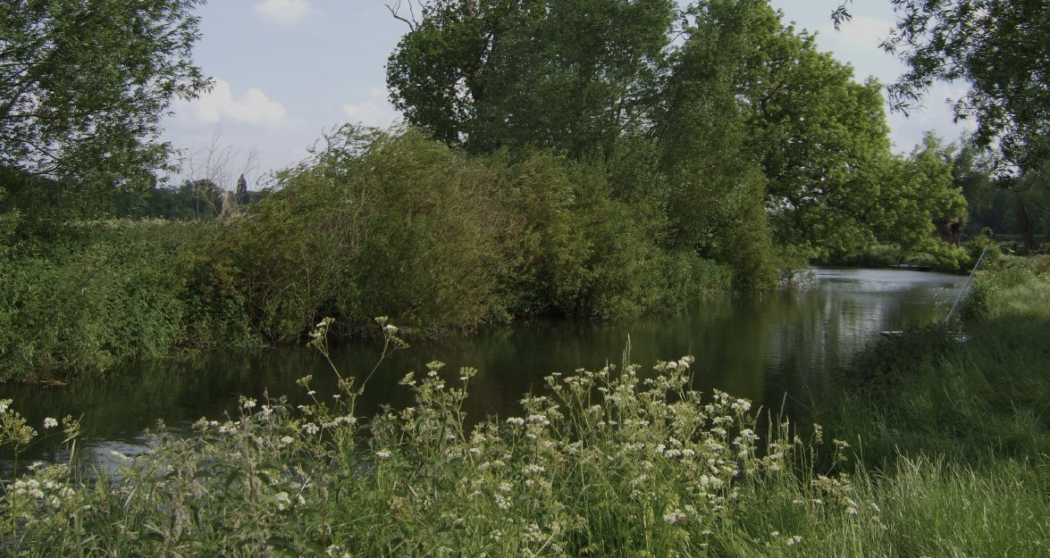
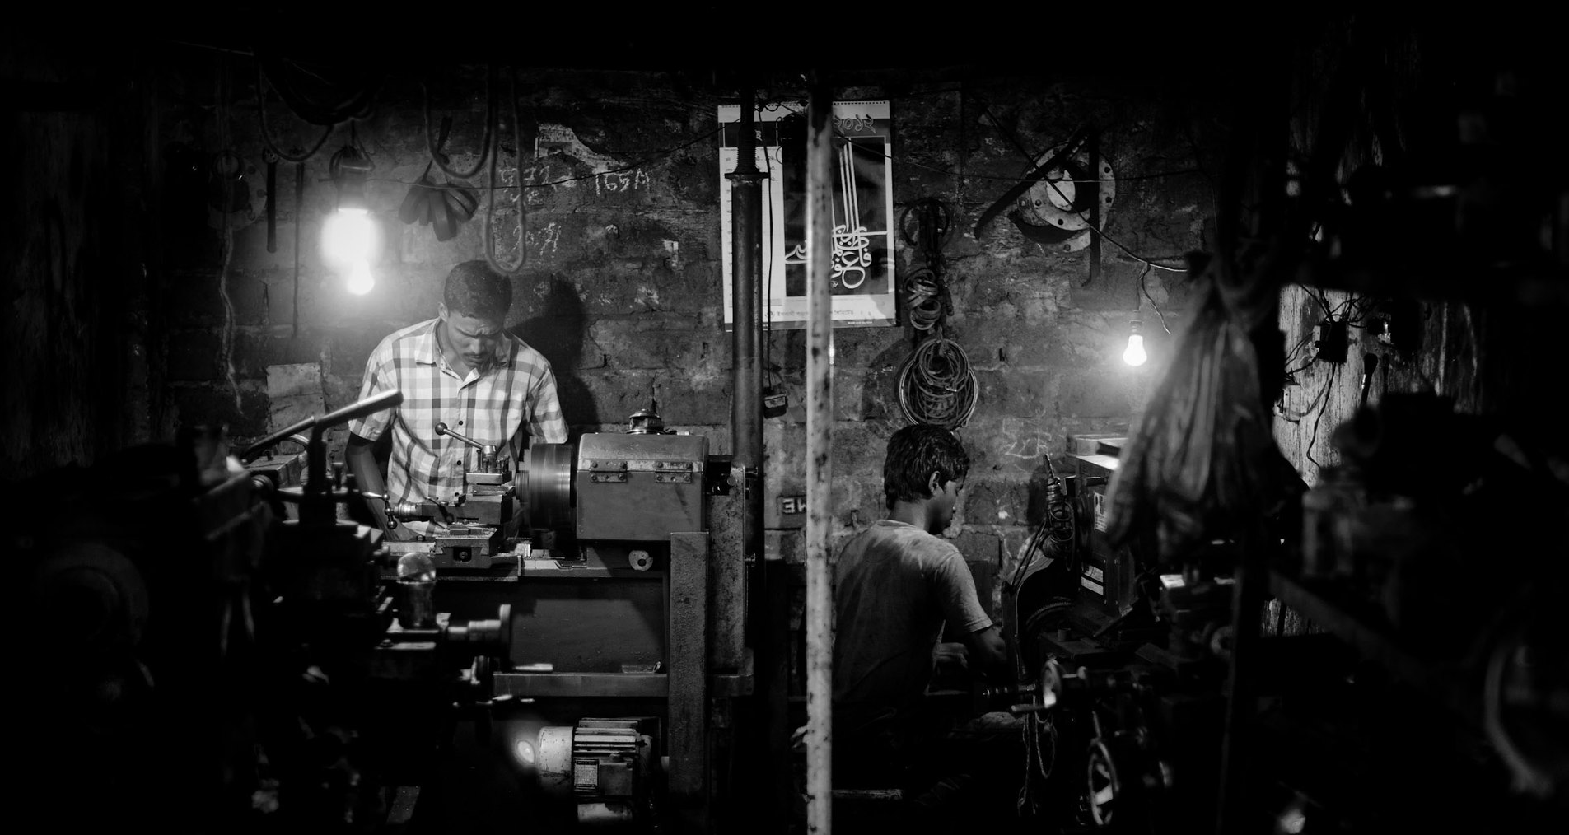
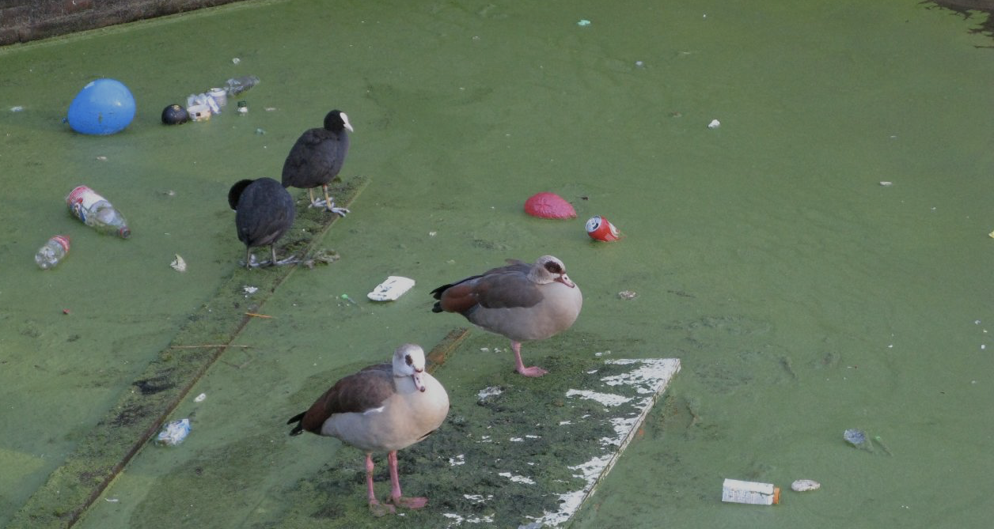
Local-social Lens: What would it mean for the people of Cambridge to thrive?
Local-Ecological Lens: What would it mean for Cambridge to thrive within its natural habitat?
Global-social Lens: What would it mean for Cambridge to respect the wellbeing of people worldwide?
Global-Ecological Lens: What would it mean for Cambridge to respect the health of the whole planet?

Slide 3
Local-social Lens: What would it mean for the people of Cambridge to thrive?

Slide 4
Local-social Lens: What would it mean for the people of Cambridge to thrive?
Local-ecological Lens: What would it mean for Cambridge to thrive within its natural habitat?

Slide 5
Global-Social Lens: What would it mean for Cambridge to respect the wellbeing of people worldwide?

Slide 6
Global-Ecological Lens: What would it mean for Cambridge to respect the health of the whole planet?

Slide 7
Credits
Picture 1: Sidney Street, Cambridge, May 30th 2019, Billy Wilson on Flickr
Picture 2: River Cam at Grantchester Meadows, May 24 2008, William Marnoch on Flickr
Picture 3: Child labor, Sept 9 2012, Zoriah on Flickr and Zoriah.net blog
Picture 4: Pollution in Rotterdam, Jan 12, 2012, Alphast on Flickr
Copyleft 2020. This resource created by Clara Todd of Cambridge Doughnut based on the City Portrait methodology for Downscaling The Doughnut. Shared with the community on Doughnut Economics Action Lab.

